Slide 1
Grant Writing Essentials, etc.
Beth Hodges
Director of Research Development
Division of Research

Slide 2
What makes grant writing different?
Expository Writing- presenting existing research
  “I have conducted this experiment; it is based on the theory of science, and here is what I found…”
  Reports, Articles, Dissertation
  Past tense
Persuasive Writing- pitching research
  “I want to conduct this experiment, it is based on the theory of science, and here is why you should give me money to do it…”
  Grants, Fellowships, Awards
  Future tense
Notes:
The first explains, the second seeks to convince.

Slide 3
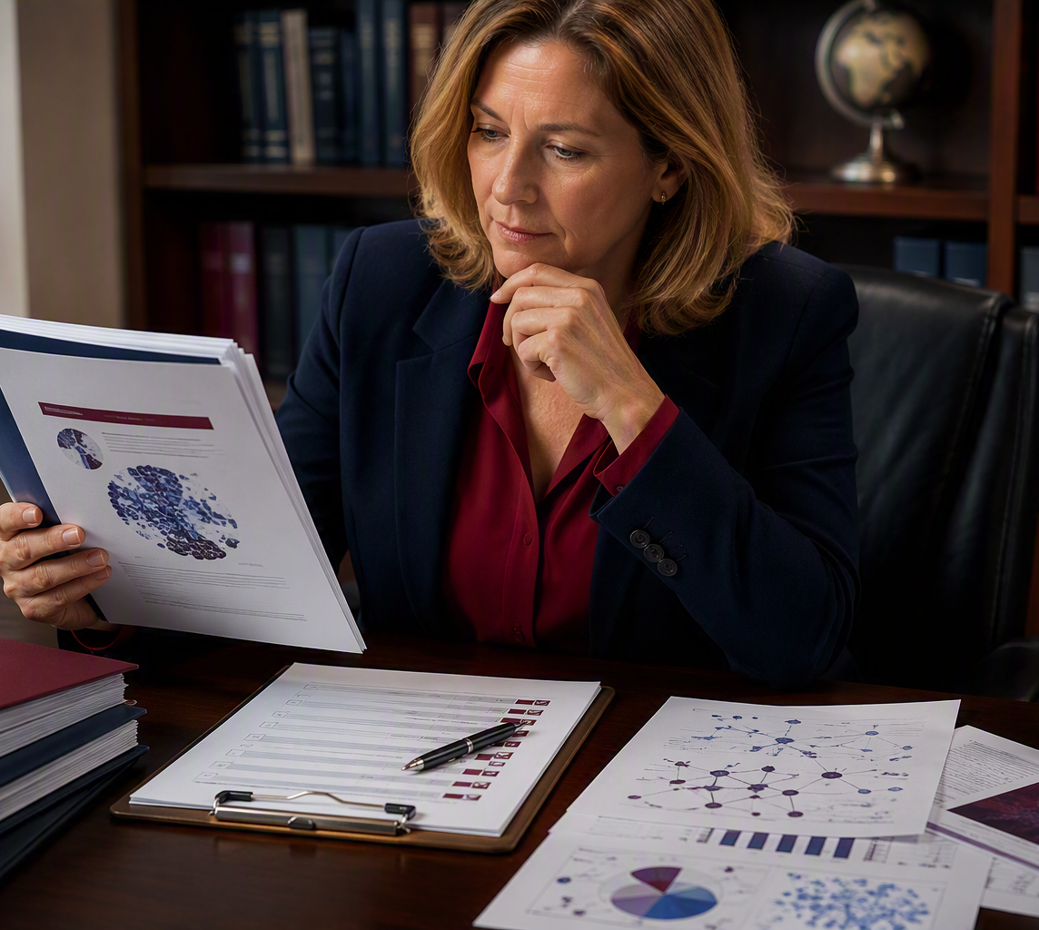
Securing a grant is not just about good writing
The strongest proposals are developed well before the narrative is drafted.
Choose the right opportunity
Align the idea with agency priorities
Build the right team
Plan early enough to improve the proposal
Great proposals are developed, not simply written.
Notes:
[Sources]
- Visual on this slide was generated with Microsoft Copilot.
[/Sources]

Slide 4
Agency and program fit come first
A strong proposal submitted to the wrong program is unlikely to succeed.
1. Read closely
2. Study the portfolio
3. Explain the match
Are you eligible? When is it due? How many awards will be made? Is it a limited submission?
Understand the eligibility priorities, and review criteria.
Look at the funder’s website (About Us, Priorities, History, etc.)
Strategic or Annual Reports
Presentations / speeches by top officials.
Review funded projects to see what the agency is already investing in, and where your work adds value.
Be able to answer: Why would this agency and this specific program invest in this project? You must understand these priorities before you start writing
Fit is not a paragraph. Fit should shape the entire proposal.
Notes:
Write with the intention of providing certain lines that can specifically fulfill certain criteria

Slide 5

Think like a reviewer
Make it easy to see why the project deserves investment.
1
Is it important?
2
Is it innovative?
3
Is the approach sound?
4
Can the team deliver?
5
Is it worth the investment?

Slide 6

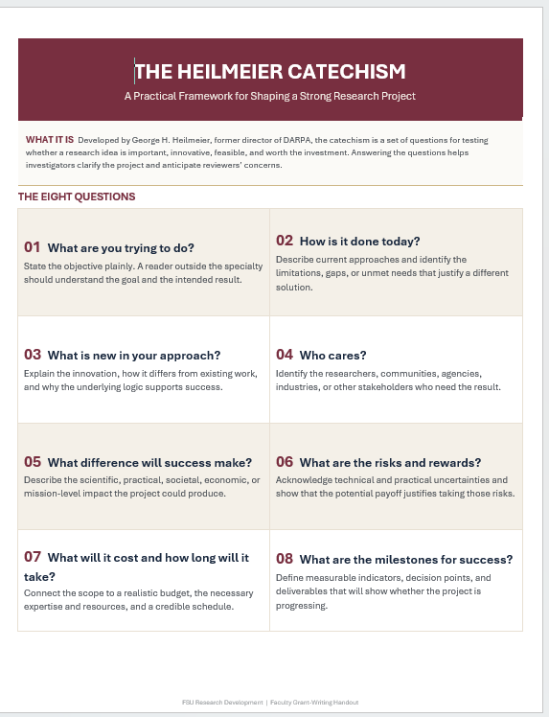
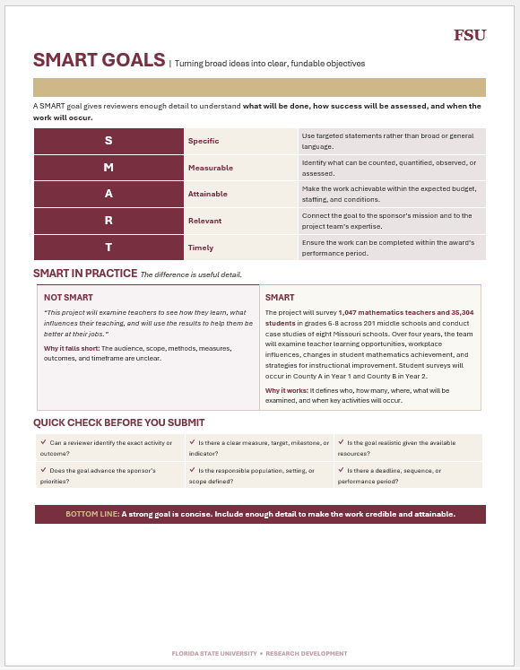
The Heilmeier Catechism &
SMART Goals
Clear goals. Good questions. Stronger proposals.

Slide 7
Things to Do, Things to Avoid

Slide 8



Make the Proposal Easy to Review
Help reviewers find your logic, evidence, and key takeaways quickly.
01
02
03
04
05
Clear headings
White space
Figures & diagrams
Simple topic sentences
Consistent terminology
Signal the purpose of each section.
Make the space for white space.
Show relationships at a glance.
Lead with the main point.
Use the same words for the same ideas.
Design for the reviewer’s reading experience.

Slide 9
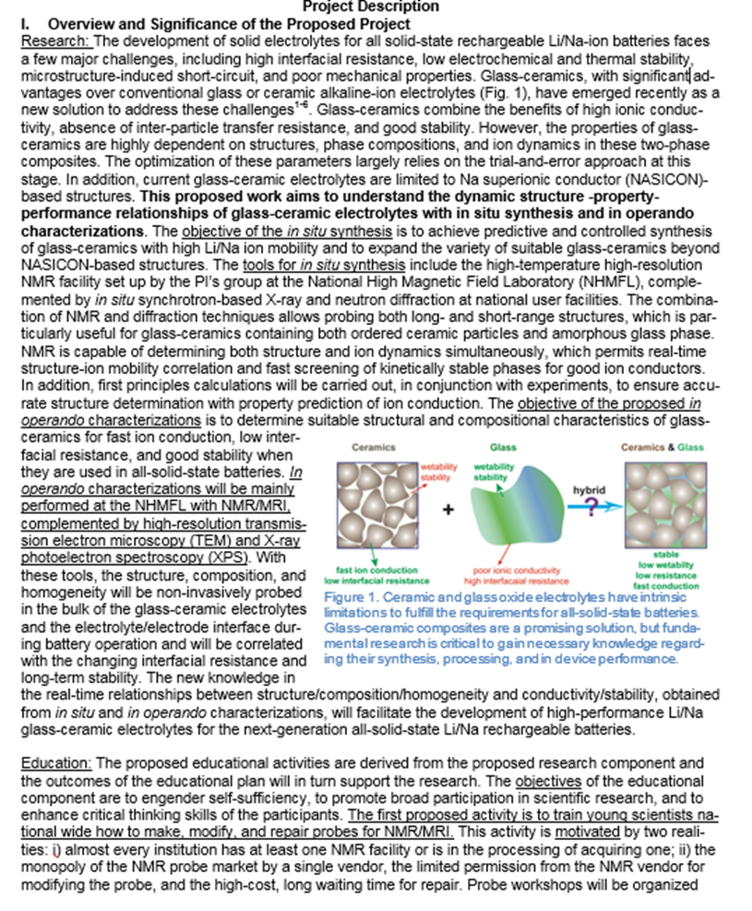
Bold, Italicize, and/or Underline Key Points
But don’t overdo it.

Slide 10
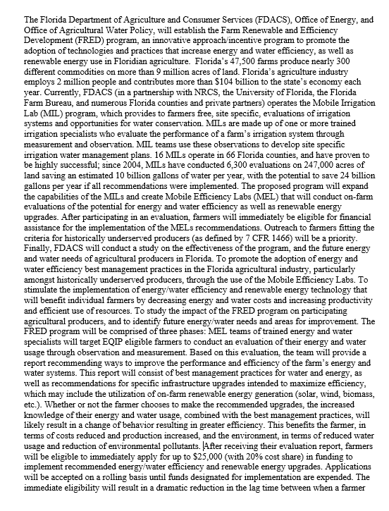
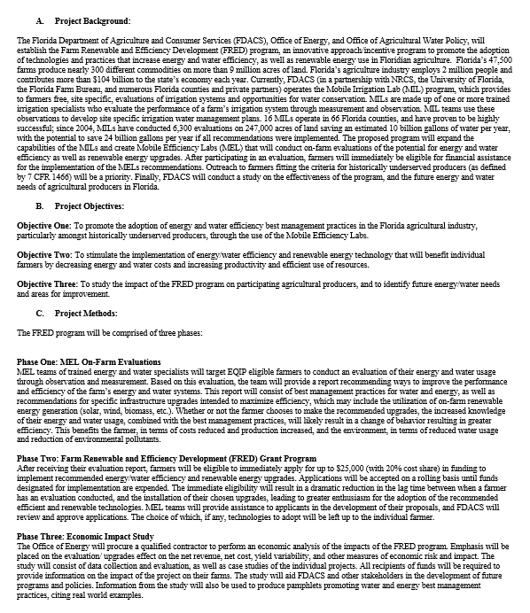
Avoid Walls of Text
BAD
GOOD

Slide 11
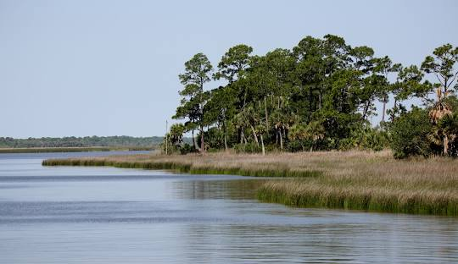
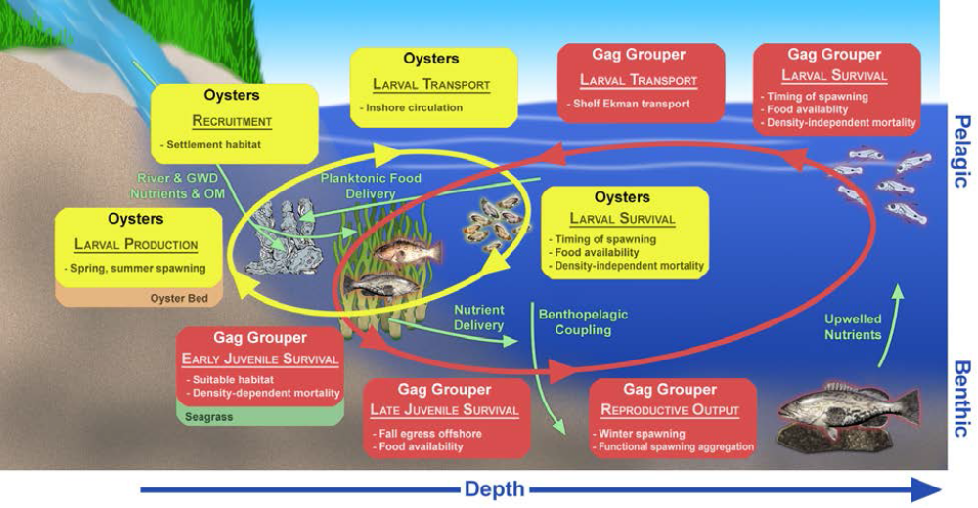
Have Good Graphics
BAD
GOOD
Figure 1. The Apalachicola Bay
Figure 1. Schematic of interactive pathways of abiotic and biotic factors of fish in the Apalachicola Bay

Slide 12
Avoid Run-on Sentences
“Acquaintance with ongoing research projects at FSU related to electric ship technologies, superconducting power systems, and cryogenic systems, as well as the development efforts in collaboration with many Navy contractors provide opportunities for the students in NEEC Program to connect their individual research efforts to powerful future superconducting ship technologies, and prepare them for future engineering careers in these fields which are rapidly expanding due to the needs of a 21st century Navy, which is faced with evolving geopolitical threats.”

Slide 13
Avoid Making the Reviewer Infer Meaning
BAD
“The results of Process A are shown in Table 1.”
“We will work with our partners to complete the project.”
“Based on this prior research, the next step is obvious.”
GOOD
“The results of Process A are shown in Table 1. These results mean…”
“We will work with our partners to complete the project. Specifically, we will conduct Process A, they will conduct Process B, and we will collaborate on Process C.”
“Based on this prior research, the next step is (state the next step)”

Slide 14
Reduce cognitive burden on your reviewers!

Slide 15
Write Specifically to the Review Criteria
“The proposed project has the potential to advance the field of science by….”
“The intellectual merit of the proposed project is based on…”
“The proposed project fulfills the Department of Science’s long-term goal of advancing science by…”
“I believe I have the potential to be an impactful recipient of the NSF GRFP because…”
“This project will benefit the local community through its use of …”
“The broader impacts of this project include…”

Slide 16
Remember that Your Proposal is More than Just Your Program Description
Proposals also require additional documentation beyond the project narrative
Biosketches/CVs, letters of support, equipment and facilities descriptions, data management plans, post-doc mentoring plans, etc.
These will take longer than you think to collect and format
Not completing your proposal as instructed can get you rejected without review

Slide 17
Why good ideas still get rejected
Many weaknesses are preventable during proposal development.
Poor program fit
Unclear significance
The project does not clearly advance program priorities.
The problem and potential impact are difficult to identify.
Overambitious scope
Weak evaluation
The work exceeds the time, budget, or team capacity.
Outcomes, measures, or decision points are vague.
Missing expertise
Reviewer confusion
The team lacks a capability central to the approach.
The narrative makes key information hard to find.
A confused reviewer rarely becomes an advocate.
Notes:
[Sources]
[/Sources]

Slide 18
What about AI?

Slide 19
AI: The Good, the Bad, and the Ugly
AI as a tool within your Research
  Federal agencies are currently very excited in seeing AI incorporated into research efforts. Including how it could boost your effectiveness and efficiency. And, it might be required in some RFPs.

Slide 20
AI: The Good, the Bad, and the Ugly
AI as an aid in your Writing
  Efficiency and time savings
    Drafting boilerplate language, summarizing requirements, helps on tight timelines
  Improved clarity and readability
    Can edit for tone, identify jargon, unclear transitions, can help “read with one voice on multi-team member projects
  Idea structuring and organization
    Helps outline sections aligned to agency review criteria
    Can take your raw note and put them into coherent sentences

Slide 21
AI: The Good, the Bad, and the Ugly
Accuracy and “Hallucinations”
    AI may fabricate citations, programs, or policy details
    Can misstate agency priorities or eligibility rules
    Everything must be fact-checked by YOU!
Generic or “Flat” Proposals
    AI-generated text can sound polished but bland
    You can risk losing your distinctive intellectual voice or boldness that reviewers want to see
    Overuse can lead to formulaic, noncompetitive proposals.

Slide 22
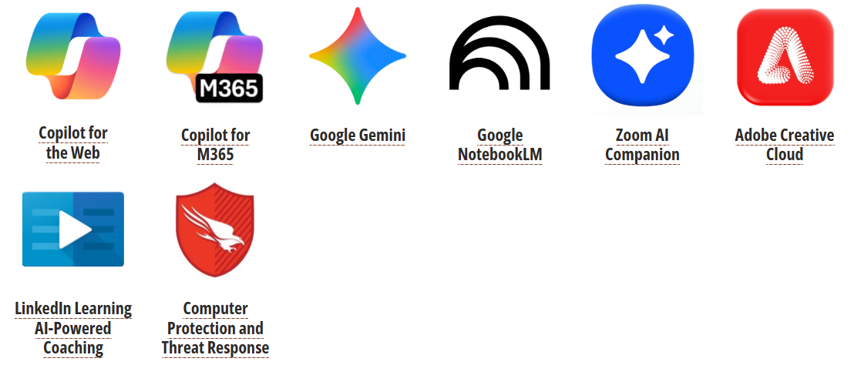
AI: The Good, the Bad, and the Ugly
Compliance and Ethical Concerns
    Some agencies and journals are still clarifying acceptable AI use
    Risk of violating institutional or sponsor policies if AI use is undisclosed or misused
    Confidential or proprietary information should not be entered into public AI tools

Slide 23
AI: The Good, the Bad, and the Ugly
If you follow guidelines it provides without checking them, it could make your proposal uncompetitive or it may not even be accepted.
If you use AI tools that are not protected behind an FSU firewall, your IP may be at risk.
If you have fabricated citations, that is not AI’s fault– it is yours.
Your name/reputation/career can be permanently damaged by submitting false work.

Slide 24
Things you should do this semester
Steps towards success
Develop a Clear Research Agenda
Build your Research Network Intentionally
Define where your scholarship is headed.
Not just inside your department or college. Collaboration is critical to success.
Pursue Early Career Funding Opportunities
Build Research Capacity Early
These can lessen the pool and get you started.
Build systems and workflows that will help you in the future.
Protect Time for Research Each Week
Ask for Help
If you don’t protect time, it won’t be there.
There are many people here to help. Just ask.
Notes:
What are the 2-3 major questions I want to be known for?
What publications do I want to produce in the next 3 years?
Which funding agencies are the best fit?
What preliminary data, partnerships, or creative works are needed?

Slide 25
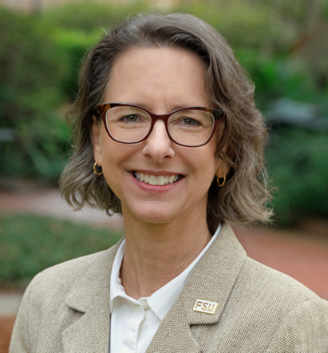
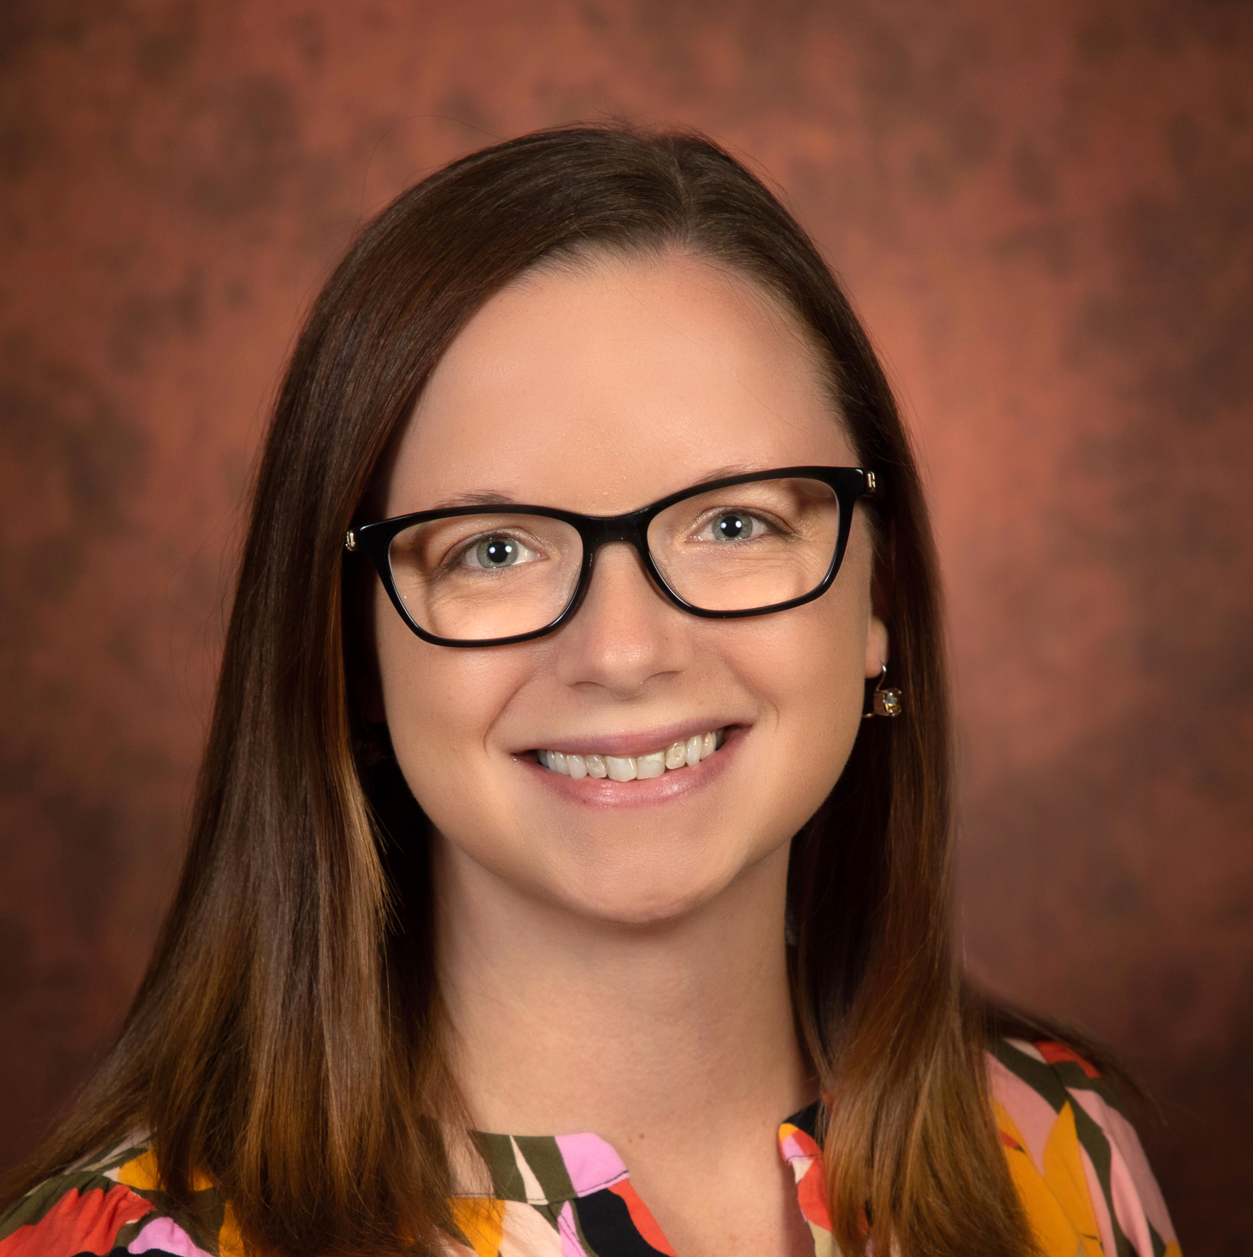
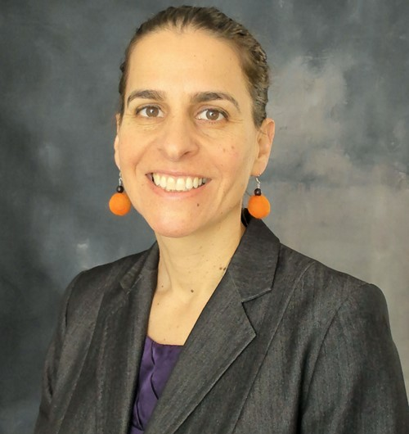
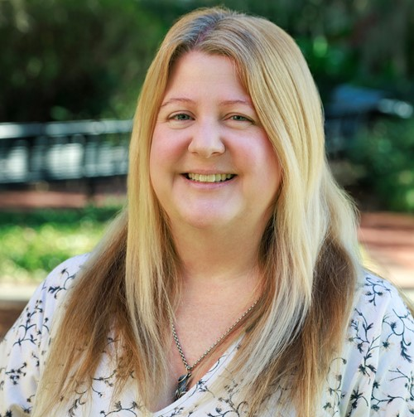
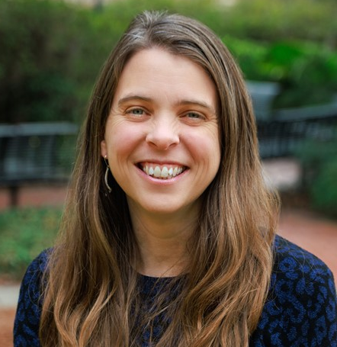
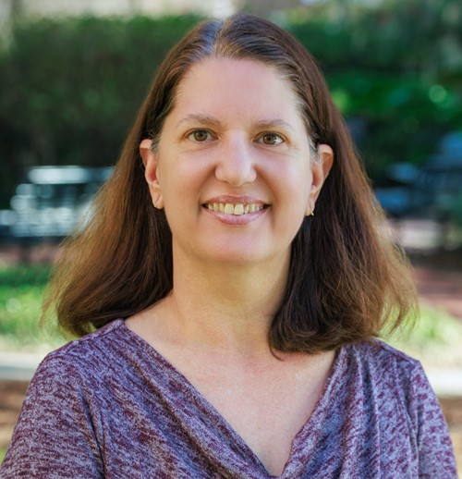
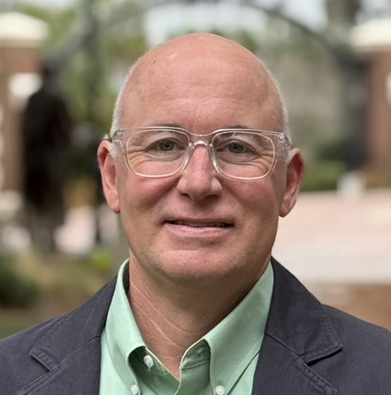
Your RD Team
Beth Hodges
Nicole Viverito
Livia Navon
Sherry Core
Carolyn Bradley
Jared Parmer
Crystal Ladwig
Chris Duclos

Slide 26
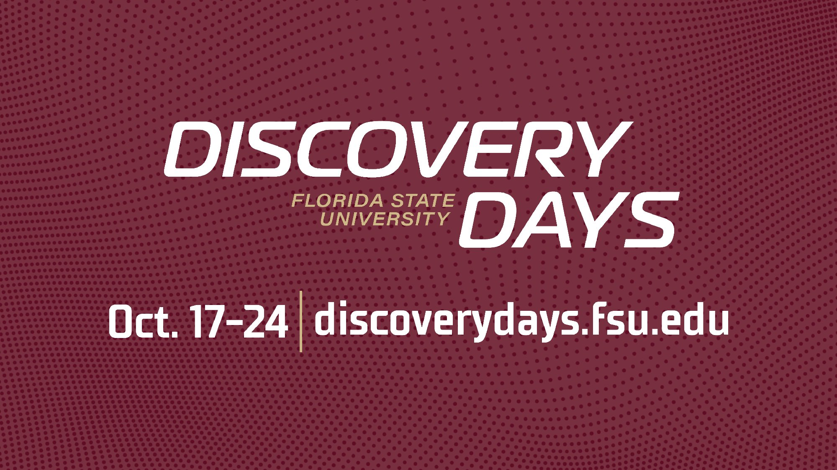

OCTOBER 17-24th
https://www.research.fsu.edu/discovery-days/

Slide 27
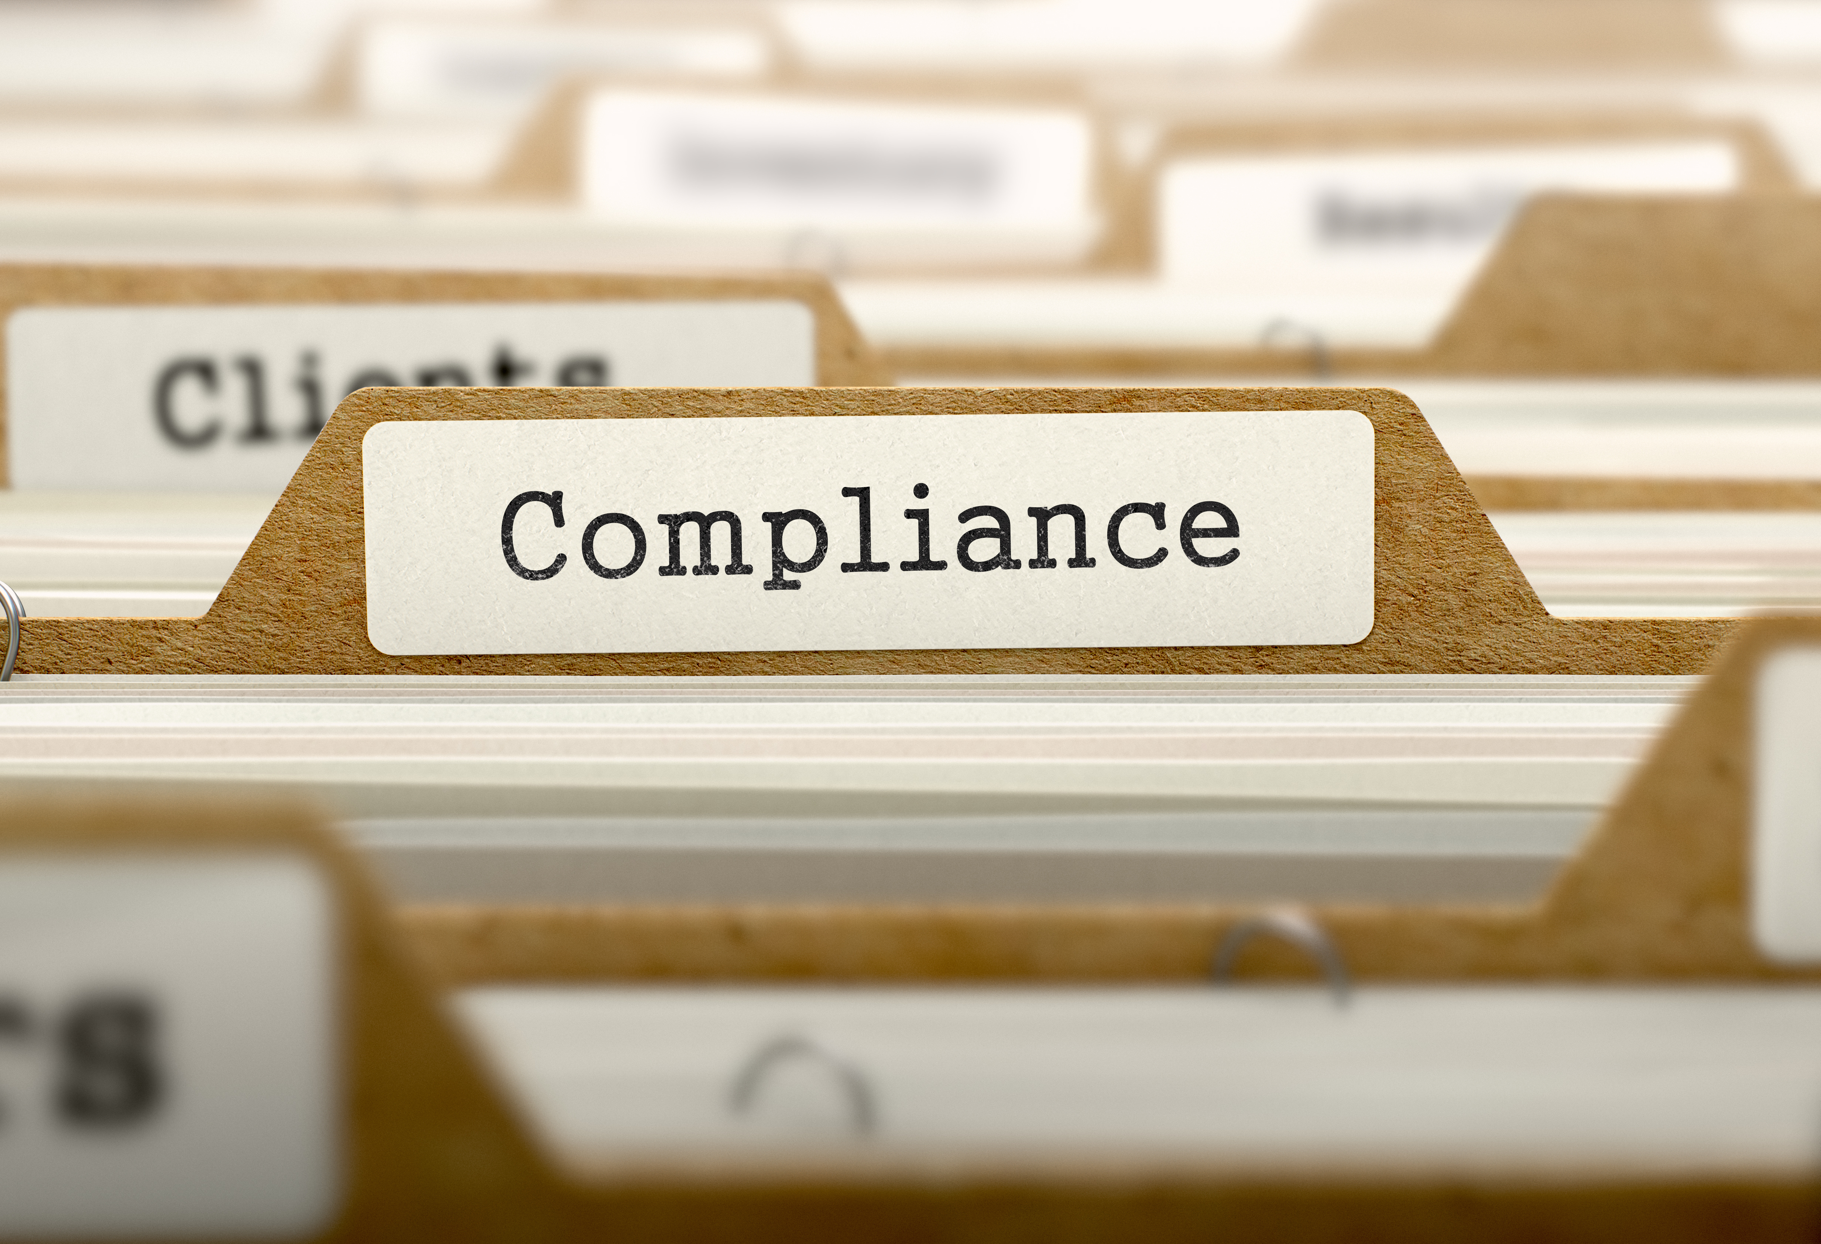

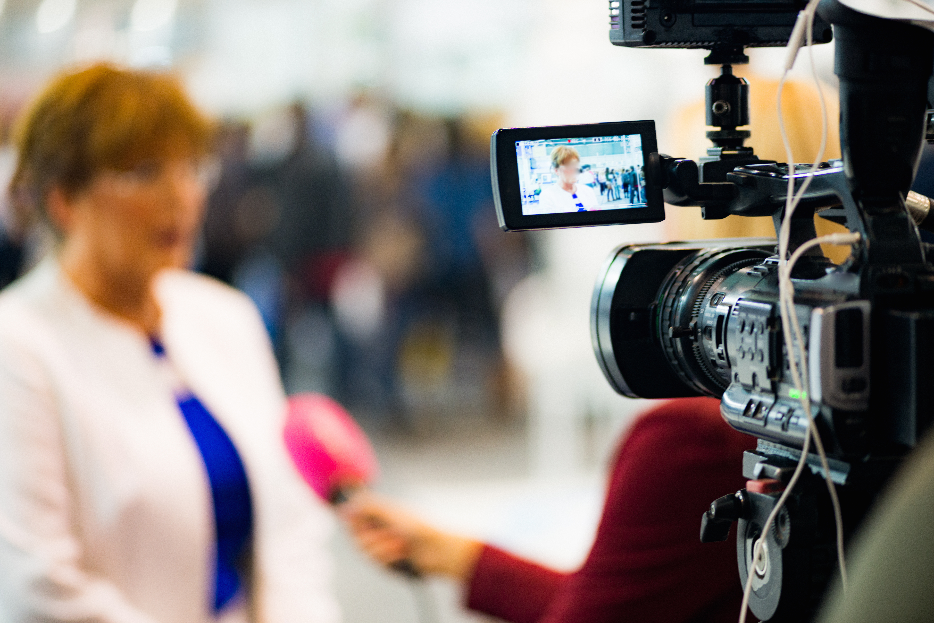
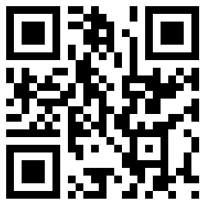
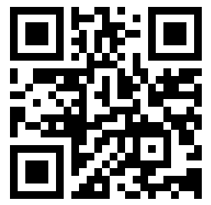
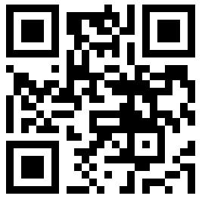
Discovery Days
Partnering with Your Compliance Office to Ensure Research Success
Tuesday, October 20th at 10am
AI for Team Science: Working Smarter, Together
Thursday, October 22 at 8:15 am
Lights, Camera, Research!
Thursday, October 23rd at 10:00 AM

Slide 28
Questions? bhodges@fsu.edu rd.fsu.edu

