Slide 1


Slide 2
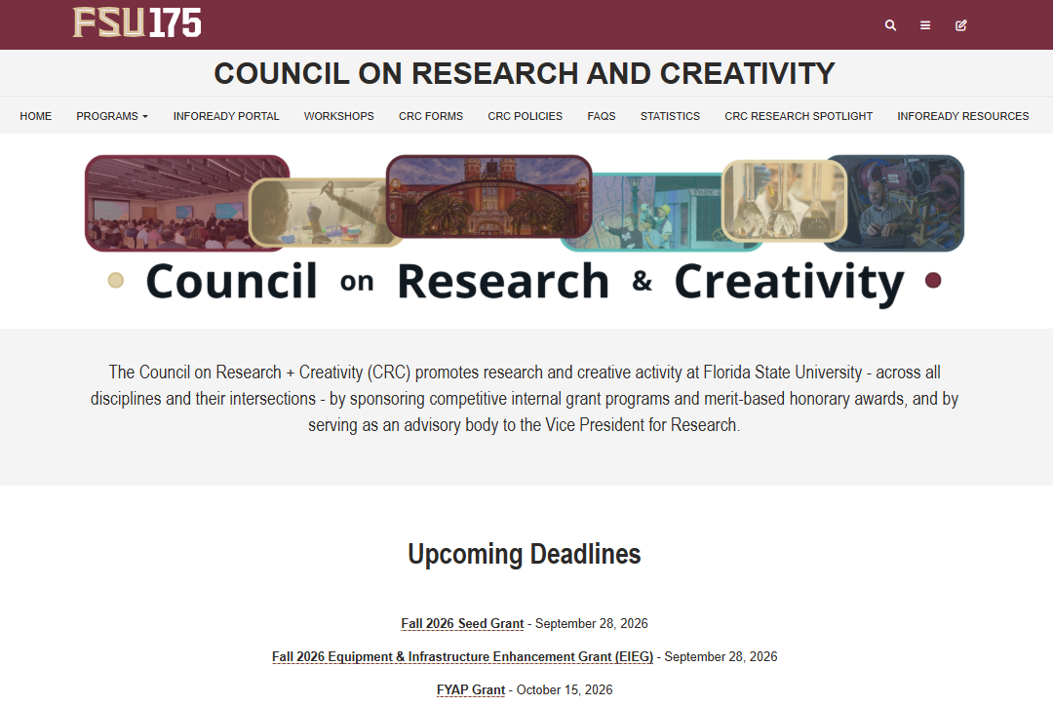
CRC Website
Programs:
The CRC offers 6 grant programs and 4 honorary awards.

Slide 3
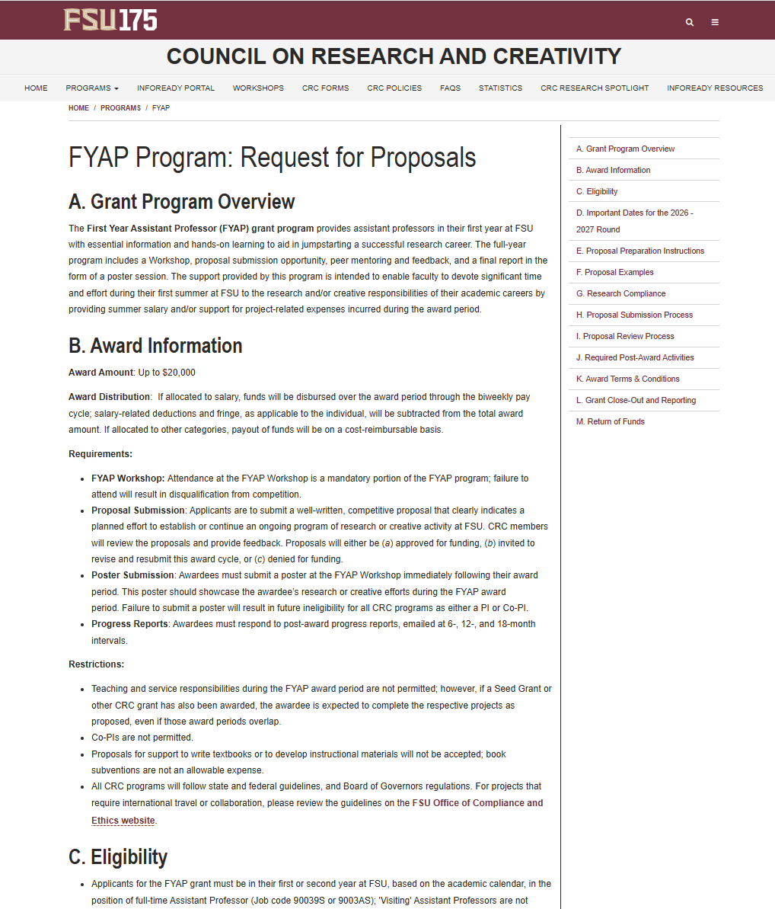
FYAP Program: Request for Proposals
The RFP:
Program overview
Award information
  Up to $20,000 for summer research support.
  Salary funds are distributed through the normal biweekly pay cycle.
  Other grant expenses can be purchased any time during the award period.
Eligibility
  Assistant Professor in your first 2 years at FSU (job code: 90039S or 9003AS)

Slide 4
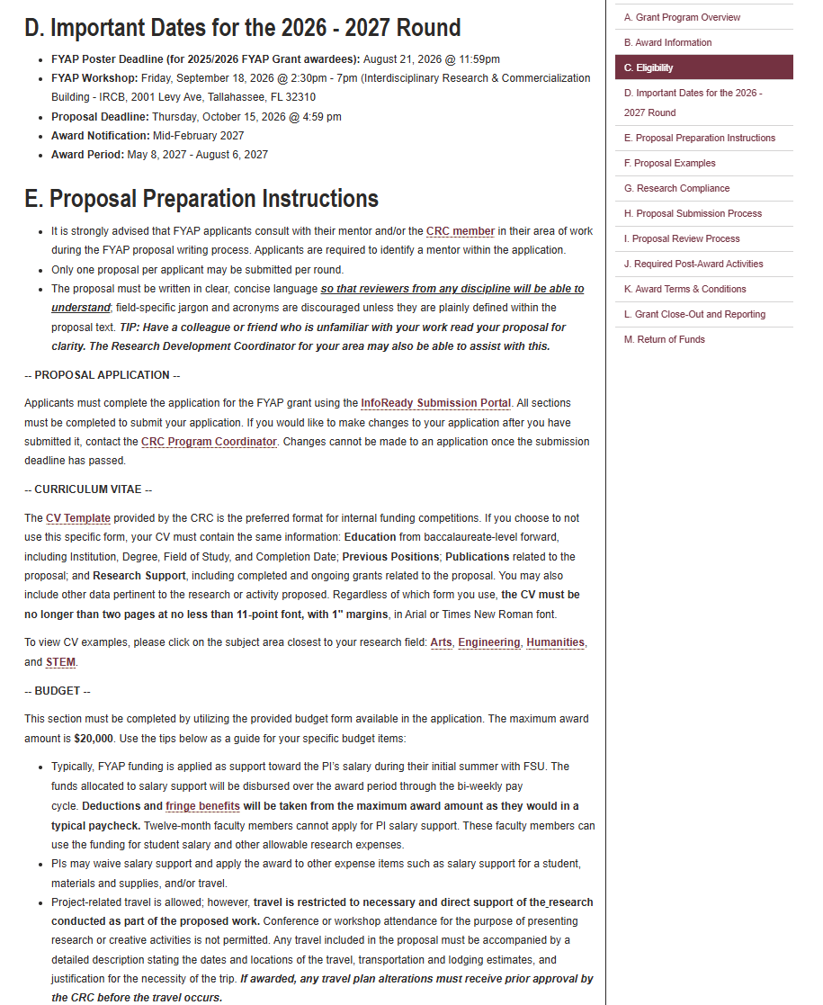
FYAP Program: Request for Proposals
The RFP:
Important dates:
  Deadline: October 15, 2026 by 5pm
  Award notification: Mid-February 2027
  Award period: 5/8/2027 – 8/6/2027
Proposal Instructions
  Proposal template
  CV template
  Budget guide (and budget form)
  General formatting:
    5 pages maximum
    11pt or larger font
    Arial or Times New Roman
    1” margins

Slide 5
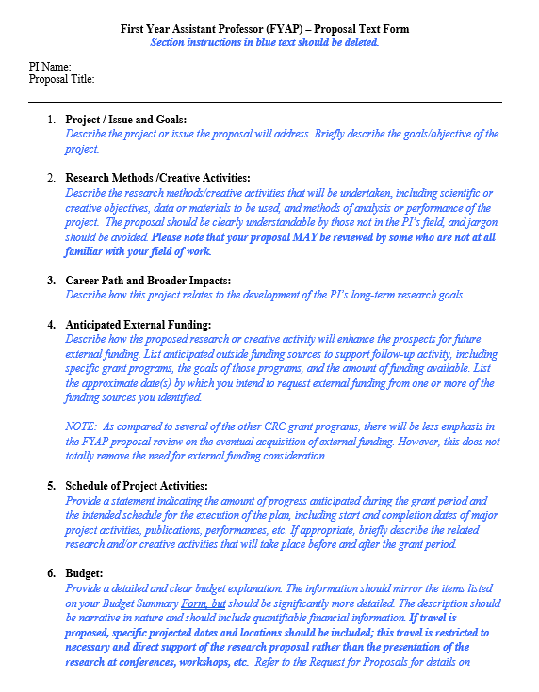
Proposal Template
Download the FYAP Grant proposal template
12 Sections:
  Project/Issue and Goals
  Research methods/Creative activities
  Career Path and Broader Impacts
  Anticipated External Funding
  Schedule of project activities
  Budget
  Differentiation from dissertation research
  Mentoring Plan
  Professional Obligations
  Previous awards or grant funds received
  References
  Appendices
Explain the importance/significance of the issue in your area of research.
Clear goals/objectives.

Slide 6
Proposal Template
Download the FYAP Grant proposal template
12 Sections:
  Project/Issue and Goals
  Research methods/Creative activities
  Career Path and Broader Impacts
  Anticipated External Funding
  Schedule of project activities
  Budget
  Differentiation from dissertation research
  Mentoring Plan
  Professional Obligations
  Previous awards or grant funds received
  References
  Appendices
Describe the research methods/creative activity to be undertaken.
Should be understandable to those not in the PI’s field!

Slide 7
Proposal Template
Download the FYAP Grant proposal template
12 Sections:
  Project/Issue and Goals
  Research methods/Creative activities
  Career Path and Broader Impacts
  Anticipated External Funding
  Schedule of project activities
  Budget
  Differentiation from dissertation research
  Mentoring Plan
  Professional Obligations
  Previous awards or grant funds received
  References
  Appendices
Is the project clearly related to the PI’s long-term research goals?

Slide 8
Proposal Template
Download the FYAP Grant proposal template
12 Sections:
  Project/Issue and Goals
  Research methods/Creative activities
  Career Path and Broader Impacts
  Anticipated External Funding
  Schedule of project activities
  Budget
  Differentiation from dissertation research
  Mentoring Plan
  Professional Obligations
  Previous awards or grant funds received
  References
  Appendices
How will the proposed research or creative activity enhance your prospects for future external funding?

Slide 9
Proposal Template
Download the FYAP Grant proposal template
12 Sections:
  Project/Issue and Goals
  Research methods/Creative activities
  Career Path and Broader Impacts
  Anticipated External Funding
  Schedule of project activities
  Budget
  Differentiation from dissertation research
  Mentoring Plan
  Professional Obligations
  Previous awards or grant funds received
  References
  Appendices
Does the schedule/timeline of project activities seem realistic?
Is there a plan for the completion of the project, including start and completion dates, or the anticipated publication, external grant proposal, or performance date?

Slide 10
Proposal Template
Download the FYAP Grant proposal template
12 Sections:
  Project/Issue and Goals
  Research methods/Creative activities
  Career Path and Broader Impacts
  Anticipated External Funding
  Schedule of project activities
  Budget
  Differentiation from dissertation research
  Mentoring Plan
  Professional Obligations
  Previous awards or grant funds received
  References
  Appendices
Clear/detailed budget explanation that should mirror items on the budget form.
Dates and locations needed on travel (must be needed for the research, cannot be workshop/conference travel).
Allowable and unallowable expenses.

Slide 11
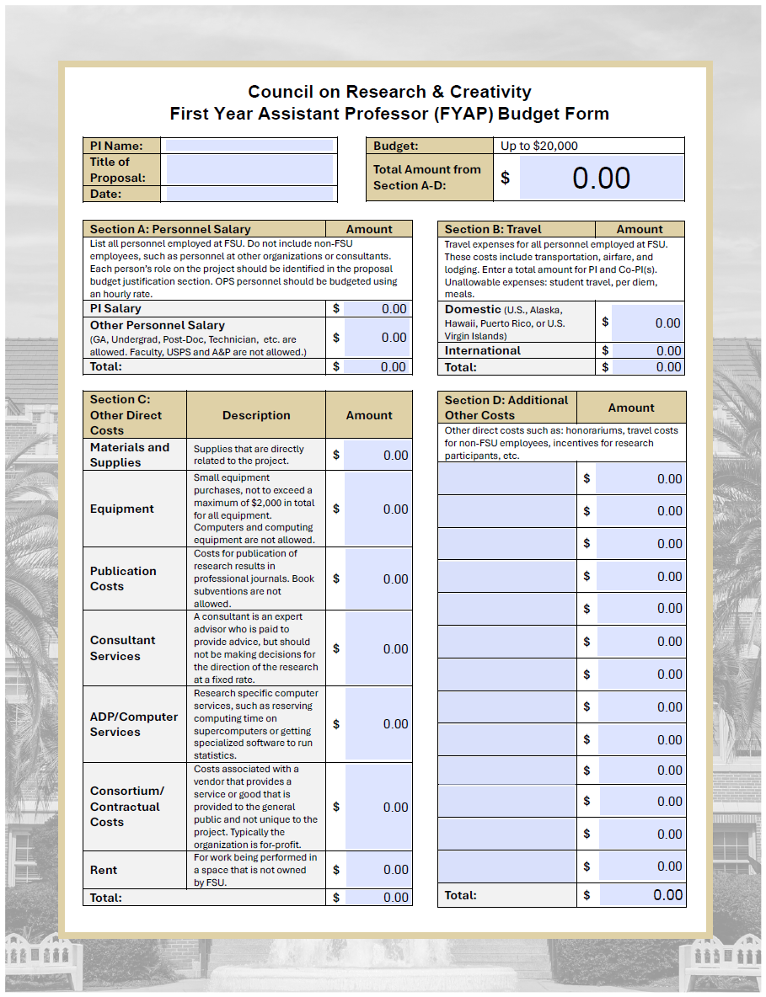
FYAP Grant Budget Form
Download the FYAP Grant Budget Form from the FYAP Grant RFP (CRC website), or it’s linked on the FYAP Grant application.
Descriptions of allowable expenses (not all-inclusive)
Notable unallowable expenses:
  Food/Meals/Drinks/Catering/Grocery
  Student tuition
  Computers/Computing equipment
  Student travel costs

Slide 12
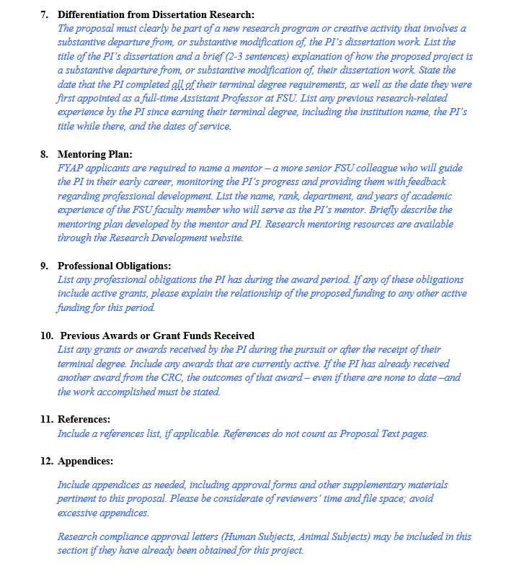
Proposal Template
Download the FYAP Grant proposal template
12 Sections:
  Project/Issue and Goals
  Research methods/Creative activities
  Career Path and Broader Impacts
  Anticipated External Funding
  Schedule of project activities
  Budget
  Differentiation from dissertation research
  Mentoring Plan
  Professional Obligations
  Previous awards or grant funds received
  References
  Appendices
Must be part of a new research program or creative activity that involves a substantive departure from your dissertation work. Explain your dissertation work and how your FYAP Grant work differs.

Slide 13
Proposal Template
Download the FYAP Grant proposal template
12 Sections:
  Project/Issue and Goals
  Research methods/Creative activities
  Career Path and Broader Impacts
  Anticipated External Funding
  Schedule of project activities
  Budget
  Differentiation from dissertation research
  Mentoring Plan
  Professional Obligations
  Previous awards or grant funds received
  References
  Appendices
You will need a faculty mentor – a more senior FSU colleague who will help you through your early career.
Plan should include goals and process for mentoring, how they will help you with your research, and expectations for your mentor (feedback, support, etc.).

Slide 14
Proposal Template
Download the FYAP Grant proposal template
12 Sections:
  Project/Issue and Goals
  Research methods/Creative activities
  Career Path and Broader Impacts
  Anticipated External Funding
  Schedule of project activities
  Budget
  Differentiation from dissertation research
  Mentoring Plan
  Professional Obligations
  Previous awards or grant funds received
  References
  Appendices
If you have an active grant, please explain the relationship of your proposed FYAP funding to any other active funding during this period.
Note: Teaching and service responsibilities during the award period are not permitted.

Slide 15

Proposal Template
Download the FYAP Grant proposal template
12 Sections:
  Project/Issue and Goals
  Research methods/Creative activities
  Career Path and Broader Impacts
  Anticipated External Funding
  Schedule of project activities
  Budget
  Differentiation from dissertation research
  Mentoring Plan
  Professional Obligations
  Previous awards or grant funds received
  References
  Appendices
List any grants or awards you have received

Slide 16
Proposal Template
Download the FYAP Grant proposal template
12 Sections:
  Project/Issue and Goals
  Research methods/Creative activities
  Career Path and Broader Impacts
  Anticipated External Funding
  Schedule of project activities
  Budget
  Differentiation from dissertation research
  Mentoring Plan
  Professional Obligations
  Previous awards or grant funds received
  References
  Appendices
Don’t count toward your 5-page limit.
Appendices (if needed) can be supplemental materials, survey questions, art installation photos, research compliance approval letters (if already received), etc.

Slide 17
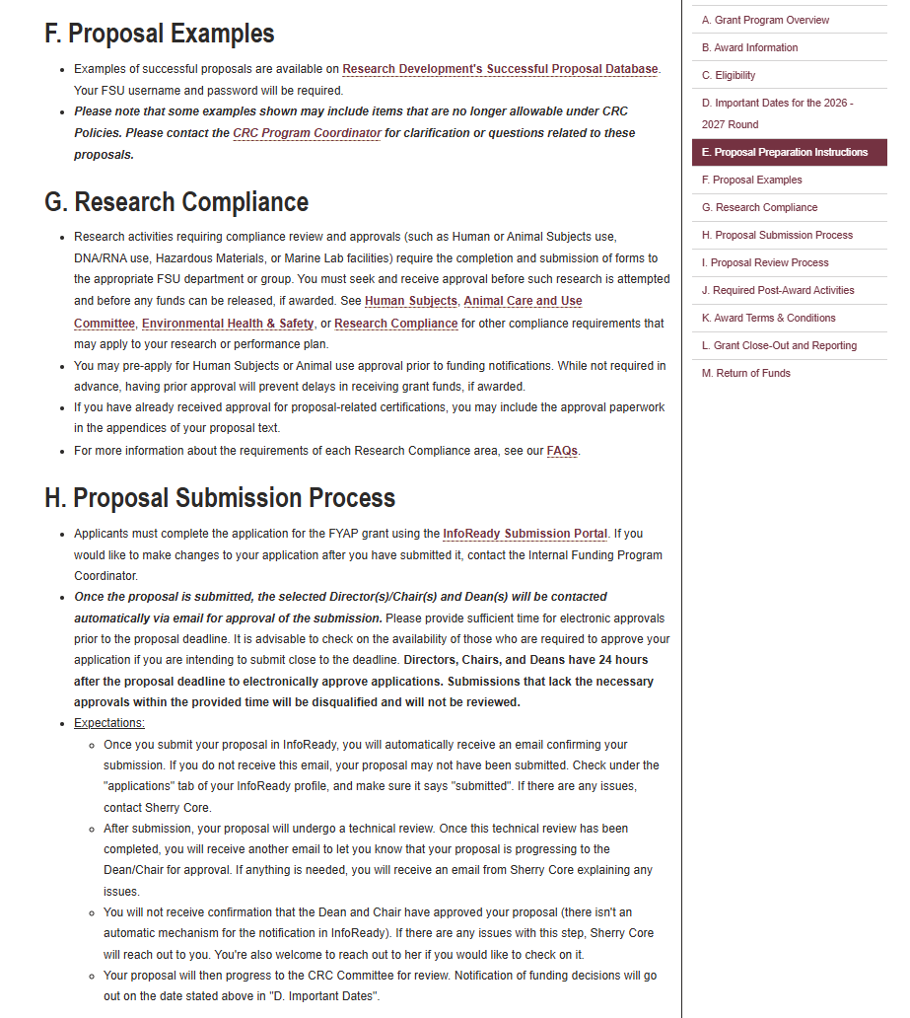
FYAP Program: Request for Proposals
The RFP:
Proposal Examples (RD Successful Proposal Database)
Research Compliance
Proposal Submission Process

Slide 18
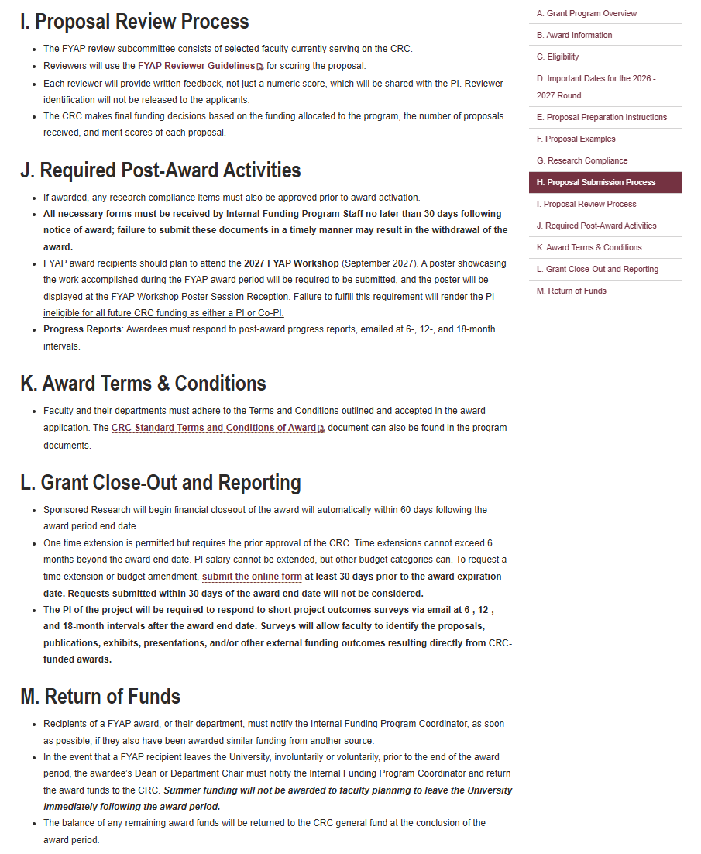
FYAP Program: Request for Proposals
The RFP:
Proposal Review Process
  FYAP Reviewer Guidelines
Required Post-Award Activities
  Progress Reports at 6-, 12-, and 18-months post-award
  Create a poster for the 2027 FYAP Workshop
Award Terms & Conditions
Grant close-out and reporting
  Time Extension and Budget Amendment request form
Return of Funds

Slide 19
CRC Website
InfoReady Portal Link:
Apply for CRC grants
Apply for additional funding opportunities that become available in the FSU FIRE Portal.
OVPR internal funding opportunities
Limited Submissions Portal

Slide 20
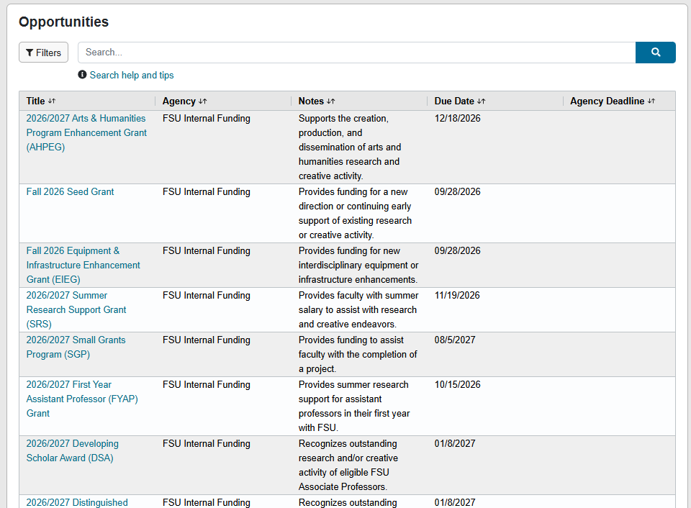
InfoReady Submission Platform

Slide 21
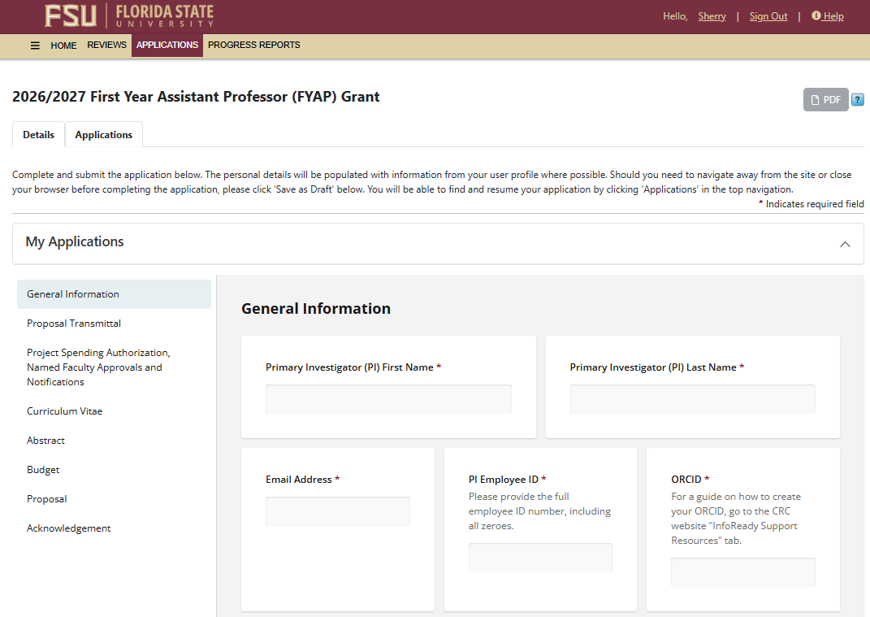
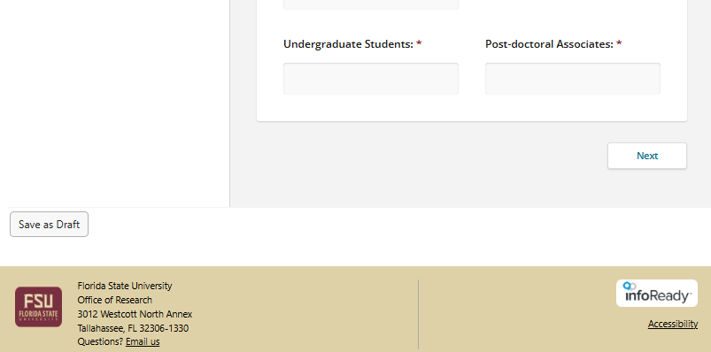
FYAP Application
FYAP Grant Application:
Basic Information
Save your application for later
All document uploads should be PDF format

Slide 22
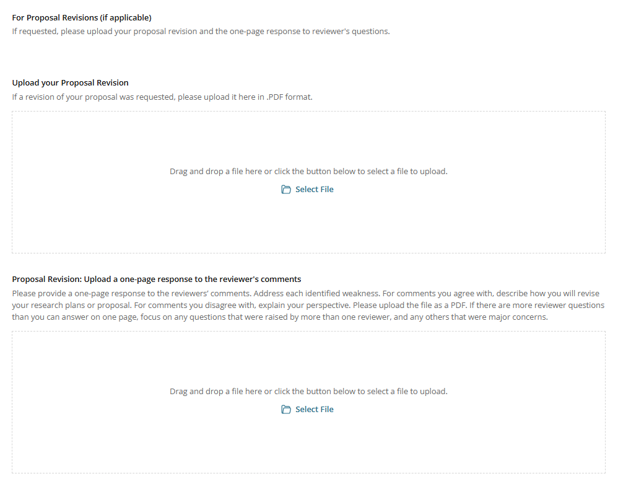
FYAP Application
If revision is requested:
If your proposal does not score high enough after the first round of reviews, I will return it to you with the reviewer’s feedback. Please revise your proposal and upload it back to your application.
Also include an additional one-page response to the reviewer’s comments.
Revision requests will go out before winter break.
Revision deadline: January 5, 2027

Slide 23
CRC Website
Workshops:
FYAP Grant resources!
Proposal template
Reviewer Guidelines
Link to the Research Development Successful Proposal Database
Last 5 years of FYAP Posters
Resources for poster creation
Links to the workshop presentations

Slide 24
CRC Website
CRC Research Spotlight:
Celebrates the success of projects that were launched with CRC funding.
We want to share your success as well! Email me your story, and we can add it to the website.

Slide 25
CRC Website
InfoReady Support Resources:
Budget forms
Prior CRC Award History Search tool
Walk-through guides for how to complete all applications
How to designate a proxy in InfoReady
CV templates
Proposal templates
Reviewer guidelines
Walk-through guide for ORCiD

Slide 26
CRC Internal Funding Programs:
Competitive Grants
Arts & Humanities Program Enhancement Grant (AHPEG)
First Year Assistant Professor (FYAP) Grant
Supports the creation, production, and dissemination
of arts + humanities research.
Award: Up to $20,000
Deadline to apply: 12/18/2026
Provides Assistant Professors in their first year at
FSU with summer research funding.
Award: Up to $20,000
Deadline to apply: 10/15/2026
Summer Research Support (SRS) Grant
Seed Grant
Provides funding for a new direction or continuing
early support of existing research or creative
activity, with the expectation that this will lead
to external funding.
Award: Averages $50,000 per award
Deadline to apply: Fall: 9/28/2026, Spring: 2/25/2027
Provides faculty with summer salary for research.
Award: Up to $20,000
Deadline to apply: 11/19/2026
Equipment & Infrastructure Enhancement Grant (EIEG)
Small Grants Program (SGP)
Provides funding for new interdisciplinary
equipment or infrastructure enhancements.
Award: Averages $40,000 per award
Deadline to apply: Fall: 9/28/2026, Spring: 2/25/2027
Provides funding for the completion of a project.
Award: Up to $5,000
Deadline to apply: Ongoing monthly awards

Slide 27
CRC Internal Funding Programs:
Honorary Awards
Developing Scholar Award (DSA)
Distinguished University Scholar (DUS)
Recognizes outstanding research and/or creative
activity of eligible FSU Associate Professors.
Award: One-time award of $10,000
Deadline to apply: 1/8/2027
Recognizes outstanding research and/or creative
activity of eligible FSU faculty (see eligibility
list on website)
Award: One-time award of $10,000
Deadline to apply: 1/8/2027
Distinguished Research Professor (DRP)
Developing Specialized Faculty (DSF)
Recognizes outstanding research and/or creative
activity of eligible FSU Full Professors.
Award: One-time award of $10,000
Deadline to apply: 1/8/2027
Recognizes outstanding research and/or creative
activity of eligible FSU faculty (see eligibility
list on website)
Award: One-time award of $10,000
Deadline to apply: 1/8/2027

Slide 28
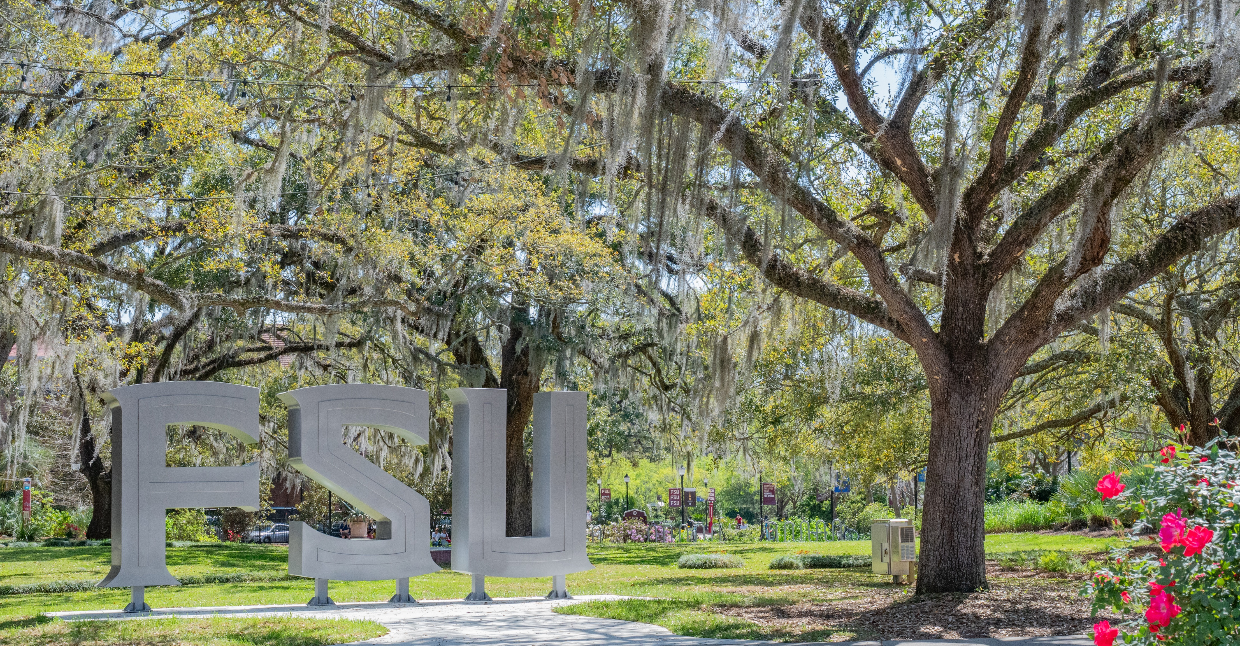
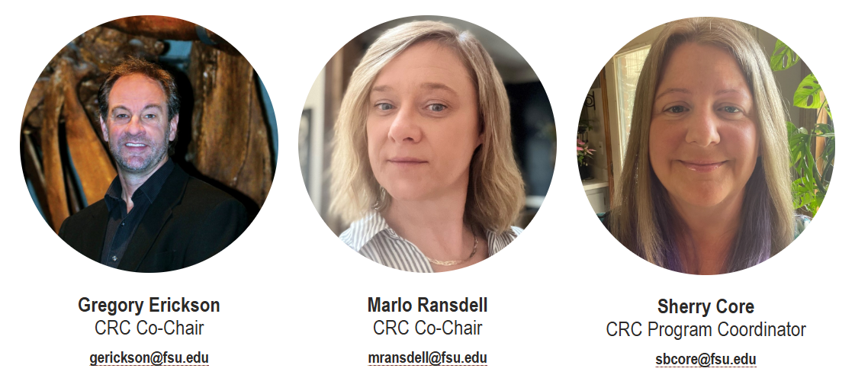
Contact
Us!

