Slide 1
Units of the Division of Research
First-year Assistant Professor Workshop
Fall 2025

Slide 2
Today’s Discussion
Office of Research Units: Their Roles and When and Why to Contact Them
RAMP and General Training Sites
Other Research Related Offices
Questions
Notes:
Specifically, we are going to go over the different units that make up the office of research what their roles are and when and why you would contact them and then we're going to talk about RAMP. I'm going to also let you know about other research related offices that aren't under the office of research but are offices you may need to work with in your research endeavors. And finally, I'll hopefully have some time for some Q&A at the end.

Slide 3
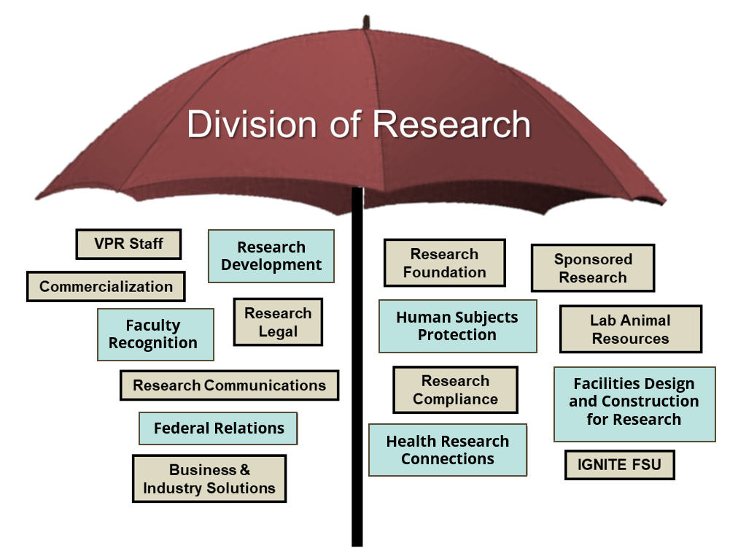
Research Units & Activities
Research Integrity & Compliance
Clinical Research Hub
Notes:
So let's start with my area which is research development,

Slide 4
Health Research Connections

Slide 5



FSU Health Research Connections (HRC)
As part of the FSU Health Initiative, the Office of the Vice President for Research offers specialized support services for all types of health research at all stages of development.
We want YOU to be aware and easily access these resources!
with support from the

Slide 6





FSU Health Research Connections (HRC)
Request Portal
Nole bot
(in development)
Website
Phone
E-mail
Currently our request portal, website, phone, and email services are active, and we have support staff ready to respond to your research questions.

Slide 7
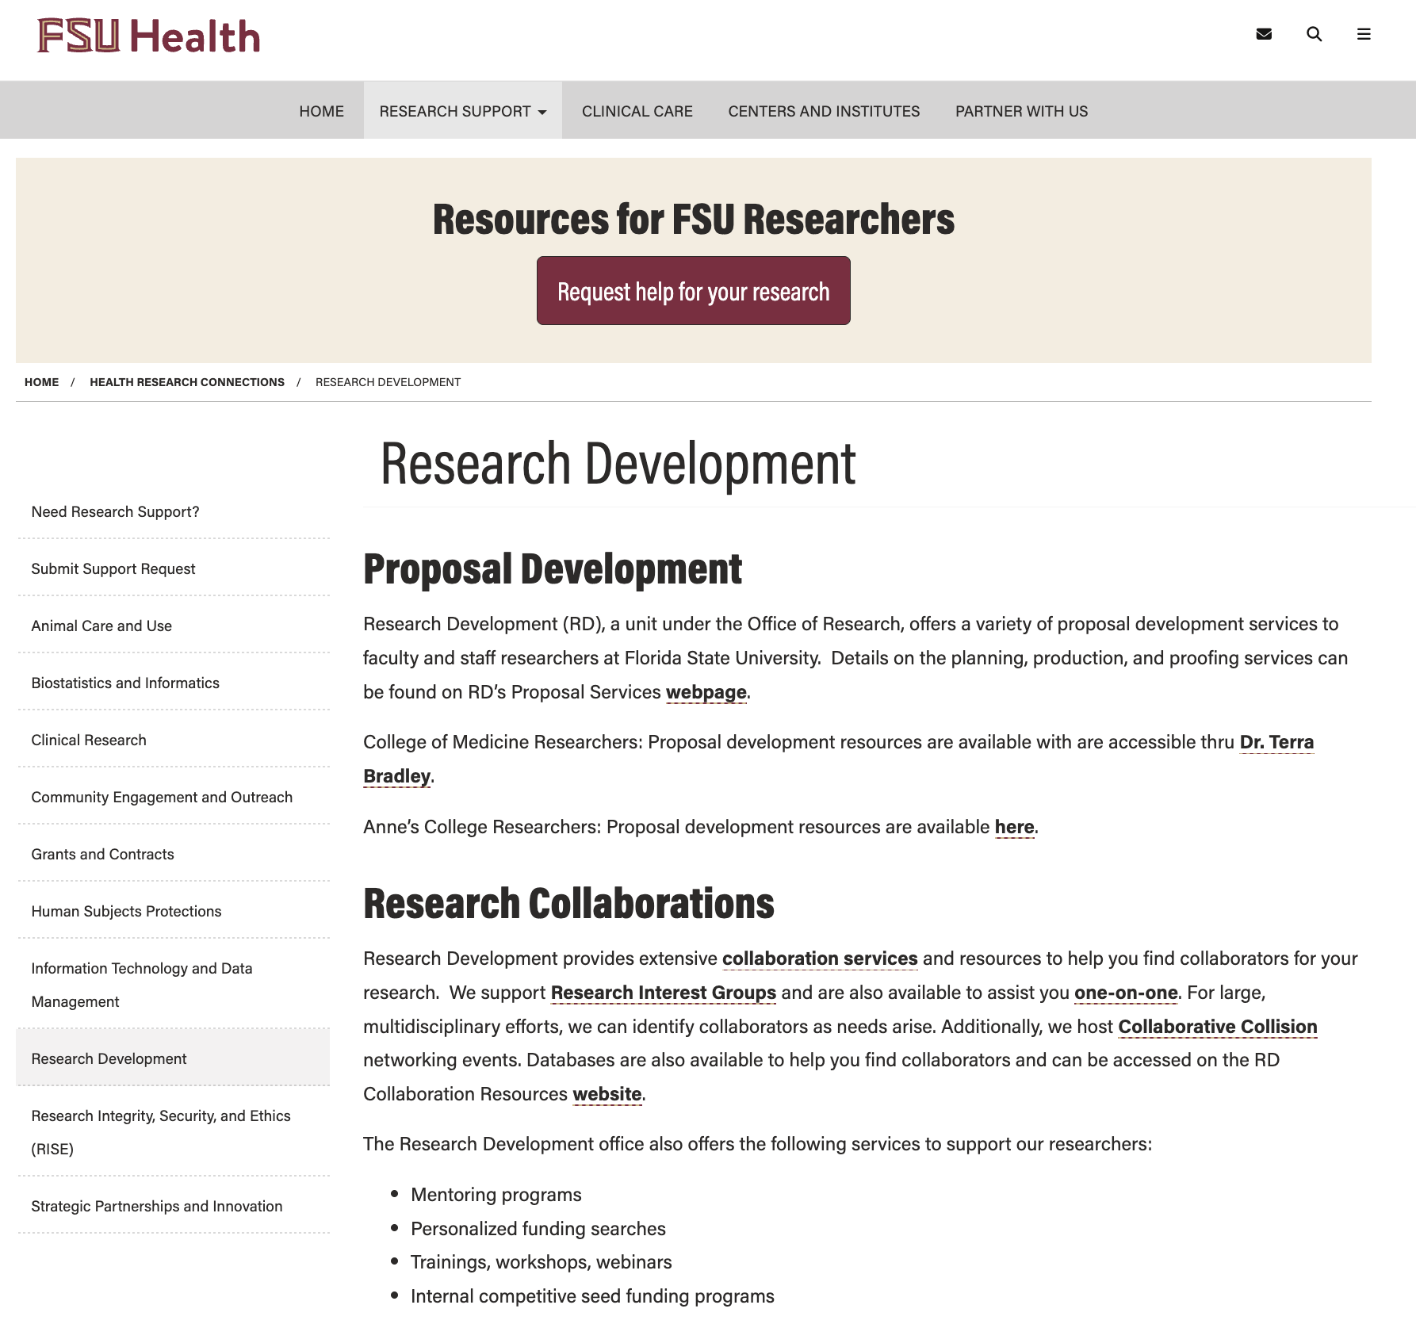
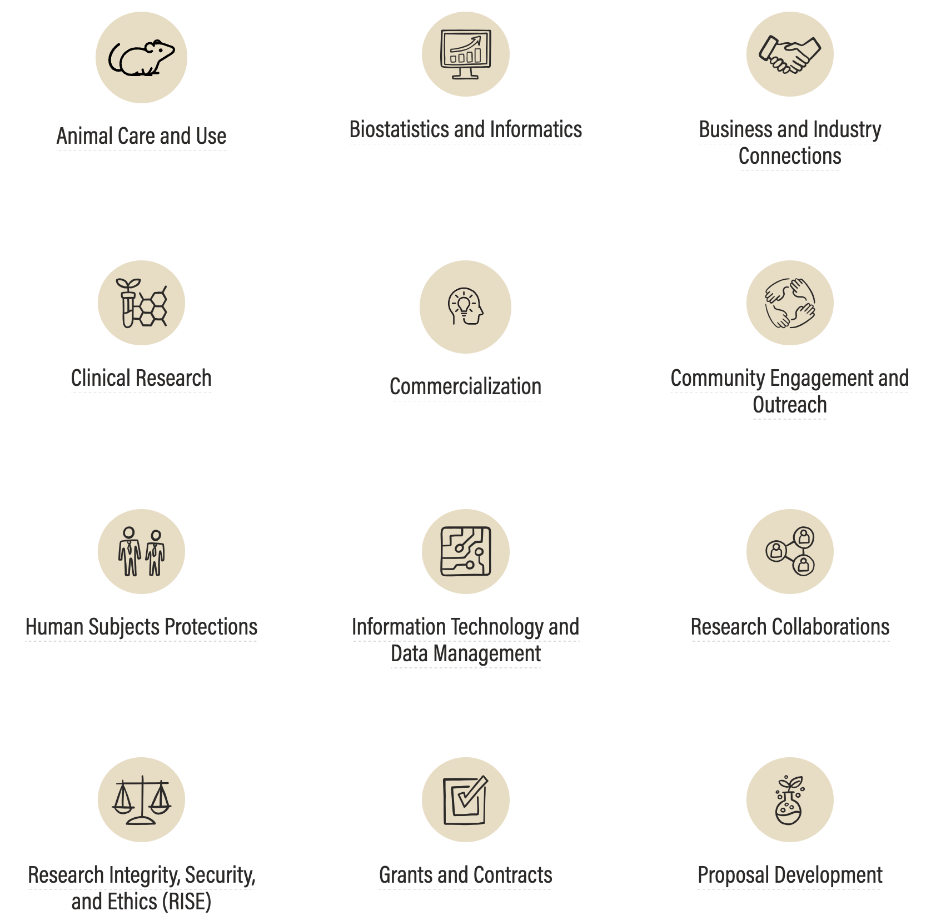
FSU HRC Switchboard
Find the service(s) you need
Learn more about the services
FSU Health Website Link
If you have trouble navigating the website or services, please email clinicalresearch@fsu.edu for assistance.

Slide 8
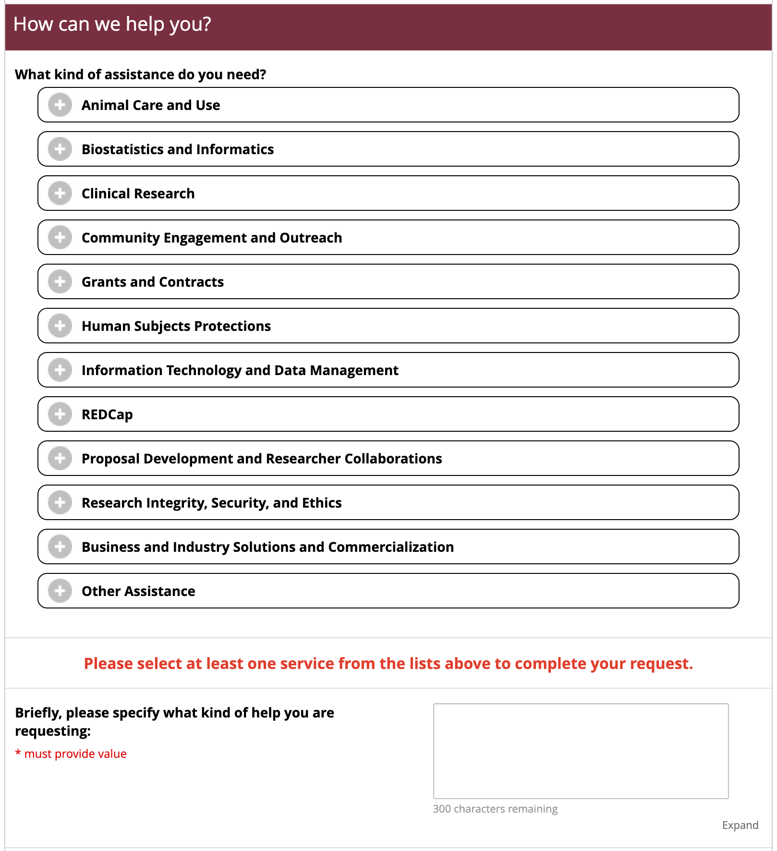
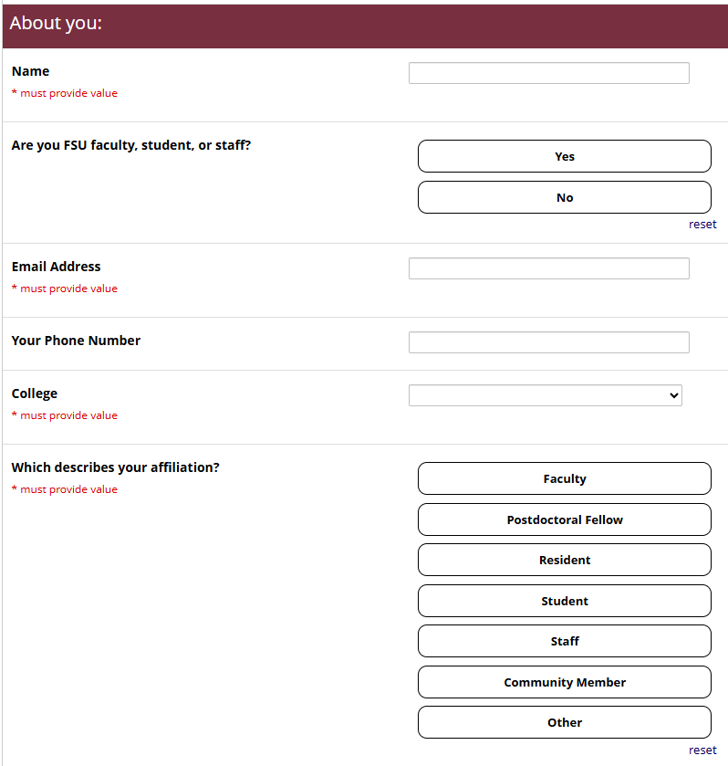
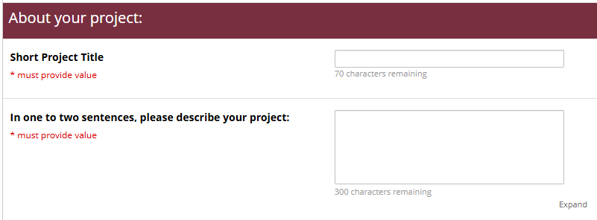
HRC Research Request Portal
Tell us About You
Tell us What You are Looking For
Tell us About Your Project
REDCap Research Request Portal Link

Slide 9
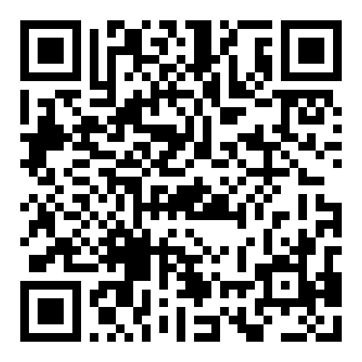
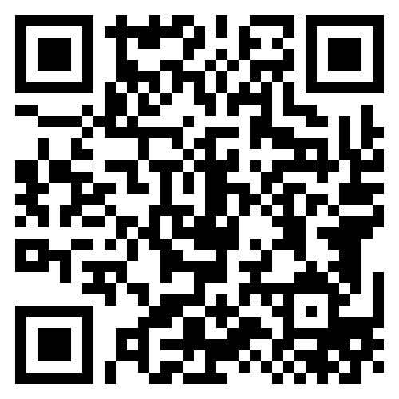
Submit a Research Support Request
FSU Health Research Connections (HRC)
Learn More about the HRC Hubs

Slide 10
Research Development

Slide 11



RD Services
Early Career Support
Discipline-Specific Research Support
Funding Identification
Proposal Services
Team Development & Collaboration
Limited Submissions
Internal Competitive Funding
Workshops & Events
On Demand Learning:

Slide 12


RD Resources
Proposal Resources
On-Demand Training
Finding Funding Resources
Proposal Resources
On Demand Training
Examples of Successful Proposals

Slide 13
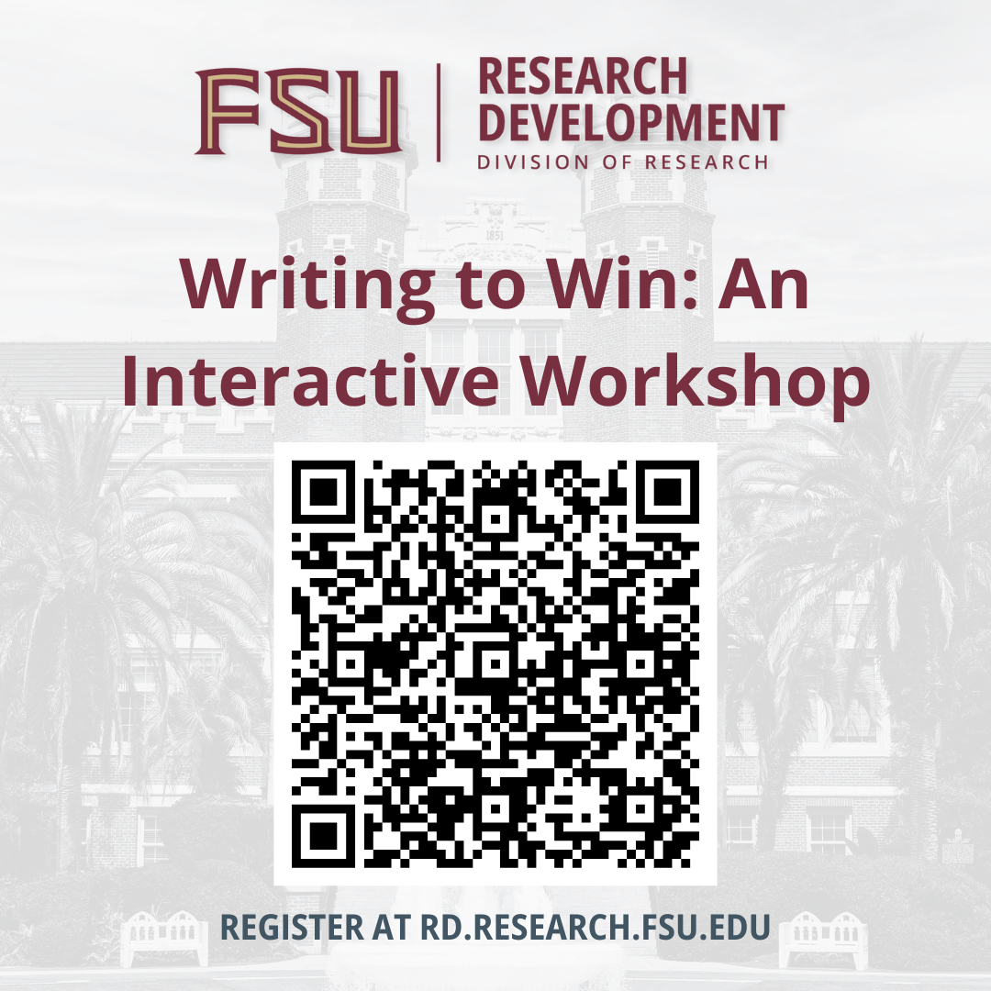
Register now: November 17
10 – 11:30 AM
Virtual (Zoom)
Hone your proposal-writing skills in this interactive workshop! Learn the grant writing ‘genre’ and get your hands dirty refining draft material.

Slide 14
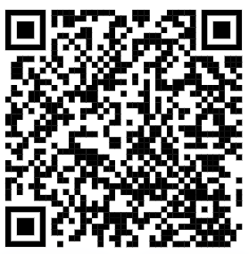
CONTACT RESEARCH DEVELOPMENT
ORD.FSU.EDU
ORD@FSU.EDU

Slide 15

Research Administration Management Portal
Notes:
Before I go into any other offices I want to talk to you about ramp next which stands for the research administration management portal. I'm bringing this up now because many of the offices that you will hear about you will need to work through ramp to work with them.

Slide 16
FSU uses the Research Administration Management Portal (RAMP), a software system, for the University’s research administration business processes and technologies, as well as research compliance and financial management.
Notes:
The ramp icon is you see here is what you will need to look for when using ramp. You can find it on the my FSU web page in the top left corner as I mentioned you were going to need to use this portal four grants, and several other processes that are grant related. In the next slides, you will see this icon on the corner of office pages that news ramp to manage their business processes.

Slide 17
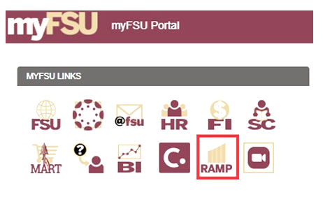
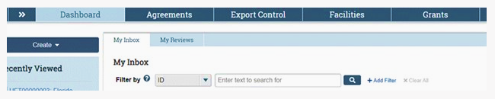
There are five modules included as part of the RAMP system—ACUC, IRB, Grants (Proposals & Awards), Agreements, and Export Control.
RAMP opens to a Dashboard Page. From there, select the module from the top tabs.
To access RAMP, log into the myFSU portal to access the RAMP icon
Notes:
Basically there are five modules that are part of ramp the ACC which is for lab animal use the IRB which is for human subjects the grants module which is for all grants running through FSU agreements, and export control. As I mentioned, you'll find the ramp icon at the top of the my FSU portal and when you click on it you will get to a dashboard page and from there you can select the different modules from the top tabs.

Slide 18
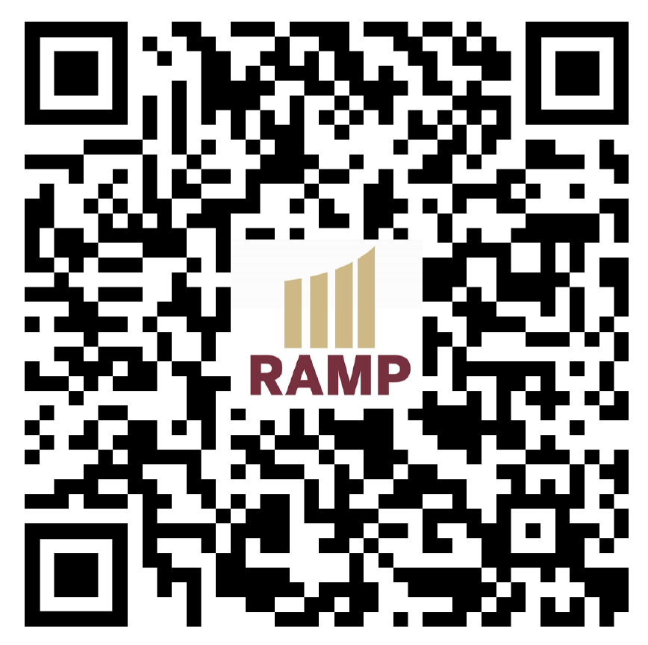
Make time to go through RAMP training:
RAMP Help Desk
Grants: RSCH-RAMP-Grants@fsu.edu
Export Controls: RSCH-RAMP-ExportControls@fsu.edu
IRB: RSCH-RAMP-IRB@fsu.edu
ACUC: RSCH-RAMP-ACUC@fsu.edu
Agreements: RSCH-RAMP-Agreements@fsu.edu
RAMP Support Director: Dan Mullins dmullins2@fsu.edu
RAMP Training
Notes:
There is training for ramp and I would suggest that you take the training soon if you're going to be engaged with research. Most of you will be in departments we'll also have department representatives that can help you with your grants and they should be well aware of how to use ramp as well. That said you need to know it. There are two ramp staff that you can reach out to for help. I've listed in this slide the different emails you can use to reach out to them.

Slide 19
Sponsored Research Administration (SRA)

Slide 20
About SRA
Combined pre- and post-award central office
Responsible for the administration of sponsored awards from public funding (federal, state, and local governments) and flow-through public funding from private organizations
Please note: All proposals must be submitted to your SRA grants officer three working days prior to the agency deadline!
Notes:
Sponsored research administration is the office you will need to work with if you are applying for public funding and flow through public funding from private organizations. Their office handles the lion's share of grants going out of Florida State. They have a combined pre award and post award office and as I note on this slide you will use ramp to input your grant information that you plan to submit to the agency. SRA is a combined pre and post award central office.

Slide 21
SRA Roles
Responsible for proposal review (compliance) and submission
Negotiating & executing sponsored agreements and assisting with Pre-Award Advances, when necessary
Setting up sponsored project accounts, including cost share and subawards
Reviewing expenditures for compliance
Processing award amendments, project extensions, budget revisions, key personnel changes, scope of work changes, etc.
Financial invoicing and reporting
Providing resources, updates, and research administration educational opportunities
Notes:
I'm going to quickly go over a few of the roles where you would be working with us SRA. So they're going to assist you with proposal review specifically making sure you are compliant with what the agency is asking for and will be the ones to actually help you submit. They are going to be the ones negotiating and executing the agreements and helping with pre award advances when necessary. They're the ones who are going to activate project accounts who will process project extensions, budget revisions, she personnel changes scope of work and other items like that and they also make sure that effort reporting is being done.

Slide 22
Additional SRA Roles
Managing cash flow including processing cash receipts, drawdowns,
deposits and collection efforts
Negotiating and issuing subawards and monitoring subrecipient activity
for compliance
Monitoring Effort Certifications
Preparing, submitting and negotiating the Facilities and Administrative
(F&A) Rate proposals
Responding to audit inquiries
Please note: All proposals must be submitted to your SRA grants officer three working days prior to the agency deadline!
Notes:
Additional SRA roles include managing cash flow negotiating and issuing sub awards preparing and submitting financial reports preparing submitting and negotiating FHA rates and responding to audit requests. One important thing you need to understand is that at FSU all proposals must be submitted to your grants officer three working days prior to the agency deadline at 9:00 AM that morning.

Slide 23
When to Reach Out to SRA
As soon as you know you will be submitting to a federal/state funding agency or if the funds are a federal/state flow-through
When you have questions about:
The proposal requirements, submission, or budgeting processes
Allowability of charges on a publicly funded project
Invoicing or reporting
Any other of the SRA responsibilities
Looking for further education in grants management
Please note: All proposals must be submitted to your SRA grants officer three working days prior to the agency deadline!
Notes:
The best time to reach out to sponsored research is when you know you plan to submit to a federal agency or state agency. In addition to the other things we mentioned make sure you reach out to them if you have questions about the submission process of an agency questions with completing your budget if you don't have a departmental Rep and any questions you might have about spending

Slide 24
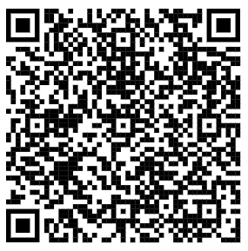
Contact SRA
Address: 874 Traditions Way (Student Services Building)
Phone: 850.644.5260
Email: SRA-Pre@fsu.edu (Pre-Award)
Website: https://www.research.fsu.edu/research-offices/sra/
Notes:
Here's your contact information for sponsoring

Slide 25
Research Foundation

Slide 26
Research Foundation
A not-for-profit corporation, and a direct-support organization (DSO) of Florida State University
Responsible for pre- and post-award functions of the university for sponsored research awards with PRIVATE and FOREIGN funding
Is the assignee of the University's Intellectual Property (IP), and therefore, is the fiscal agent for all activities with respect to the commercialization of IP
Distributes funds, such as licensing and royalty revenue
Manages Research Buildings at Innovation Park and on Commonwealth Blvd
Notes:
Like sponsored research the FSU Research Foundation also handles grants that they're going to handle private and foreign funding. They are also a not-for-profit corporation so those grants where a nonprofit is necessary we'll run through the Research Foundation. Additionally Research Foundation is the assignee of the universities linked to actual property and that's the fiscal agent for all activities with respect to commercialization. They also manage research buildings out at innovation park hand out on commonwealth blvd period

Slide 27
Research Foundation
Applying for Research Foundation:
Follows the same "3-day" rule as SRA
Handles the same responsibilities as SRA, but for private sponsors
Different than the FSU Foundation which handles philanthropic gifts
Manages cradle-to-grave grant and contract administration -
proposal review, negotiating awards, administering grant
agreements, reporting requirements, and payment disbursements
GAP and Krafft Awards are administered at the FSURF
Notes:
Just like Sr. A the Research Foundation follows the three day rule. So please, again remember 3 days is the deadline for submitting all grants through issue period

Slide 28
Contact fsurf
Address: 2000 Levy Avenue (Southwest Campus), Building A., Suite 351
Phone: 850.644.8650
Email: hcave@fsu.edu (Heather Cave, Director)
Website: https://www.research.fsu.edu/research-offices/fsu-research-foundation/
Notes:
Here is the research foundations contact information

Slide 29
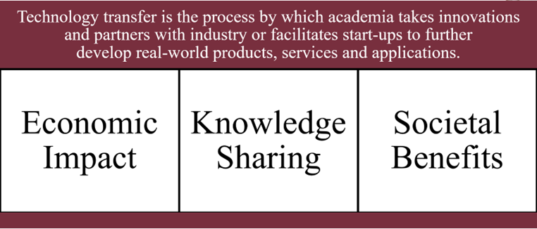
Commercialization

Slide 30
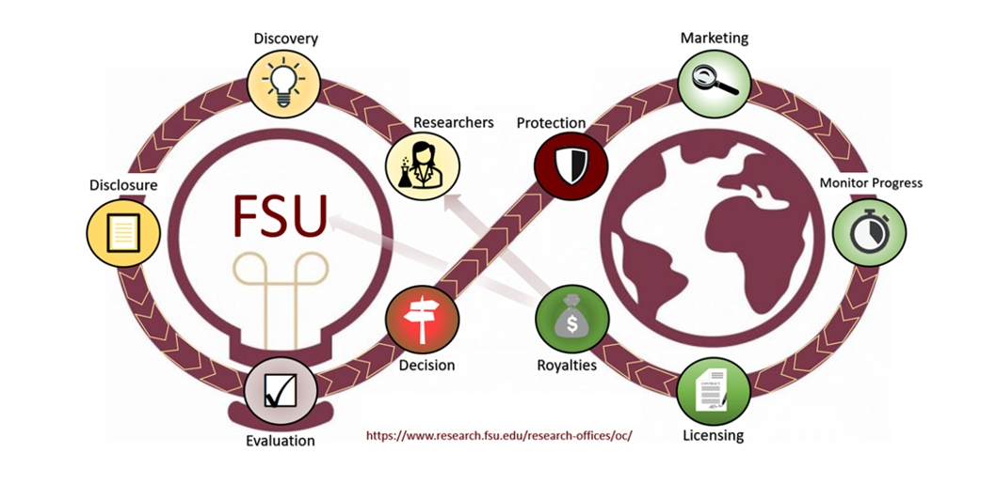
Commercialization
New ideas and Innovations? Commercialization wants to help you to get them to the market
We will come to you!
Evaluate for and provide intellectual property protection
Identify and Market to potential partners
Initiate Start-ups
Negotiate and manage license agreements
Notes:
Commercialization essentially is about getting your ideas into the marketplace. Staff and commercialization will help you commercialize your inventions discoveries and work, will help you to assess the commercial potential, will also help you protect your intellectual property. Plan to reach out to commercialization when you have new inventions discoveries or a work that might have commercial value. Also, when intellectual property clauses are part of agreements or collaborative interaction.

Slide 31
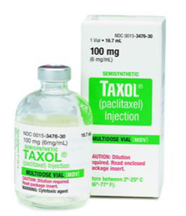
Contact Commercialization
“The value of an idea lies in the using of it.”
-- Thomas Edison
Phone: 850.645.2143
Email: vmcdevitt@FSU.edu
Website: https://www.research.fsu.edu/research-offices/oc
Notes:
Here is their contact information

Slide 32


Slide 33
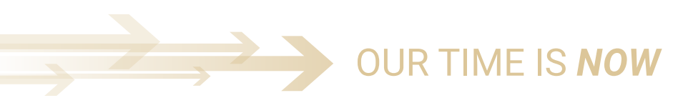
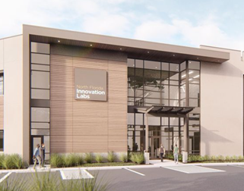
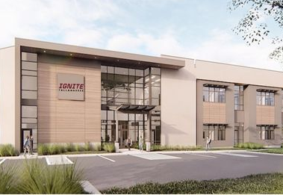
IGNITE FSU
Located in IGNITE Tallahassee technology incubator
Support for early-stage technology startups and entrepreneurs
Multi-use including wet, dry, and engineering lab space
Shared equipment and facilities
Regional support and collaboration: FAMU, TVCC, Office of Economic Vitality
Notes:
Commercialization essentially is about getting your ideas into the marketplace. Staff and commercialization will help you commercialize your inventions discoveries and work, will help you to assess the commercial potential, will also help you protect your intellectual property. Plan to reach out to commercialization when you have new inventions discoveries or a work that might have commercial value. Also, when intellectual property clauses are part of agreements or collaborative interaction.

Slide 34
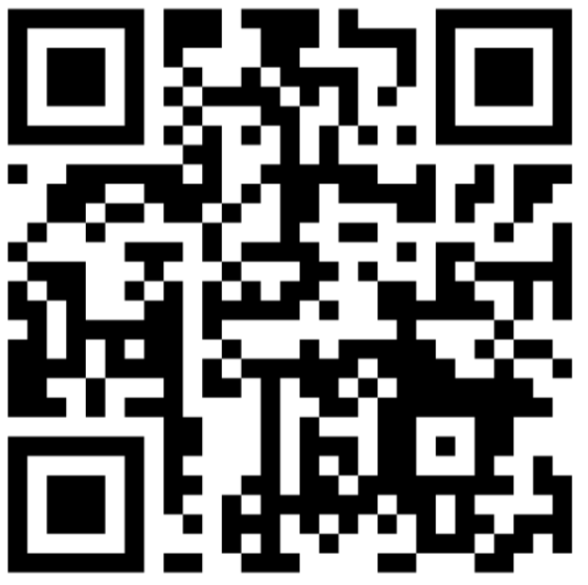
Contact IGNITE FSU
Phone: (850) 644-1528
Email: acostabile@fsu.edu, ignite-tallahassee@fsu.edu
Website: https://www.research.fsu.edu/ignite
Notes:
Here is their contact information

Slide 35
Business and Industry Solutions

Slide 36
FSU’s Industry Liaisons
Industry liaisons help our corporate partners navigate the university-
enabling researchers and industry to work together more efficiently
Act as the point of contact for industry
Arrange and facilitate meetings between industry executives and faculty/researchers
Participate in discussions
Facilitate non-disclosure/confidentiality agreements
Facilitate sponsored research through individual or master research agreements
Grow the relationships with new and existing industry partners
Notes:
Industry relations is a fairly new thing for FSU and we're very excited about get. FSU’s industry relations person we'll help you navigate the bureaucracy that comes along with working with industry. He can help participate in discussions arrange and facilitate meetings and act as a point of contact.

Slide 37
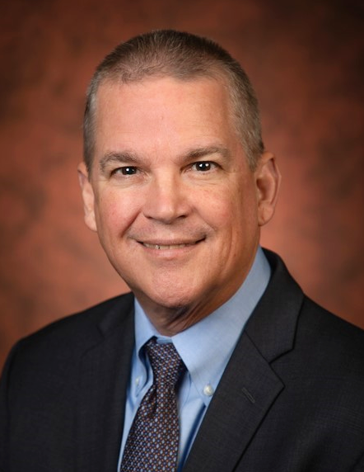
Thinking about working with private industry?
Contact:
Michael “Mike” Campbell Chief Business and Industry Liaison Office of Research 2000 Levy Avenue, Bldg A Rm323 mscampbell@fsu.edu Cell: 850-545-7354 Office: 850-644-0106
Notes:
Our industry liaison is Mike Campbell. He's a great guy and we'll help you get started with those industry contacts. Also, if the industry reaches out to you, please let Mike know.

Slide 38
Faculty Recognition

Slide 39
Faculty Recognition and Awards
Data-informed approach, focused on targeted list of prestigious, highly prestigious, and pathway awards.
Supporting a culture of recognition for faculty earning external awards.
Close partnership with offices of the Provost and Faculty Development & Advancement
Sonja Carter, JD sacarter@fsu.edu -- (cell) 917-558-0552

Slide 40
Research Communication & Publications

Slide 41
Research Communication & Publications
Communicates and disseminates information about FSU research
Contact us with story ideas, interesting findings, or questions
Kathleen Haughney -- khaughney@fsu.edu 850.644.1489

Slide 42
Research Legal

Slide 43
Research Legal
Provides support for Research Administrative Units, including contract and grant review for compliance with state and federal laws and university policy
Prepares research-related agreements such as non-disclosure agreements (NDAs), material transfer agreements (MTAs), and data use agreements (DUAs)
Utilizes the RAMP system for agreement management (researchers can streamline this process by uploading their agreement information and supporting documents at the outset)
Negotiates research-related agreements with outside entities, when needed
Advises Office of Research Departments on research-related legal matters
Notes:
Research legal primarily works with the research administrative units. So, you may not necessarily contact them directly but it is still good to understand that they're the ones that are gonna keep you and the university out of trouble legally.

Slide 44
How Can Legal Help? and how to contact Research Legal
When you need a non-disclosure agreement (NDA), material transfer agreement (MTA), data use agreement (DUA), or other research-related agreement
When you receive a contract from an academic or industry collaborator, vendor, or other outside entity
https://ramp.research.fsu.edu/modules/agreements/
Phone: 850.644.8648
Questions: Angela Jackson
adjackson3@fsu.edu
Notes:
You may reach out to them when you need a non disclosure agreement material transfer agreement or data use agreement or any other research related agreement or, when you receive a contract from an academic or industry collaborator vendor outside entity. Russ Lentz and Glenn Ladwig are our attorneys and this is the contact information for Paralegal Angela Jackson, so if you have questions feel free to reach out.

Slide 45
Human Subjects Protection

Slide 46
Human Subjects Protection
Protecting the rights, welfare, and well-being of human subject participants through the initial review and life-cycle oversight of research in accordance with applicable law and policy and to promote ethical research (University Human Subjects Policy7-IRB-0 )
The IRB is a committee composed of scientists, laypersons, and community representatives who are charged by law to review human subjects research
Human Subjects professional and administrative staff support the IRB, faculty, staff, and students through:
identifying IRB review pathways depending upon study scope, risks, and applicable laws
conducting pre-IRB review and other regulatory reviews (not requiring IRB review) of studies to streamline review processes and requirements, serving as a resource for investigators and regulatory subject matter experts for IRB members and the FSU research community
maintaining a database for submission and review of research (RAMP IRB)
providing training regarding applicable law and FSU policies
Notes:
Oh HSP protects human participants in research. There is an IRB committee who's charged to review all human subjects research. There are also human subjects professional and admin support available. They serve as a resource for investigators and are very helpful. As a reminder, when you're dealing with human subjects you're going to be using the ramp portal to input your information

Slide 47
When to Contact HSP
Well in advance of commencing your research (not at the proposal stage)
See IRB Metrics on website for current turnaround times
When there is a change in your plans after approval
When you have any human subjects-related questions
New!! Pre-Submission Consultation Services https://outlook.office365.com/book/PresubmissionConsulting@fsu.edu/
All human subjects research requires review and approval/determination, prior to subject recruitment and data collection, and prior to the use of extant data or private information.
Notes:
You are going to need to contact human subjects well in advance beginning your research. Not at the proposal stage. You would also reach out to them when there is a change in your plans on your grant and of course whenever you have any human subjects related questions.

Slide 48
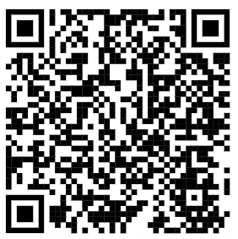
OHSP Contact information
Address: 2010 Levy Avenue Suite 276 (SW Campus)
Phone: 850.644.7900
Email: humansubjects@fsu.edu
Website: https://www.research.fsu.edu/research-offices/ohsp/
Notes:
Here is their contact information period

Slide 49
Laboratory Animal Resources

Slide 50
LABORATORY ANIMAL RESOURCES Centrally administered campus organization responsible for care of all vertebrate animals used in teaching and research at FSU
Animal procurement
Husbandry care
Veterinary care and consultation
Training
Notes:
The sister unit to human subjects is animal subjects and LAR is the campus organization responsible for the care of all vertebrate animals used in teaching and research at FSU

Slide 51
Animal Care and Use Committee (ACUC)
Federally mandated entity with specific regulatory functions
Conducts semiannual program and facility evaluations
Reviews and investigates animal welfare concerns
Makes recommendations regarding Program needs to Institutional Official
Reviews and approves animal use protocols
Authorized to suspend animal activity
Notes:
And, like LAR with their IRB, LAR works with an animal care and use committee who reviews and approves animal use protocols and performs other duties as well as you see here. Again, you will need to use ramp in working with LAR.

Slide 52
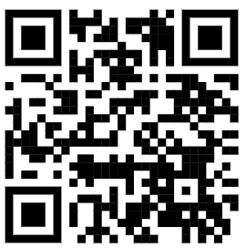
LAR Contact information
Address: 107 Chieftan Way, 101 Biomedical Research Facility
Phone: 644-4262
Email: wahill@fsu.edu
William Hill, Director
Website: lar.fsu.edu
Notes:
Here is layers contact information

Slide 53
Research Integrity, Security, and Ethics (RISE)

Slide 54
Research Integrity, Security, and Ethics
Ensures university compliance with federal, state, and local regulations regarding research.
Develops and monitors research compliance program for FSU
FSU's RISE encompasses all areas that support or relate to FSU’s research and creative activities
Notes:
Research compliance, as this slide shows ensures university compliance with federal state and local regulations regarding research. It encompasses all areas that support and relate to research and creative activities

Slide 55
When to Contact RISE
To report potential issues not being addressed (anonymous hotline provided)
For guidance with compliance issues in any area related to research, including but not limited to:
Conflicts of Interest
Contracts & Grants Management
Foreign Influence
Export Controls
Human Subjects​
Data Management​
Responsible Conduct of Research​
Research Data Management & Security​
Notes:
You need to reach out to research compliance to report any issues you feel is not being addressed, for example with LAR human subjects or anything else you feel that is being done outside of compliance. Also, for guidance with compliance issues related to things like conflict of interest contracts and grants management foreign influence environmental health and safety and the other areas you see listed here

Slide 56

Florida State University uses the Conflict Administration Management System (CAMS) to report, approve, and manage outside activity/employment, as well as financial disclosures for employees at Florida State
The system is also used to identify and manage conflicts of interest within research activities and has components that integrate with the RAMP Grants and RAMP IRB modules.
CAMS provides the following features and benefits, including:
automated COI processes and workflow
streamlined disclosure forms
early flagging and resolution of potential conflicts
elimination of redundant data input
tracking of compliance and improvement of response rates
fostering of a culture of transparency
Additional information and training materials may be found on the CAMS Project website at: https://cams-project.fsu.edu/
Notes:
FSU’s Conflict Administration Management System (CAMS) is used to report, approve, and manage outside activity/employment, as well as financial disclosures for employees at Florida State. Disclosures for all faculty is required. Each faculty member will receive an email from the CAMS system reminding them that their Disclosure Profile must be updated. New faculty will also have to take the training integrated within the Disclosure Profile update process.

Slide 57
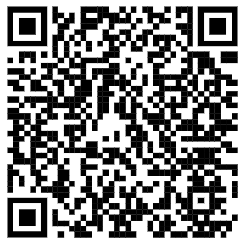
RISE Contact Information
Phone: 850.644-9947 (Mary Sechrist, PhD, Director)
Hotline: 855-231-7511 (24 hours a day, 365 days a year)
Email: m.sechrist@fsu.edu
Website: https://www.research.fsu.edu/research-compliance/

Slide 58
Clinical Research Hub
Notes:
The Clinical Research Hub specializes in clinical research and trials. The CR Hub, as part of its portfolio, offers flexible research lab space for researchers to come in an conduct studies with our team that they may not necessarily have room for in their lab, or the equipment, or the staffing skills that the CRTU has under one roof.

Slide 59
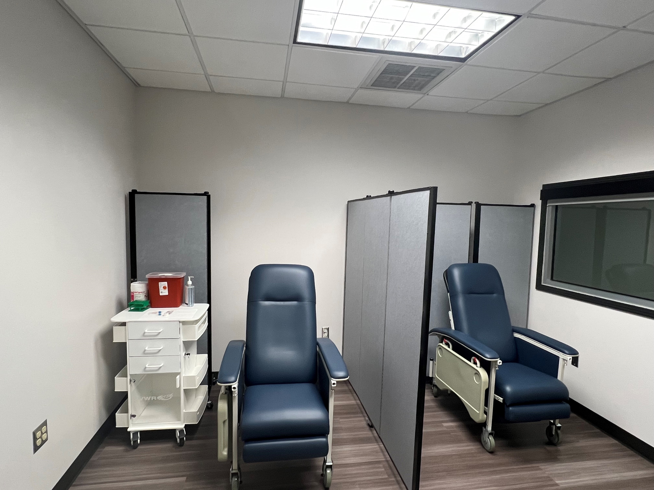
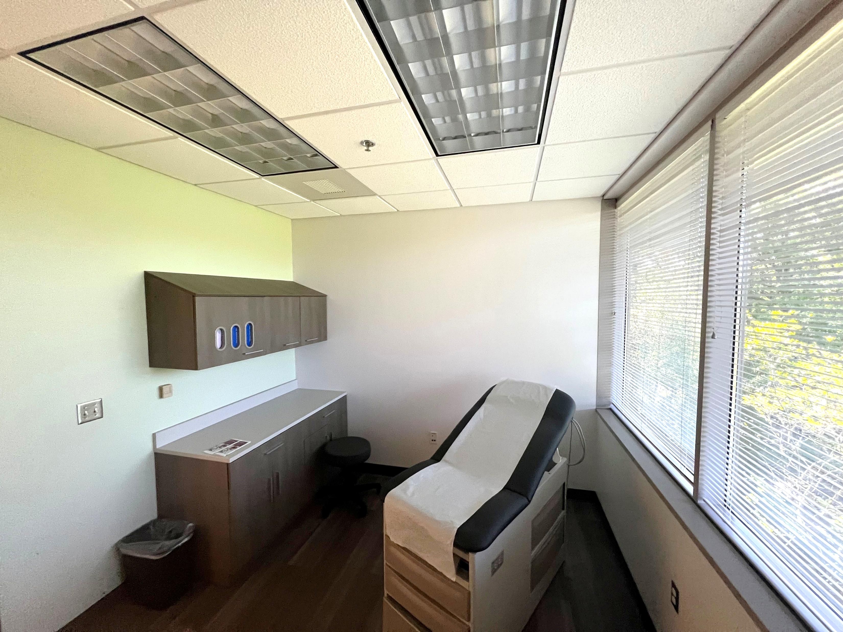
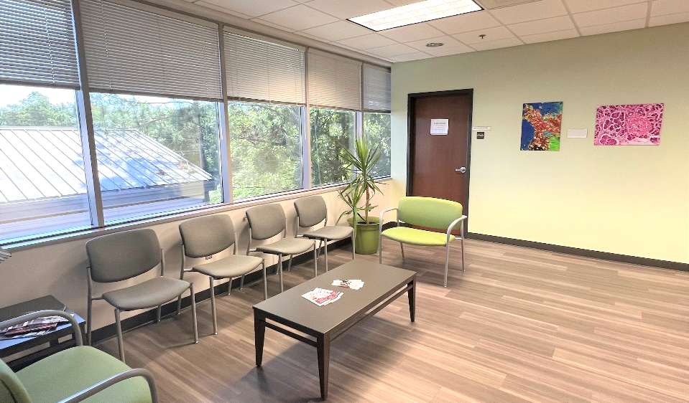
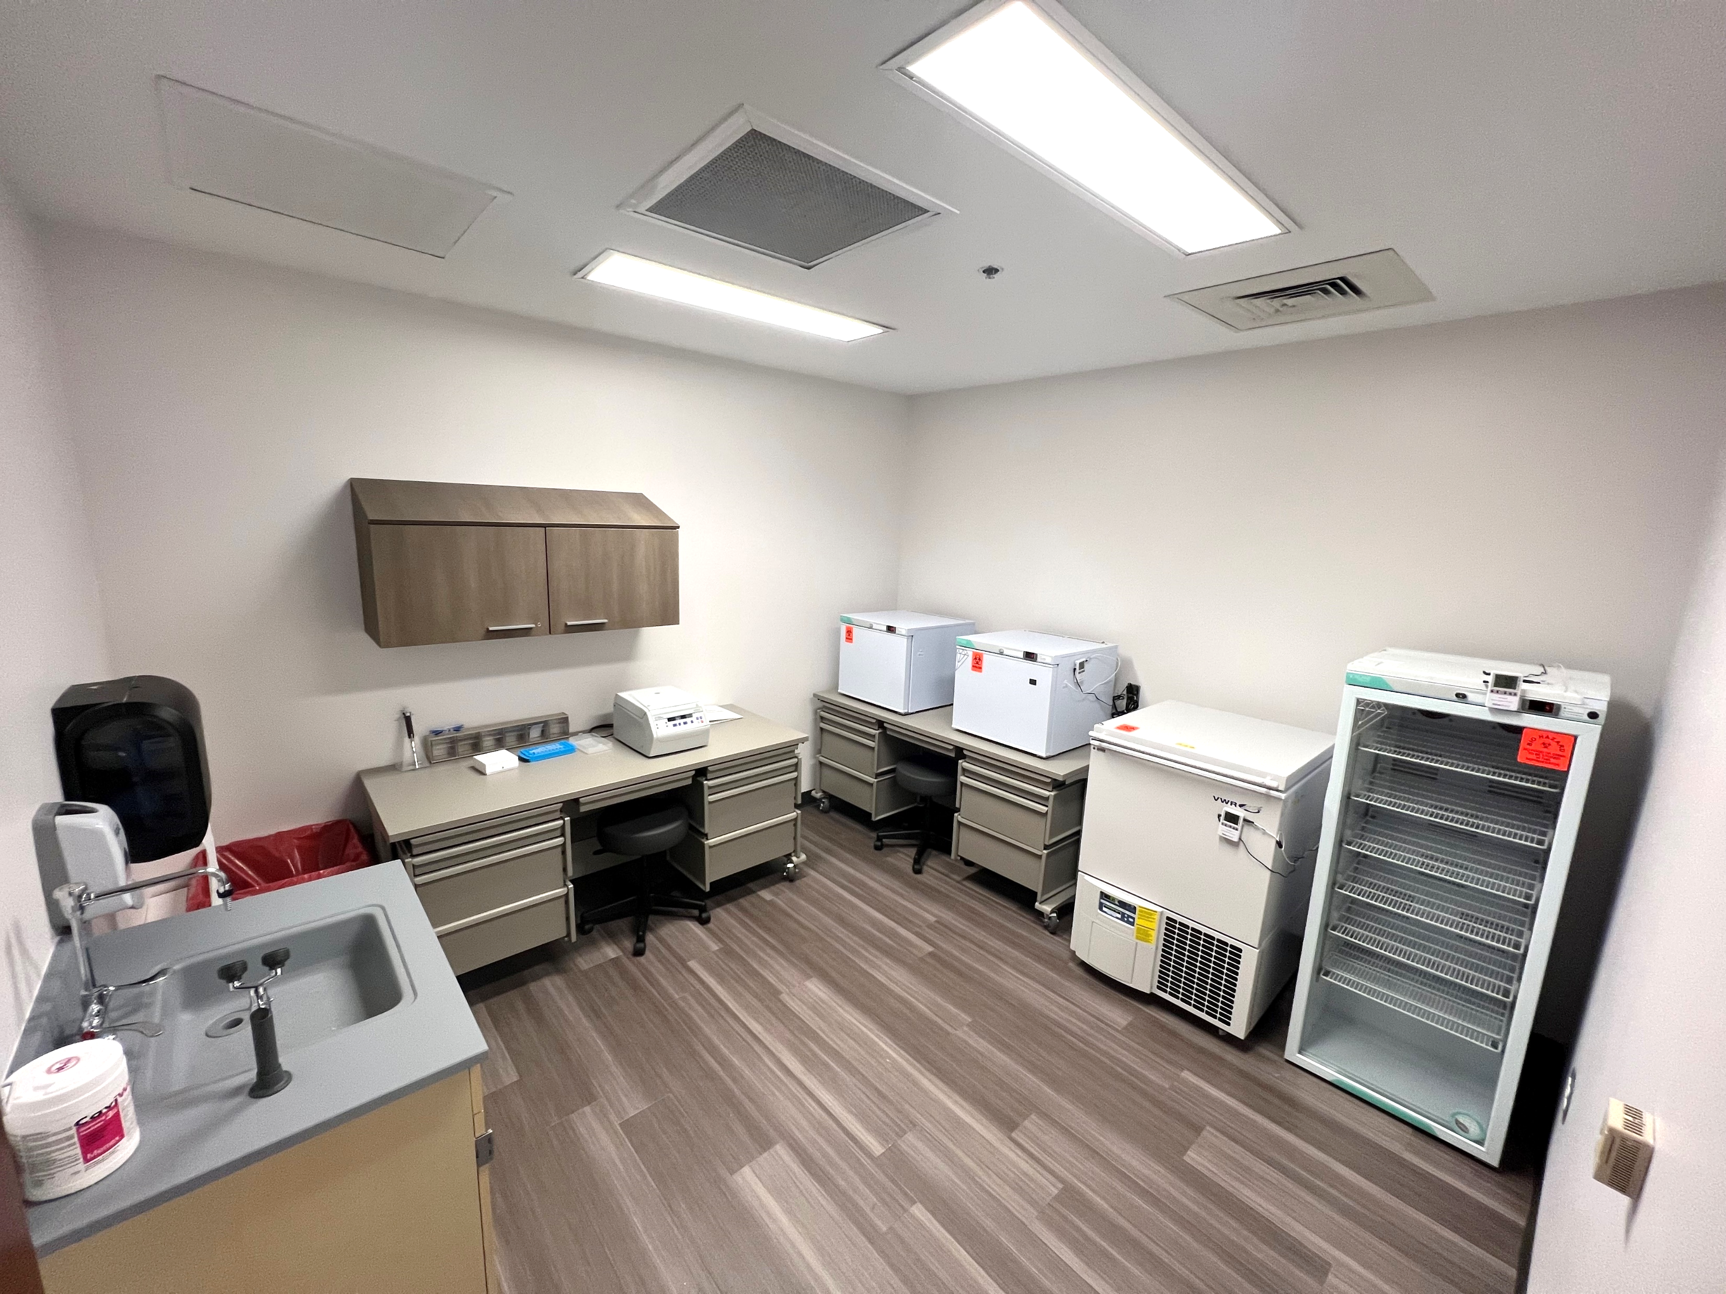
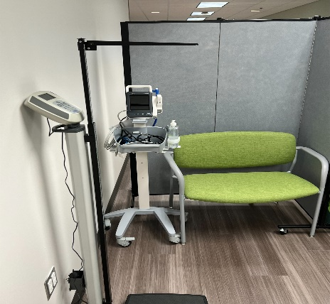
Clinical Research and Trials Unit (CRTU)
Centrally supported location for multiple services with convenient access for study participants
A 2,200 sq-ft, dedicated core facility for clinical research, including interview and procedure rooms
Phlebotomy, specimen processing and freezer storage, supply storage, and researcher workroom
Experienced clinical research staff are available onsite
Easy parking and a bus stop at our site
For tours or information, submit a request through the FSU HRC Research Request Portal.
Located in Innovation Park, Research Foundation Bldg. A
2000 Levy Ave. Tallahassee, FL 32306

Slide 60



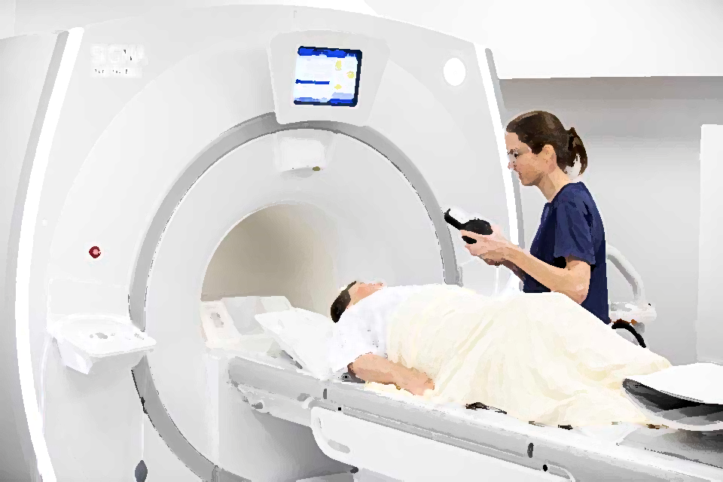

Tallahassee Memorial HealthCare
Office of Research
Clinical Research Collaboration with FSU
TMH and FSU have partnered to provide FSU researchers with collaborators at TMH and access to clinical populations
Interested? Contact the Clinical Research Hub, which works directly with the TMH Office of Research
Our offices can help with study feasibility, design, and clinical partnerships
A dedicated TMH/FSU Research Coordinator is available to assist with:
Facilitating TMH provider relationships
Submitting to the TMH IRB
Accessing TMH PHI
Regulatory compliance/documentation
Implementation of the study design
Screening, recruiting, consenting, and follow-up
Data requests for study feasibility assessments
For more information, submit a request through the FSU HRC Research Request Portal.

Slide 61
Research Training and resources for faculty and researchers

Slide 62
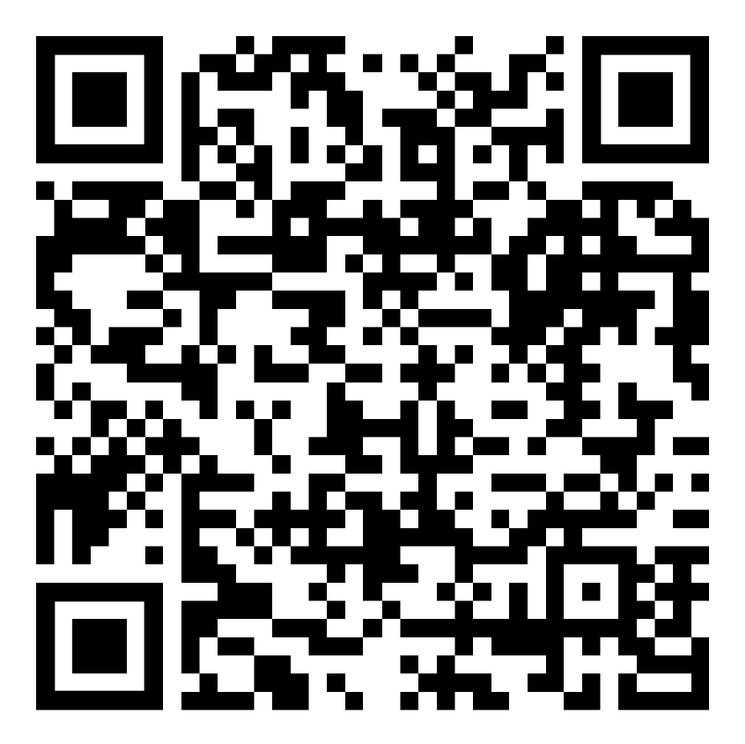
Some of the Available Resources
Research Administration Knowledge and Support Hub – an online knowledge center, training information, and online forum
Research Administration Manual (RAM) – an online research administration manual
Online training, tools, and guides:
Self-paced faculty orientation to research at FSU
Researcher Pathway
Workflow Maps
Roles & Responsibilities
Access for policies & procedures
RAMP Information
Up2Speed – Education videos on research administration topics
Information regarding the Office of Research
Research Administration topics
Information on Finding Funding
And many other topics

Slide 63
Faculty-Centered Resources
Researchers New to FSU – Online orientation on conducting research at FSU
Research Development Resources
High-Performance Computing Resources
Human Subjects Research
Office of Clinical Research Advancement
And many other information and resources...
https://hub.research.fsu.edu/learning-center/faculty-and-researcher-resources

Slide 64
Other Research-Related Entities on Campus

Slide 65
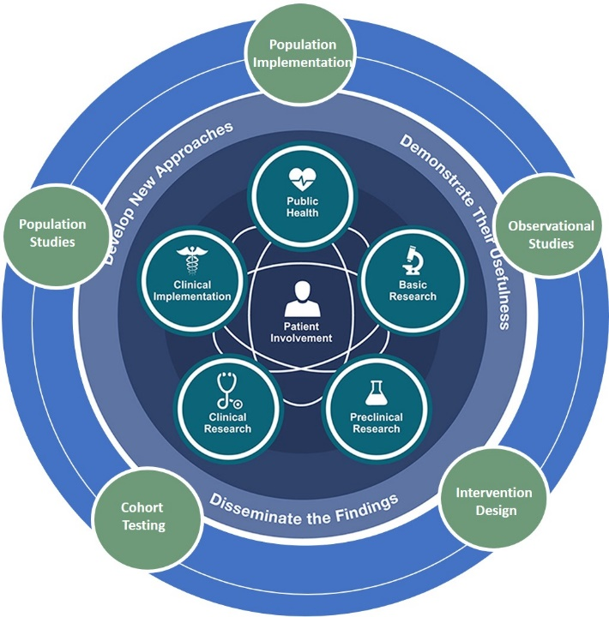

The Biostatistics, Informatics, and Research Design (BIRD) Program is your resource for research design support and consulting services from health data experts.
The BIRD Program provides a central location to access support services related to human health data science, informatics, and clinical and translational research design including:
Clinical and translational research design
Biomedical informatics database access (e.g., OneFlorida Data Trust, i2b2)
Informatics and data science support
Quantitative data analysis
Qualitative data analysis
Access to support services for health data collection
Supported in part by the UF-FSU Clinical and Translational Science Award (CTSA)
NEED ASSISTANCE?
CONTACT OUR TEAM!
FSU CTSA Service Request Form
We Make Your Data Soar!
First consultation is free! Let us help you design your studies and develop your grant applications!
For More Information: https://ctsa.research.fsu.edu/resources/bird/

Slide 66
K2R Scholars Program at FSU
Develop a community of K2R Scholars and mentors
Establish mentoring teams
Support initial K applications to NIH
Virtual and in-person workshops and boot camps
Initiate competitive NIH-funded KL2 Scholars (2) and internally funded K2R Scholars (1)
Provide ongoing professional development
Training courses (in-person and virtual)
Listserv and website: https://ctsa.research.fsu.edu/services/k2rprogram/
Notes:
Canvas Site:
Currently available contents
OneFlorida publications
i2b2 query examples
BIRD training materials
Recordings of previous workshops
Publicly available health datasets

Slide 67
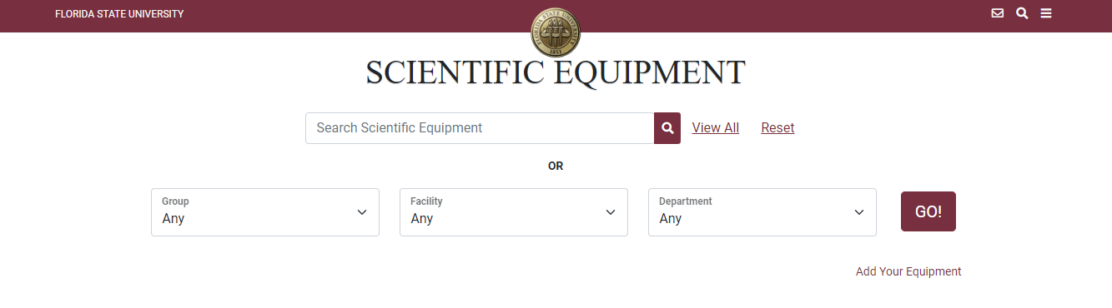
Shared Scientific Equipment Portal
https://apps.its.fsu.edu/AssetManagement/
Contact: Thayumanasamy Somasundamam “Soma”
soma@sb.fsu.edu

Slide 68
Environmental Health and Safety
Biological Safety, Chemical Safety, Lab Safety, Environmental issues /training
644-6895
ehs@admin.fsu.edu
FSU Libraries
Digital Research & Scholarship
Academic Publishing
Research Data Management
Digital Humanities
https://www.lib.fsu.edu/drs

Slide 69
Questions? ? ?
Notes:
Done

Slide 70
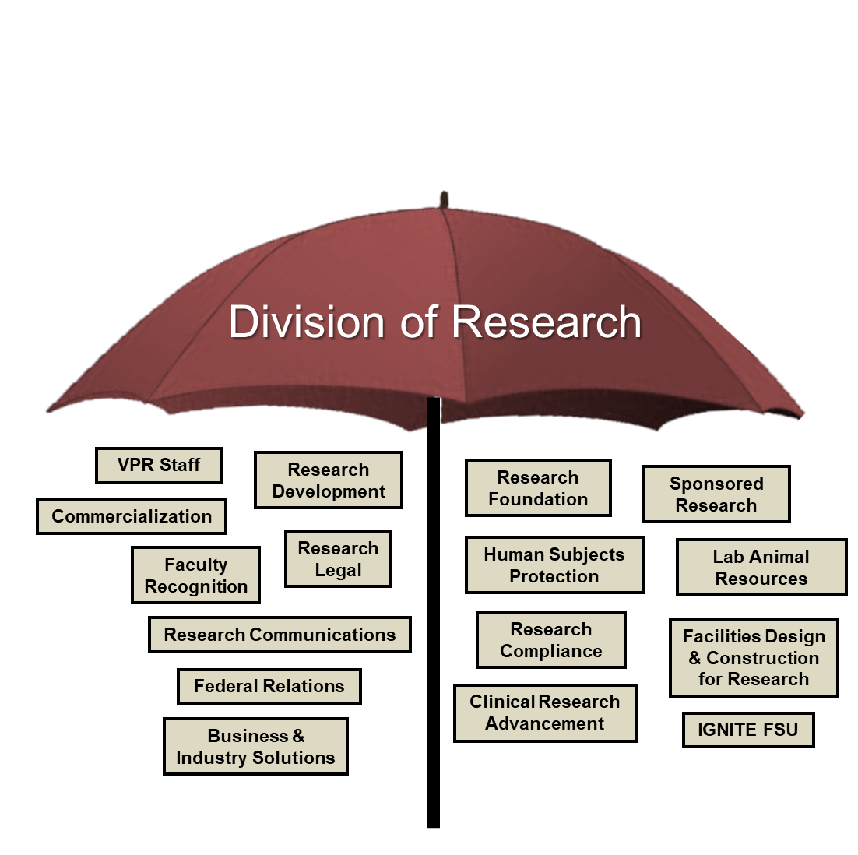
Research Units & Activities
Research Development
Faculty Recognition
Human Subjects Protection
Facilities Design and Construction for Research
Federal Relations
Health Research Connections
Notes:
So let's start with my area which is research development,

