Slide 1


Council on Research + Creativity
FYAP
WORKSHOP
September 12, 2025

Slide 2

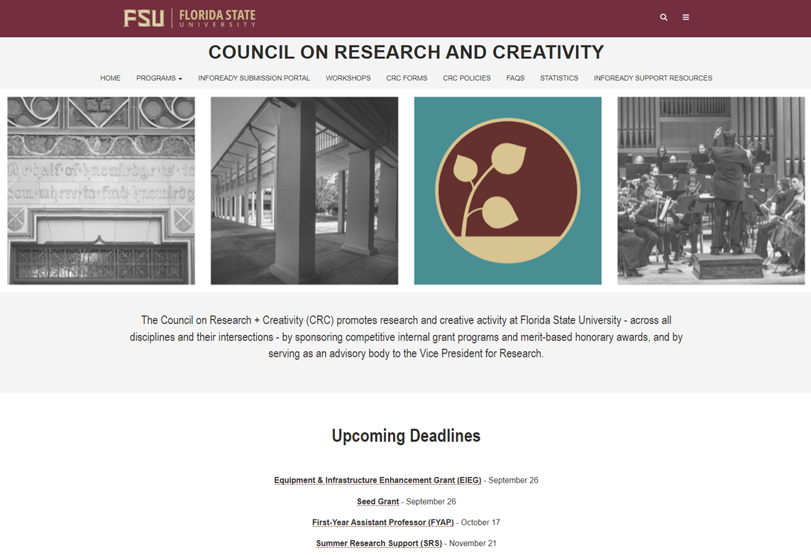
Website and
Submission
Portal
https://internalfunding.research.fsu.edu/

Slide 3
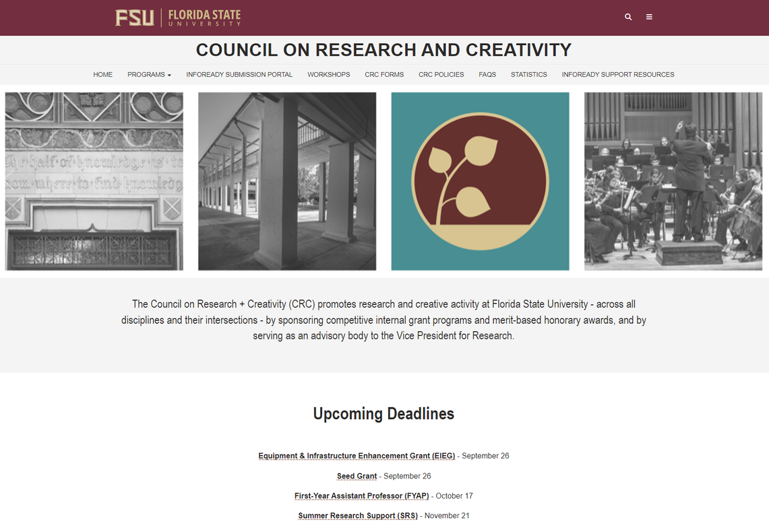
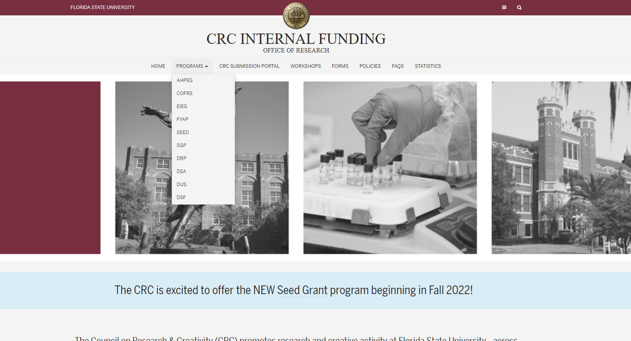


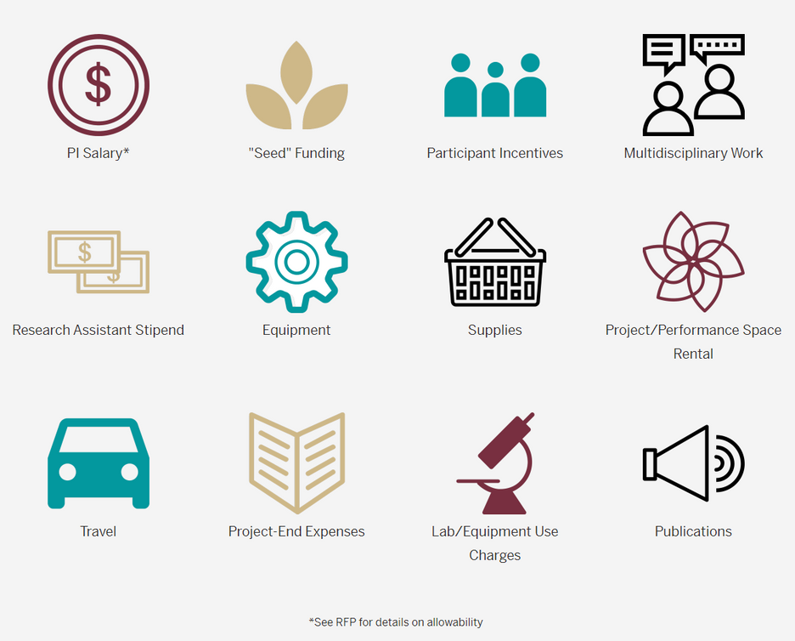

Locating Programs
  Top menu drop-down
  Funding Guide icons

Slide 4
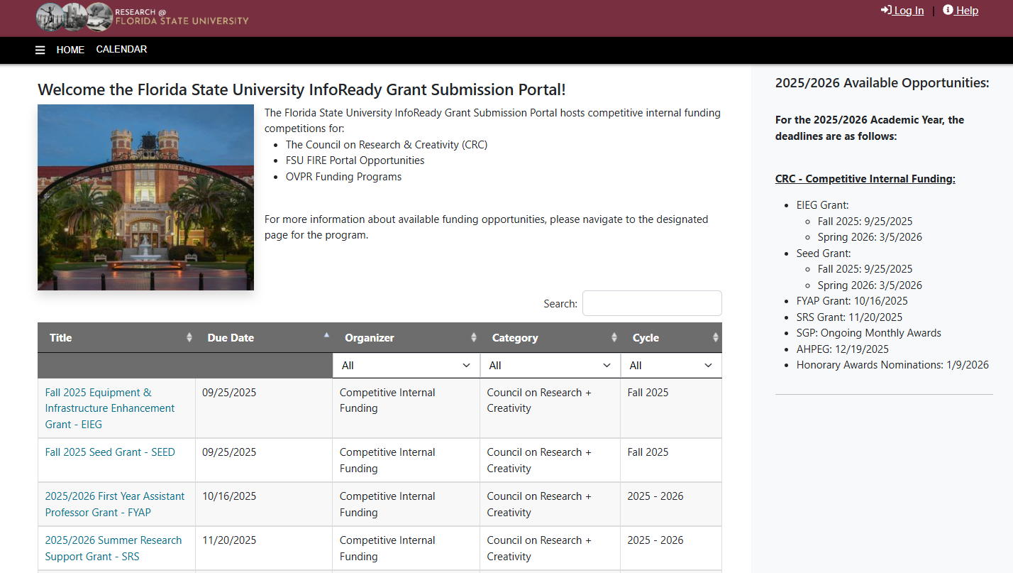
InfoReady Submission Platform
  Apply for CRC Grants and Honorary Nominations
  Review your applications
  Access Progress Reports
https://fsu.infoready4.com/

Slide 5
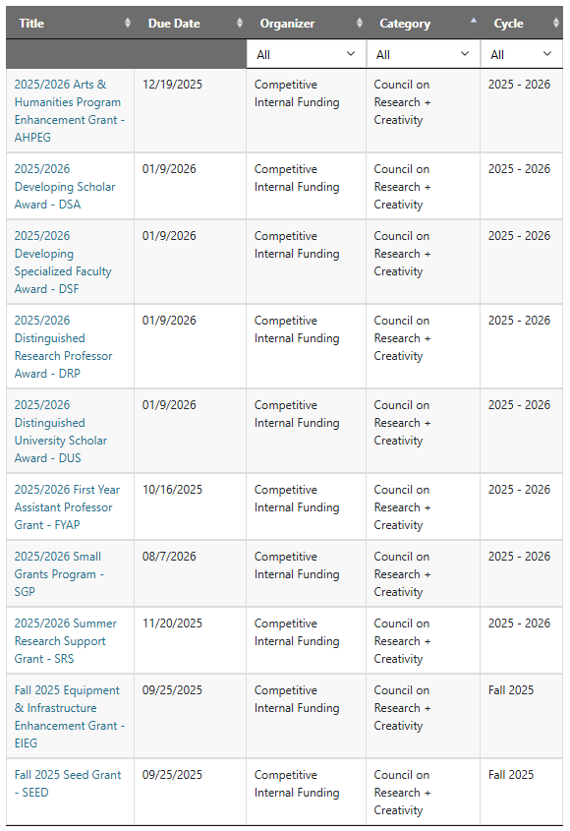
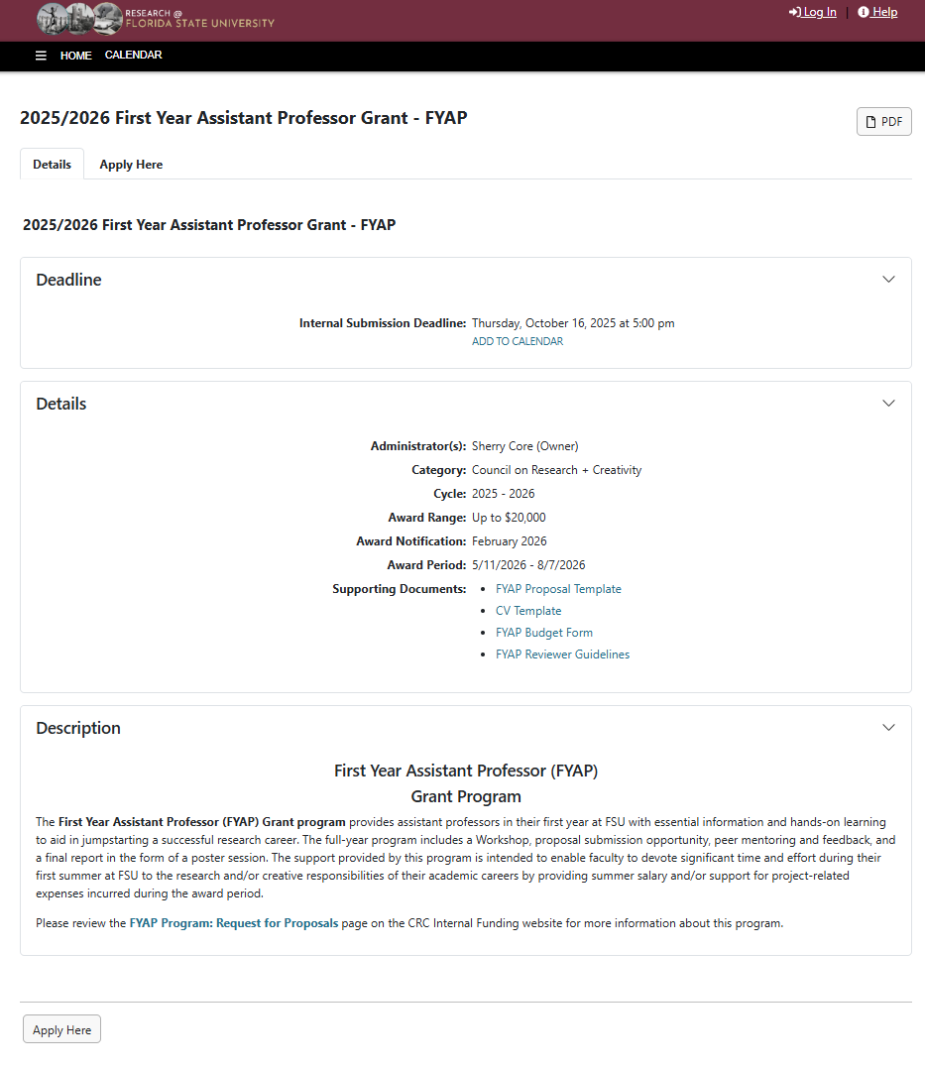

Getting Started
  Click on the link for the FYAP Grant
  On the information page, click to “Apply Here”.

Slide 6
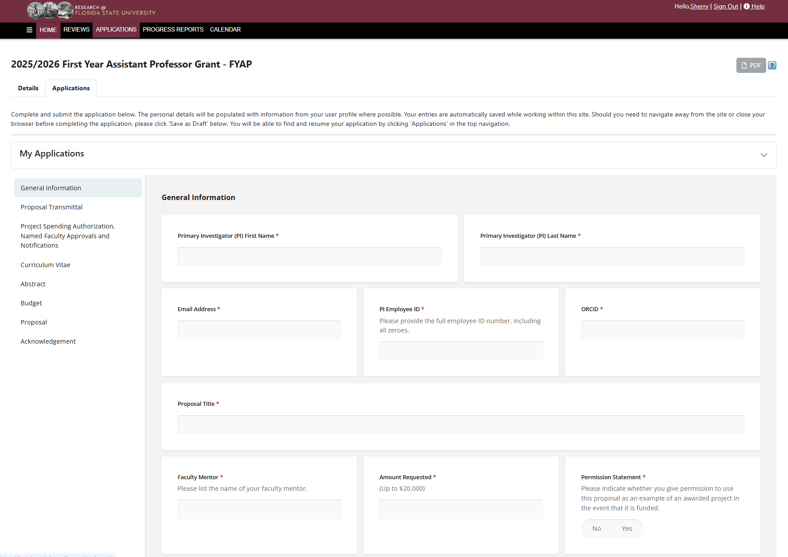
The Application
  General Information about you, the title of your proposal, the amount requested, and any nonfaculty support that you expect to fund with the grant (i.e. Grad/Undergrad students and Post-Docs).

Slide 7
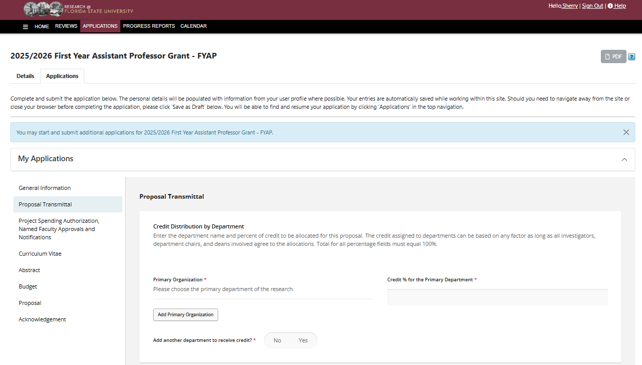
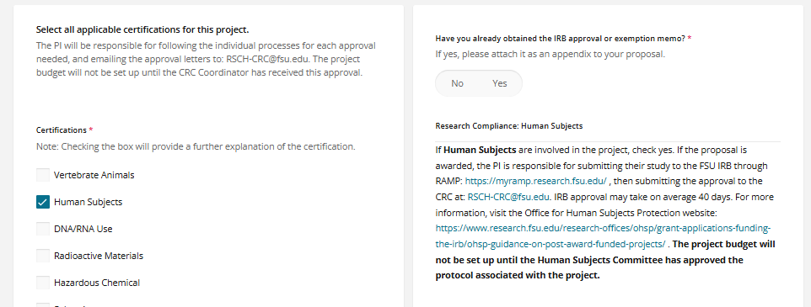

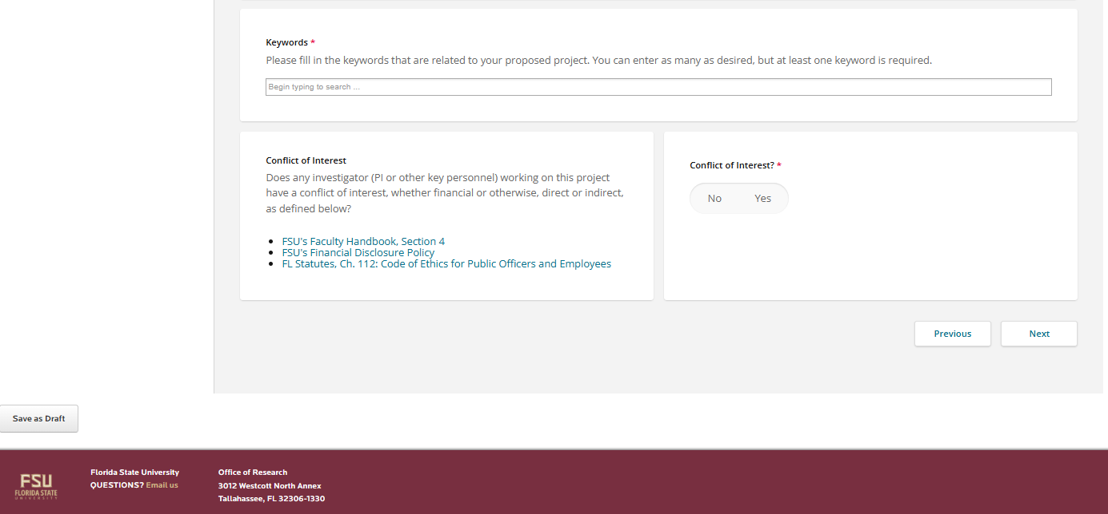
Proposal Transmittal
  Choose your “Primary Organization”, which is your Primary Department.
  If the research will be completed entirely in your primary department, the “Credit Distribution” will be 100%.
  Select any “Certifications” (if needed).
  Enter at least one “Keyword” to describe your research.

Slide 8
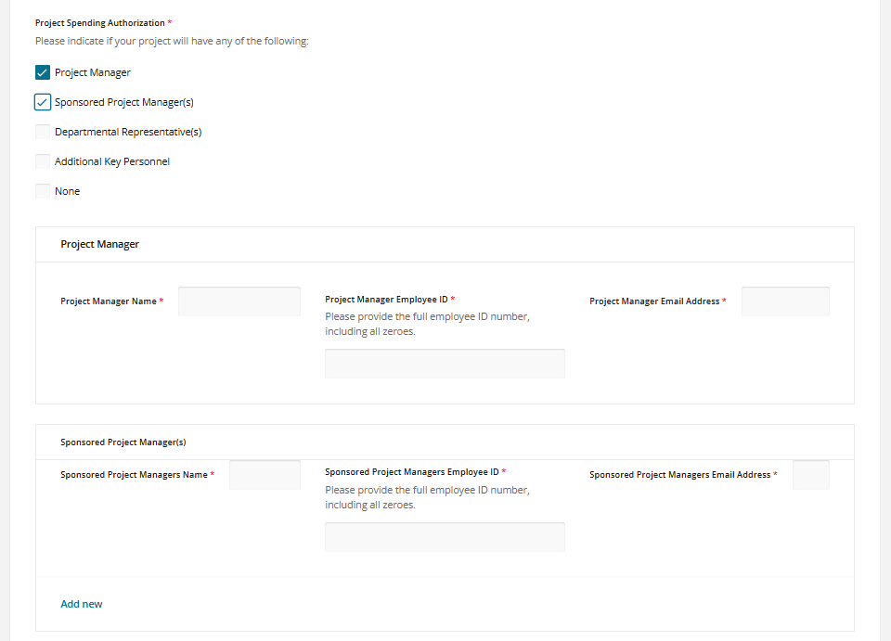
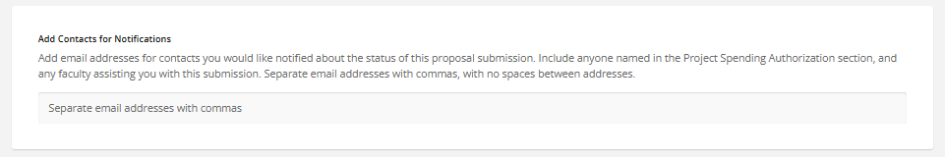
Project Spending Authorization, Named Faculty Approvals, and Notifications
  List the members of your department grant team (if needed)
  Add the email addresses for anyone in your department who you would like to receive notifications about your proposal as it progresses through the process.

Slide 9
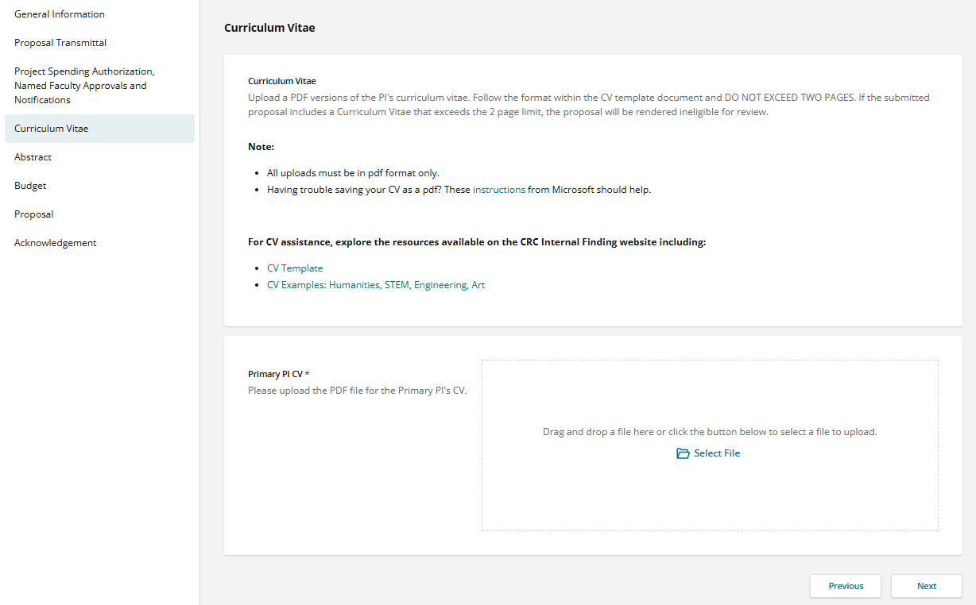
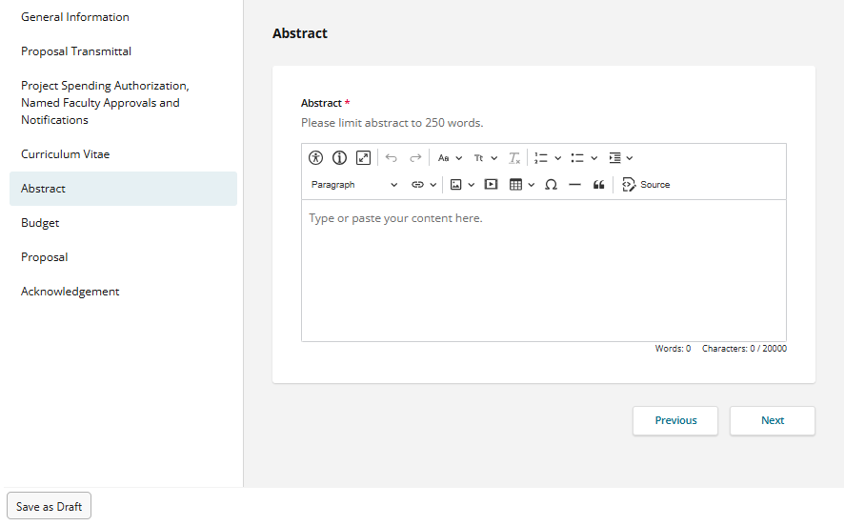
Curriculum Vitae
Abstract
There is a CV template and a 2-page limit.
Make sure to occasionally click the “Save as Draft” button, or any changes you make to the application will not be saved.

Slide 10
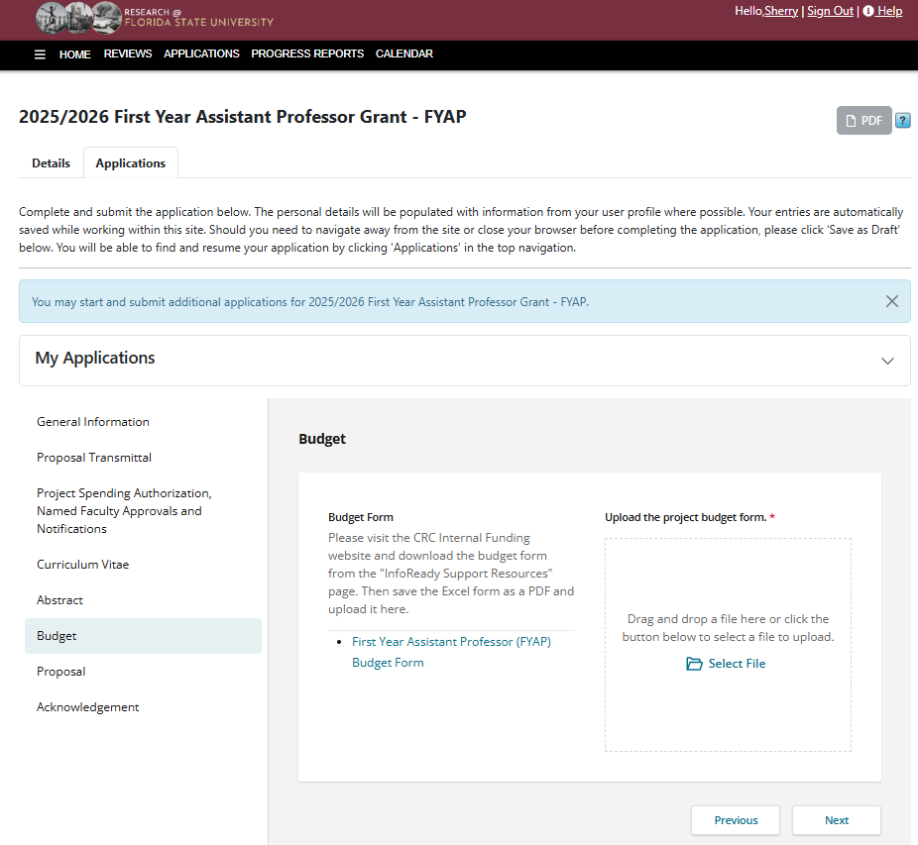
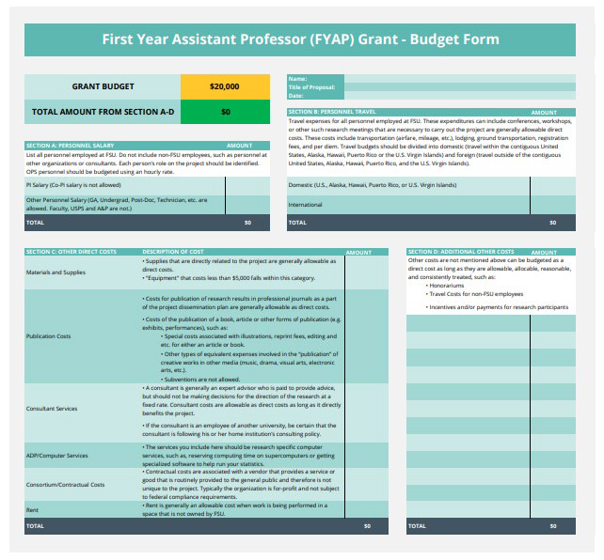
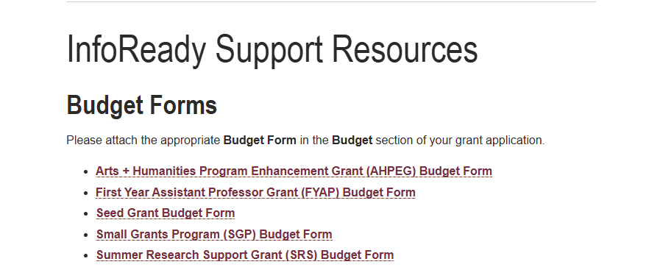
Budget
  Click the link for the First Year Assistant Professor Budget Form. It will take you to the CRC website.
  Download the FYAP Budget Form, fill it out, and attach it as a PDF to the application.

Slide 11
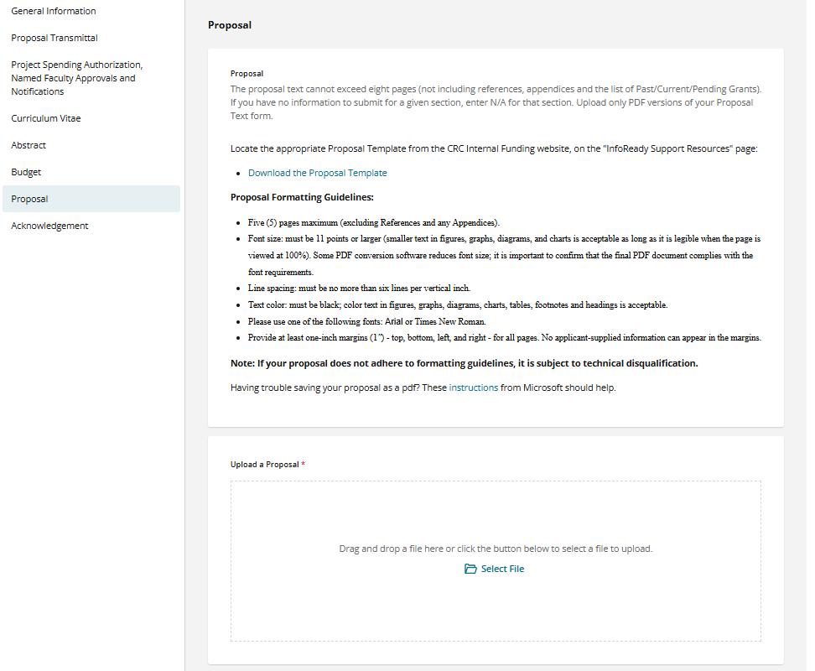
Proposal
  Download the FYAP Grant Proposal Template from the CRC website.
  Read the formatting instructions, and limit the proposal to 5 pages.
  After that is a quick Acknowledgement statement, then “Preview” and “Submit” your application.

Slide 12
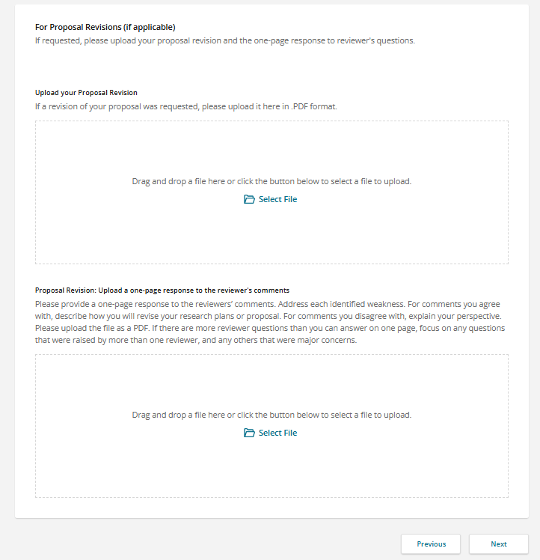
Proposal Revision
  If proposal revision is requested, your application will be returned, and you can upload the revision in the space provided below the original proposal.
  You will also need to provide a 1-page response to reviewer’s comments.

Slide 13
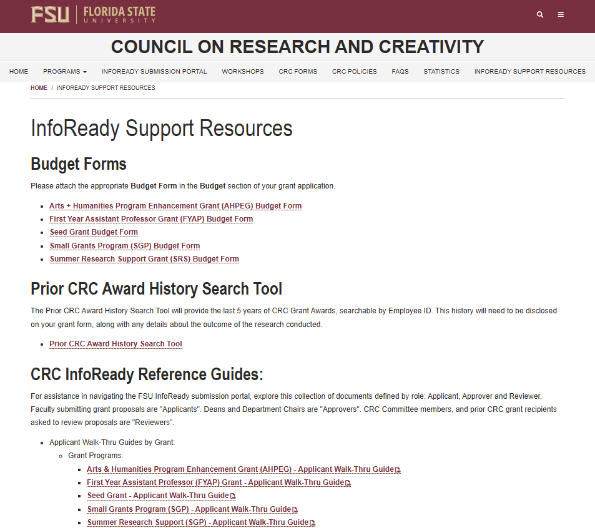
Resources
  There are lots of resources available to you on the CRC website!
  For any assistance with the application process, review the “InfoReady Support Resources” tab.
  There you will find:
    Budget Forms
    A Prior CRC Award History Search Tool (where you can search your last 5 years of CRC award history)
    CRC InfoReady Reference Guides (a walk-through guide for every grant and honorary award form).
    A walk-thru on how to designate a proxy.
    CV and Proposal Help Documents.
    Reviewer Guidelines for every grant and honorary award.
    A walk-thru guide on how to create an ORCiD.
Email: RSCH-CRC@fsu.edu

Slide 14
Competitive Grants
CRC Internal Funding Programs
    Arts & Humanities Program Enhancement Grant (AHPEG)
    Supports the creation, production, and dissemination of arts + humanities research.
    Award: Up to $20,000
    Deadline to apply: 12/19/2025
    Summer Research Support (SRS) Grant
    Provides faculty with summer salary for research.
    Award: Up to $20,000
    Deadline to apply: 11/20/2025
    Equipment & Infrastructure Enhancement
    Grant (EIEG)
    Seed Grant
    Provides funding for a new direction or continuing early support of existing research or creative activity, with the expectation that this will lead to external funding.
    Award: Averages $50,000 per award
    Deadline to apply: Fall: 9/25/2025, Spring: 3/5/2026
    Provides funding for new interdisciplinary equipment or infrastructure
    enhancements.
    Award: Averages $40,000 per award
    Deadline to apply: Fall: 9/25/2025, Spring: 3/5/2026
    First Year Assistant Professor (FYAP) Grant
  Small Grants Program (SGP)
    Provides Assistant Professors in their first year at FSU with summer research
    funding.
    Award: Up to $20,000
    Deadline to apply: 10/16/2025
    Provides funding for the completion of a project.
    Award: Up to $5,000
    Deadline to apply: Ongoing monthly awards

Slide 15
Honorary Awards
CRC Internal Funding Programs
    Developing Scholar Award (DSA)
    Recognizes outstanding research and/or creative activity of eligible FSU Associate Professors.
    Award: One-time award of $10,000
    Deadline to apply: 1/9/2026
    Distinguished Research Professor (DRP)
    Recognizes outstanding research and/or creative activity of eligible FSU Full Professors.
    Award: One-time award of $10,000
    Deadline to apply: 1/9/2026
    Distinguished University Scholar (DUS)
    Recognizes outstanding research and/or creative activity of eligible FSU faculty (see eligibility list on website)
    Award: One-time award of $10,000
    Deadline to apply: 1/9/2026
    Distinguished University Scholar (DUS)
    Recognizes outstanding research and/or creative activity of eligible FSU faculty (see eligibility list on website)
    Award: One-time award of $10,000
    Deadline to apply: 1/9/2026

Slide 16
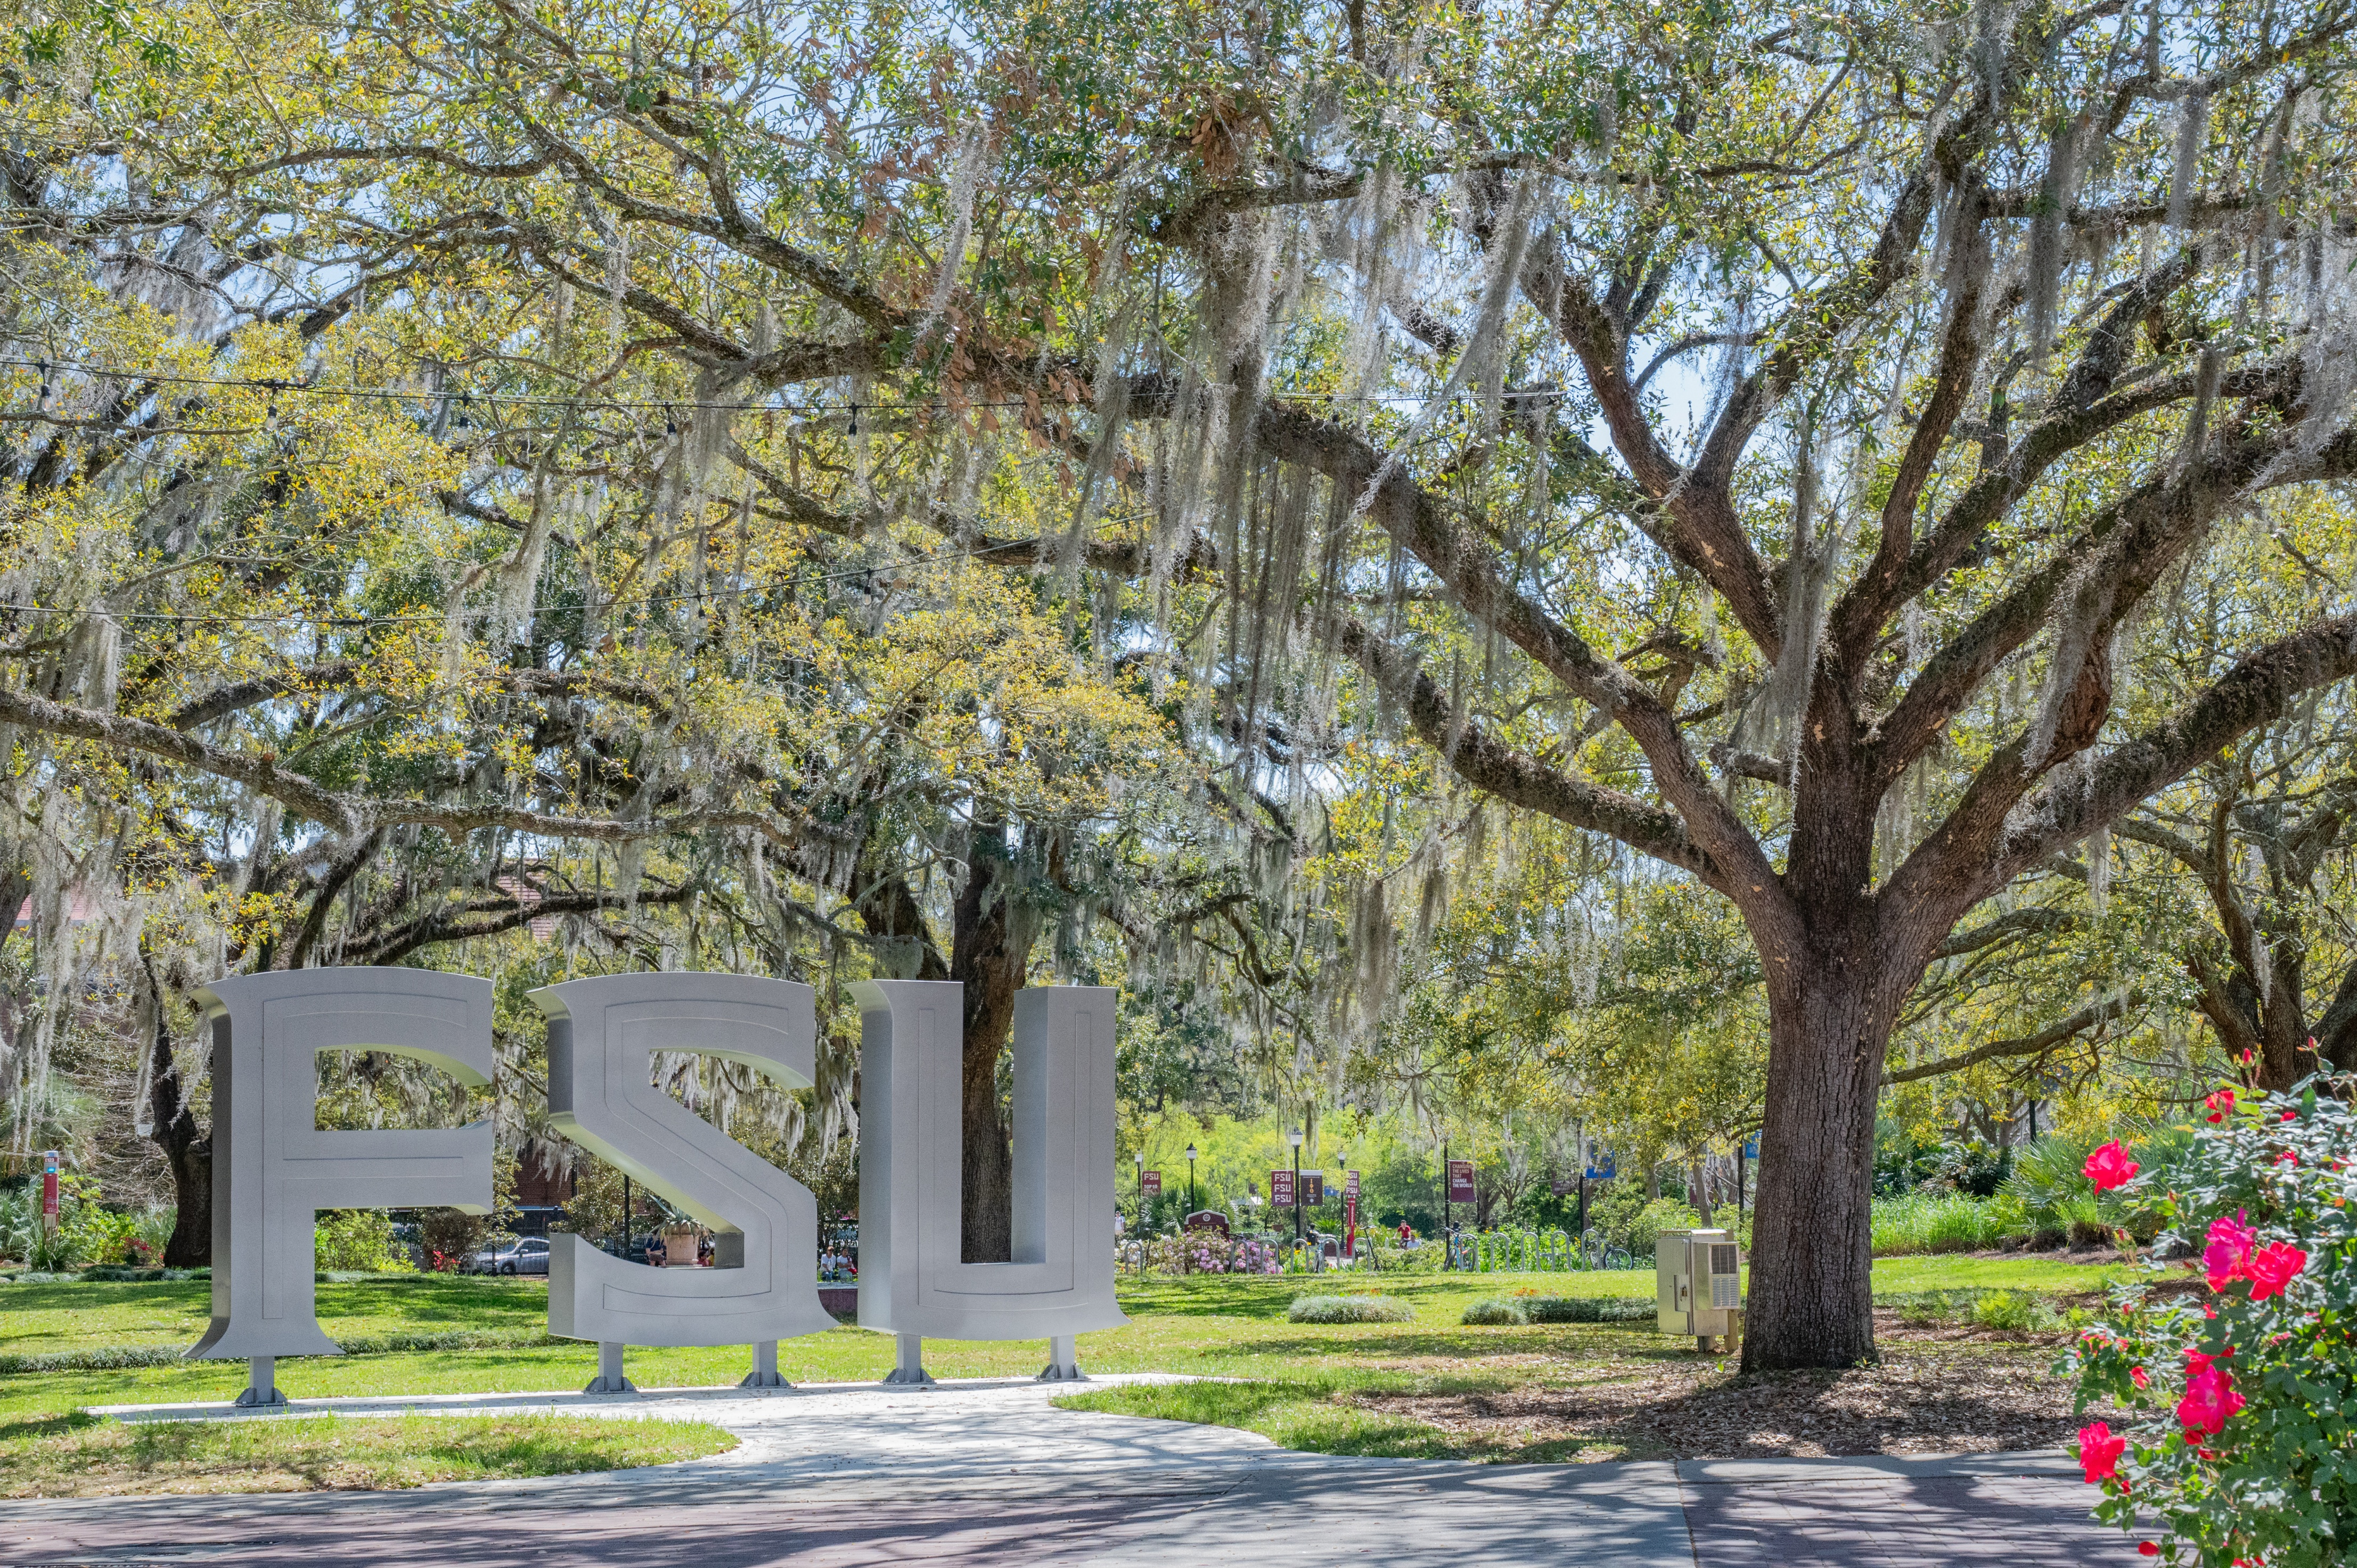
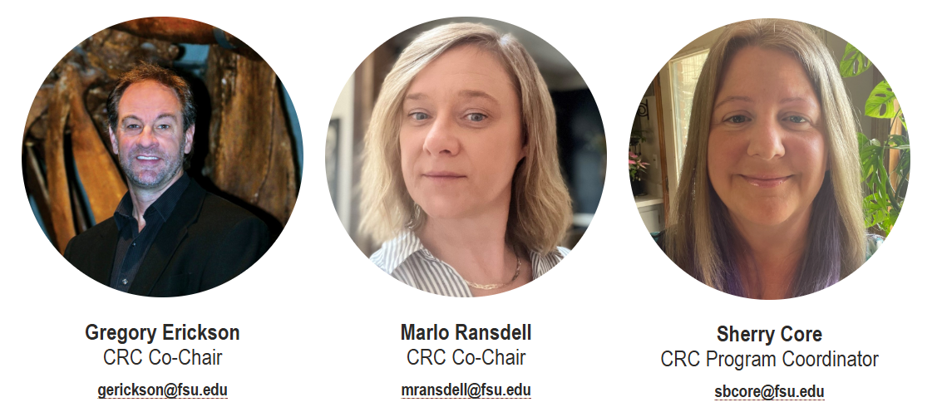
Contact Us!
Contact Us!

