Slide 1


Council on Research + Creativity
FYAP WORKSHOP
September 20, 2024

Slide 2

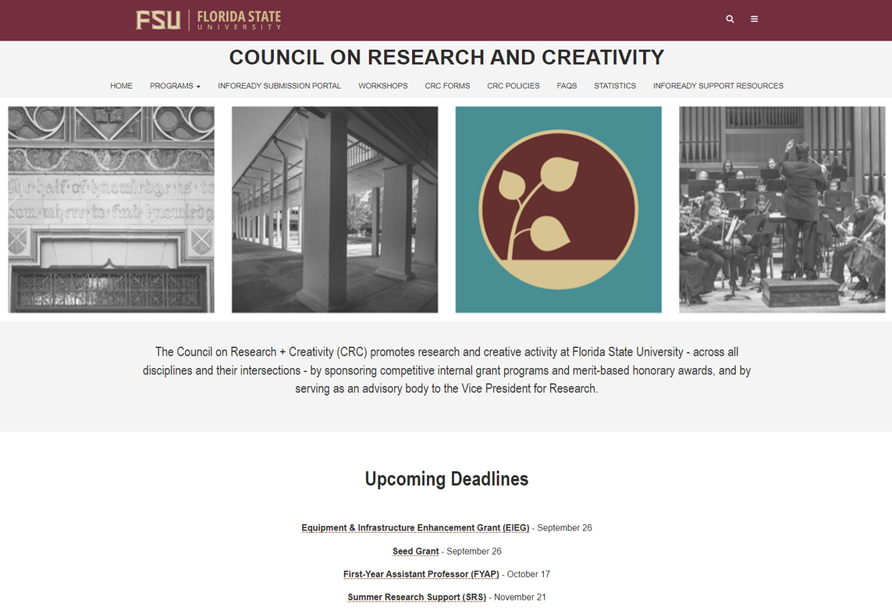
Website and
Submission
Portal
https://internalfunding.research.fsu.edu/

Slide 3
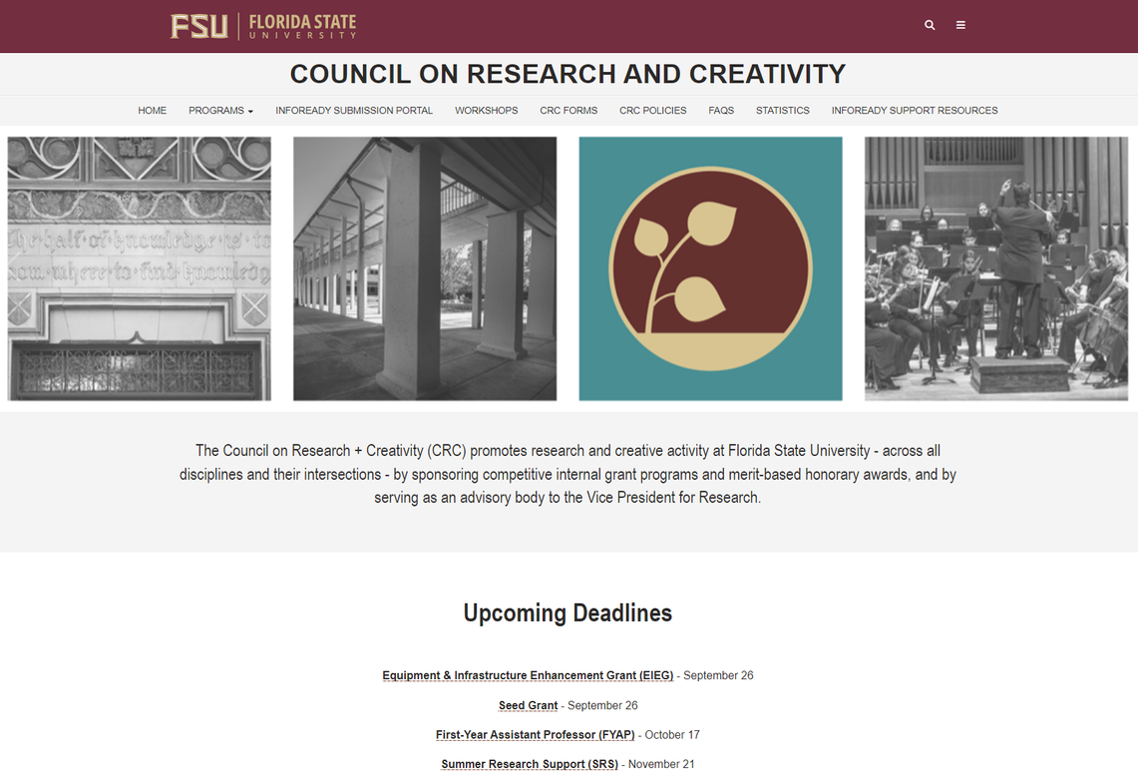
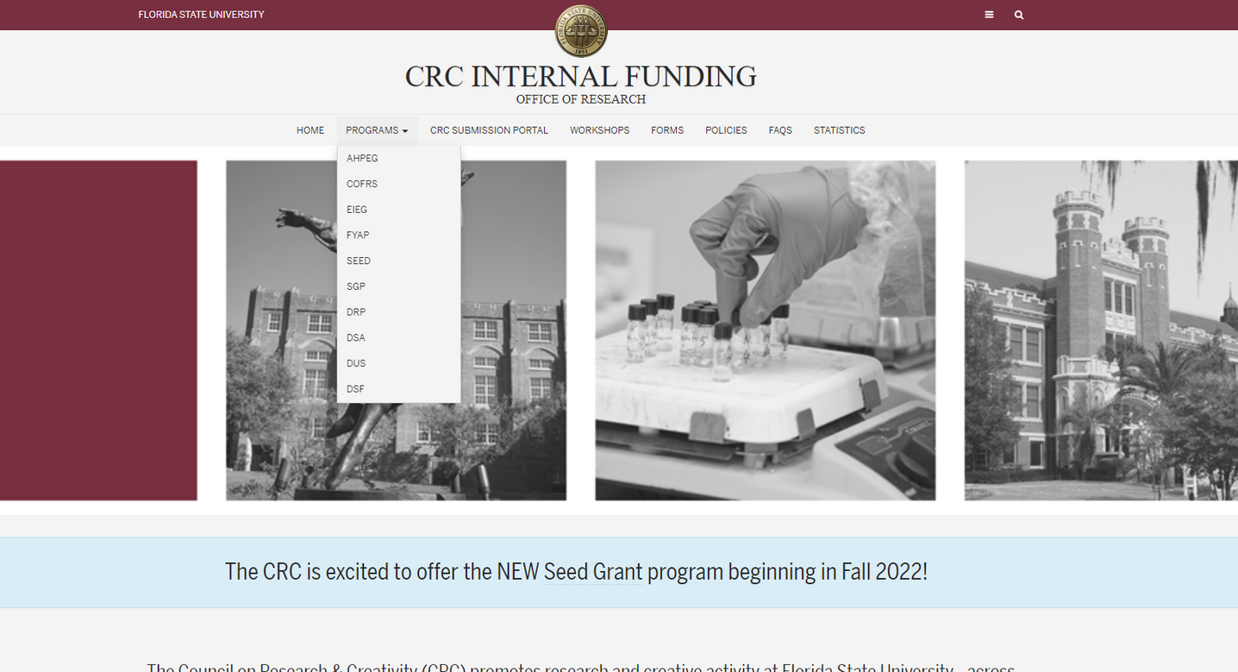


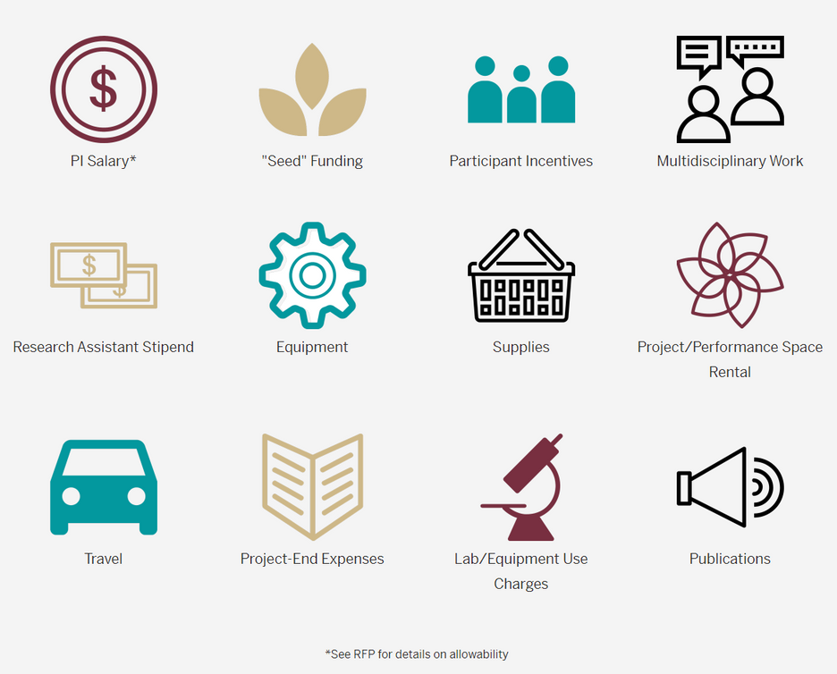

Locating Programs
  Top menu drop-down
  Funding Guide icons

Slide 4
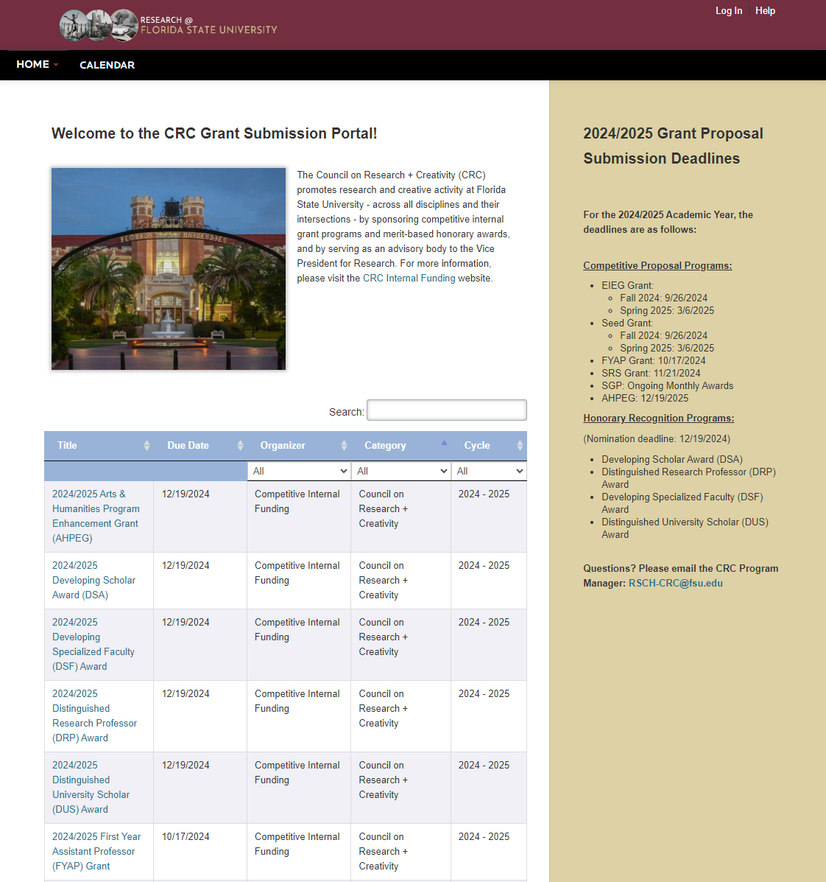
New InfoReady Submission Platform!
  Apply for CRC Grants and Honorary Nominations
  Review your applications
  Access Progress Reports
https://fsu.infoready4.com/

Slide 5
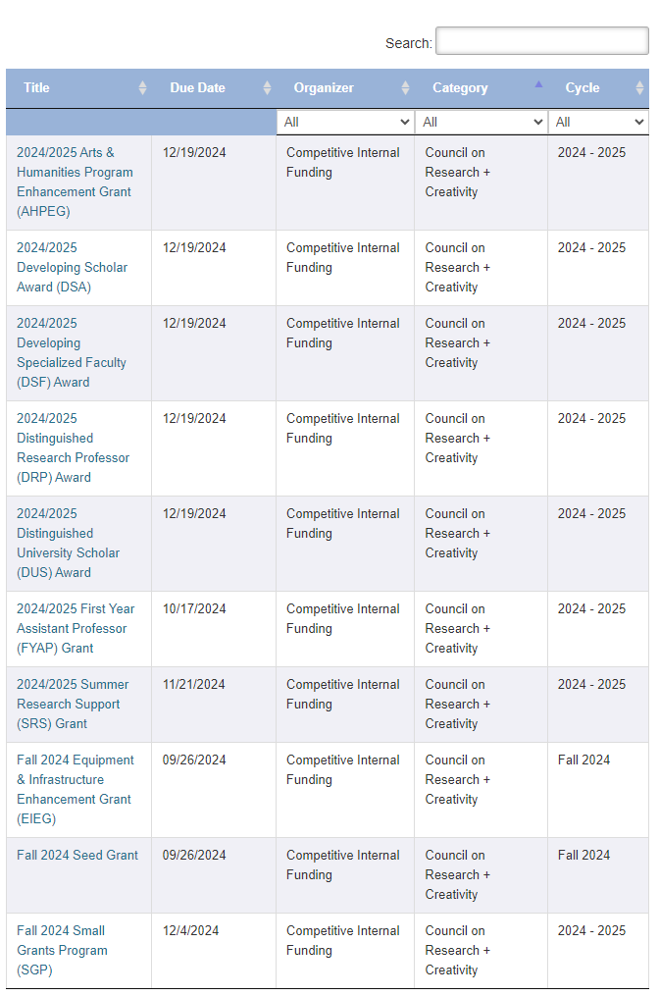
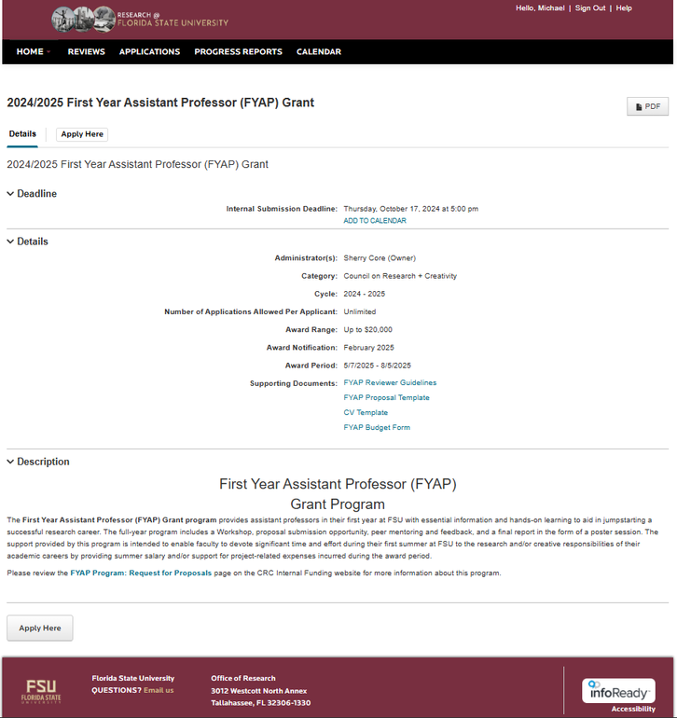

Getting Started
  Click on the link for the FYAP Grant
  On the information page, click to “Apply Here”.

Slide 6
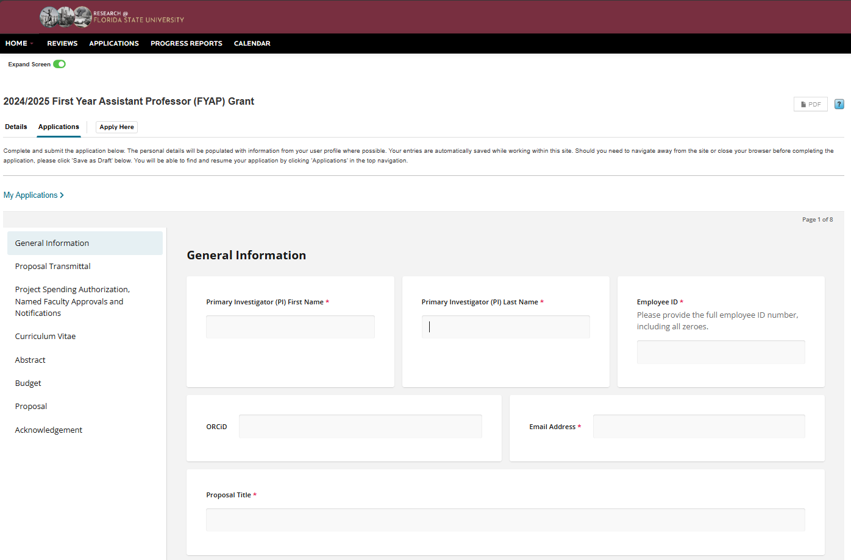
The Application
  General Information about you, the title of your proposal, the amount requested, and any nonfaculty support that you expect to fund with the grant (i.e. Grad/Undergrad students and Post-Docs).

Slide 7
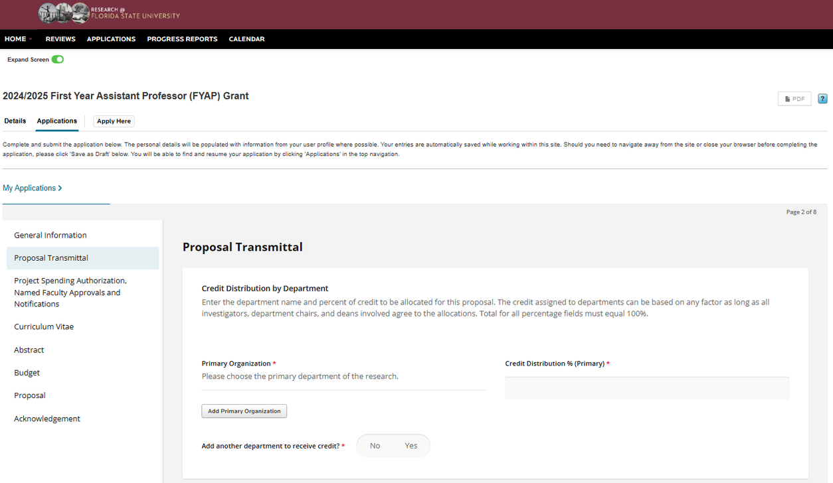
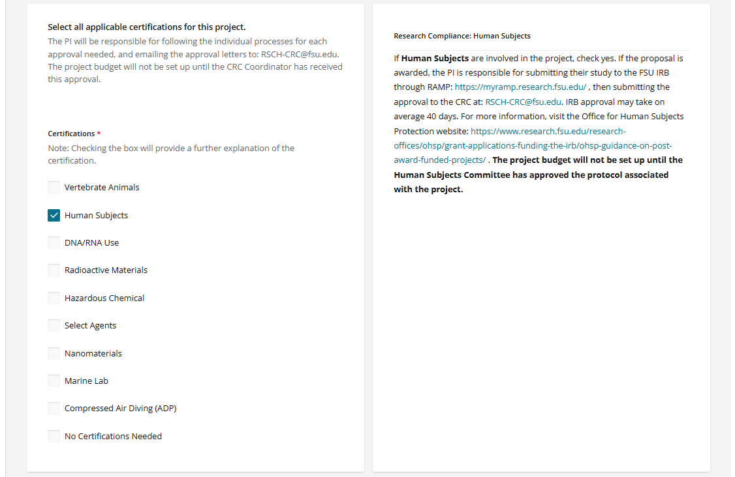

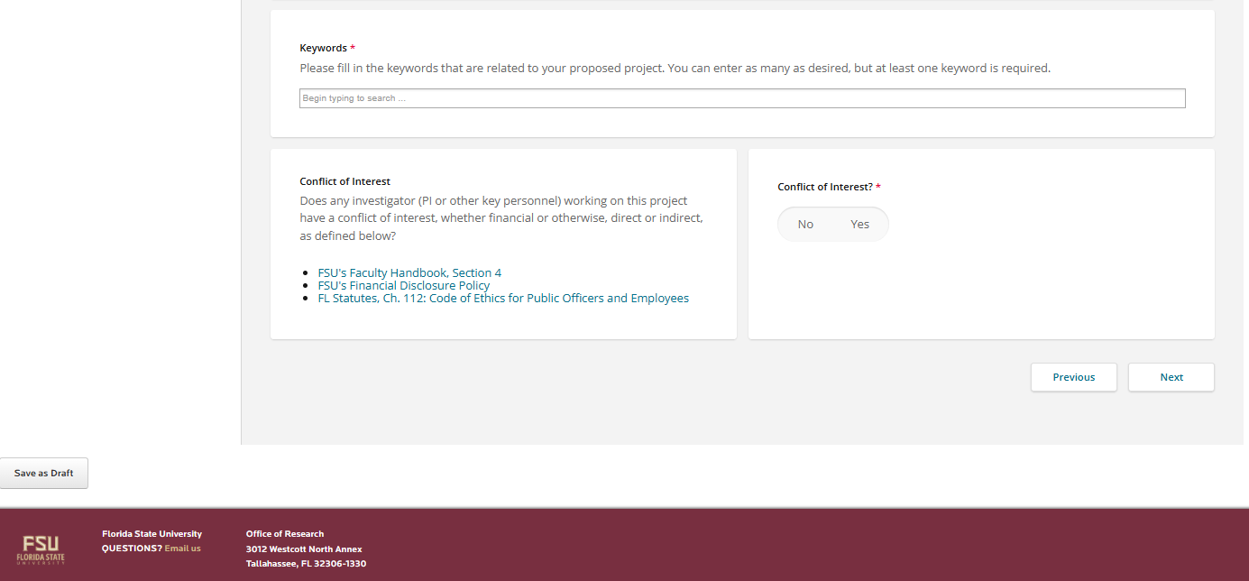
Proposal Transmittal
  Choose your “Primary Organization”, which is your Primary Department.
  If the research will be completed entirely in your primary department, the “Credit Distribution” will be 100%.
  Select any “Certifications” (if needed).
  Enter at least one “Keyword” to describe your research.

Slide 8
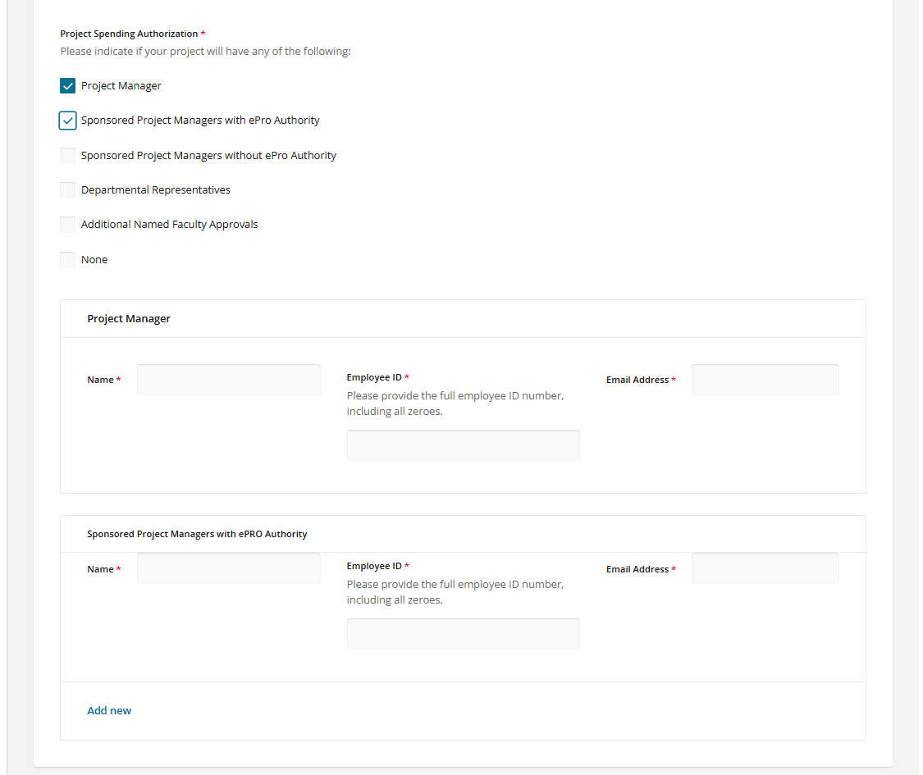
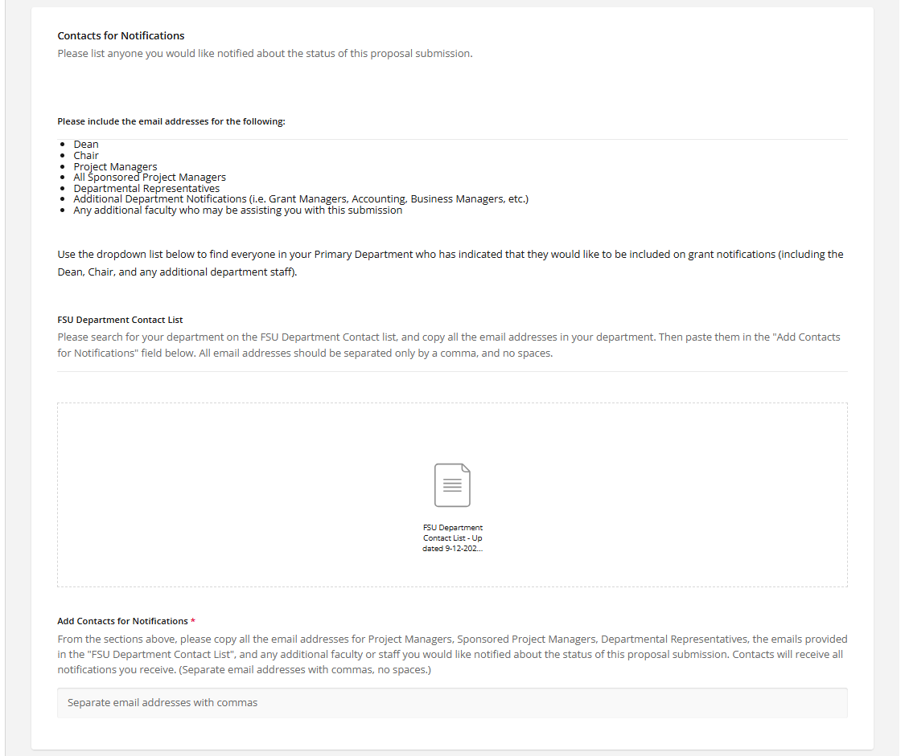
Project Spending Authorization, Named Faculty Approvals, and Notifications
  List the members of your department grant team (if needed)
  Add the email addresses for anyone in your department who you would like to receive notifications about your proposal as it progresses through the approval and review process.

Slide 9
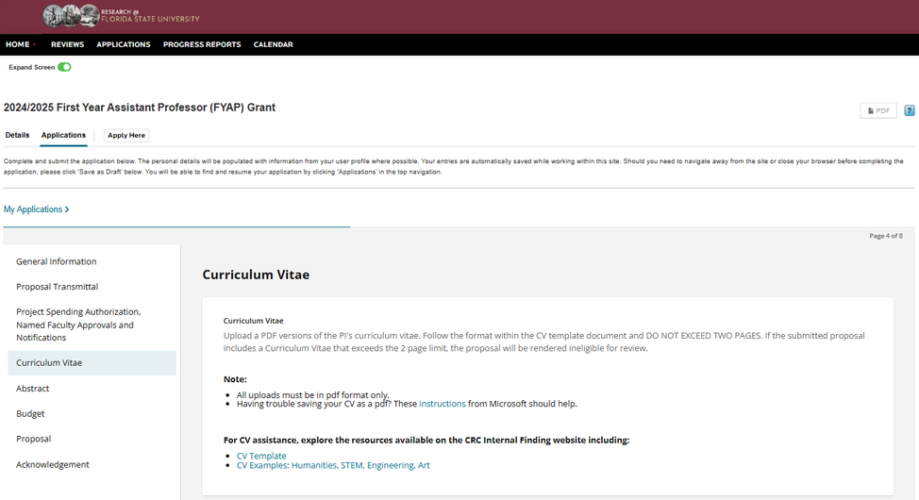
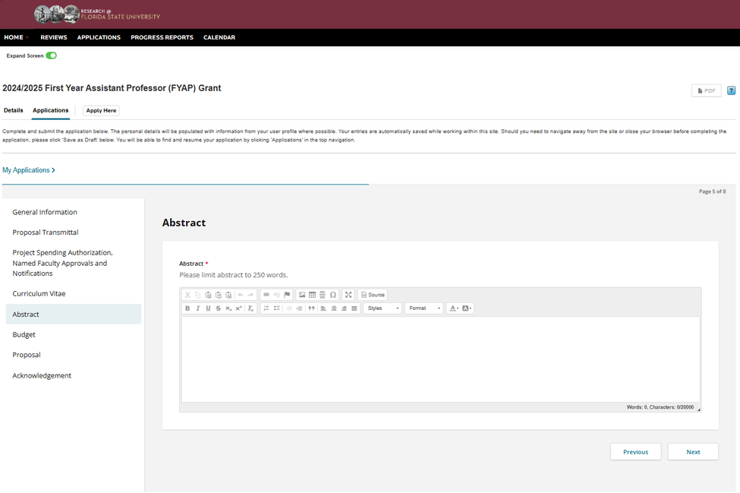
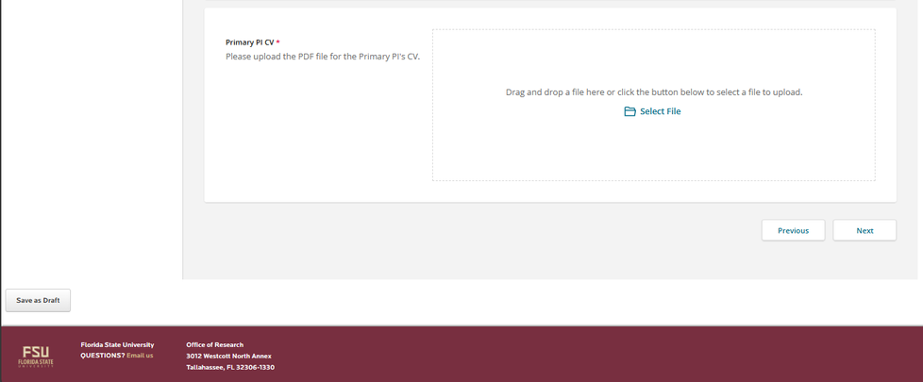

Curriculum Vitae
Abstract
Make sure to occasionally click the “Save as Draft” button, or any changes you make to the application will not be saved.
There is a CV template and a 2 page limit.

Slide 10
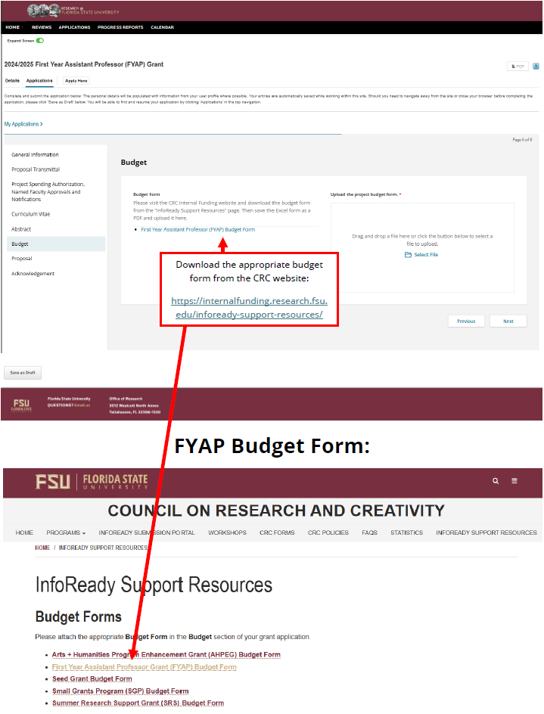
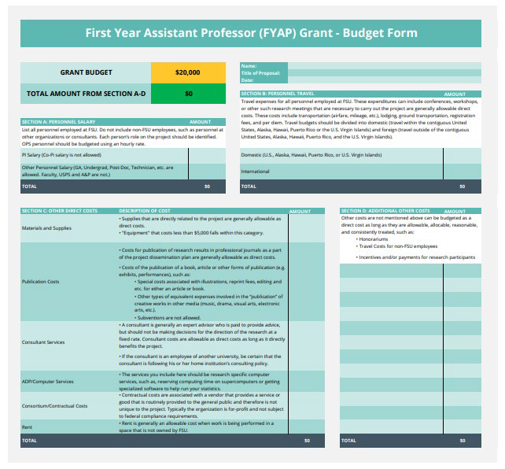
Budget
  Click the link for the First Year Assistant Professor Budget Form. It will take you to the CRC website.
  Download the FYAP Budget Form, fill it out, and attach it as a PDF to the application.

Slide 11
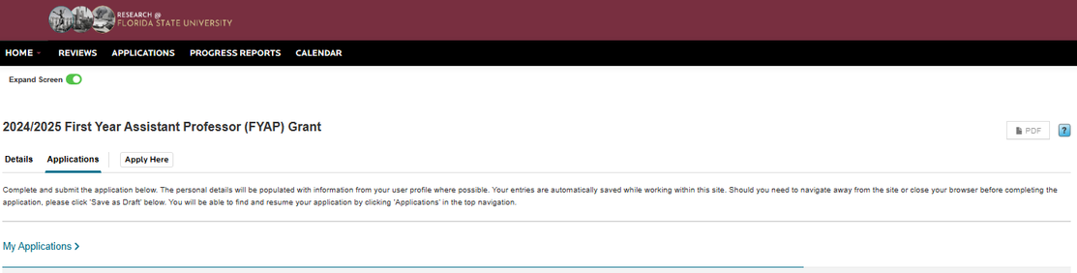
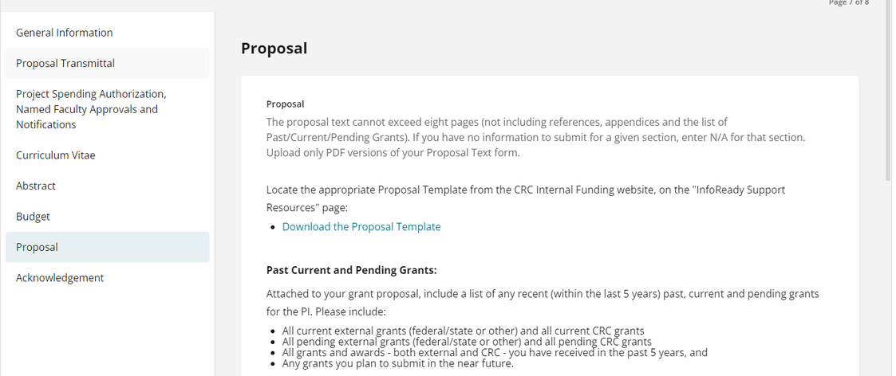
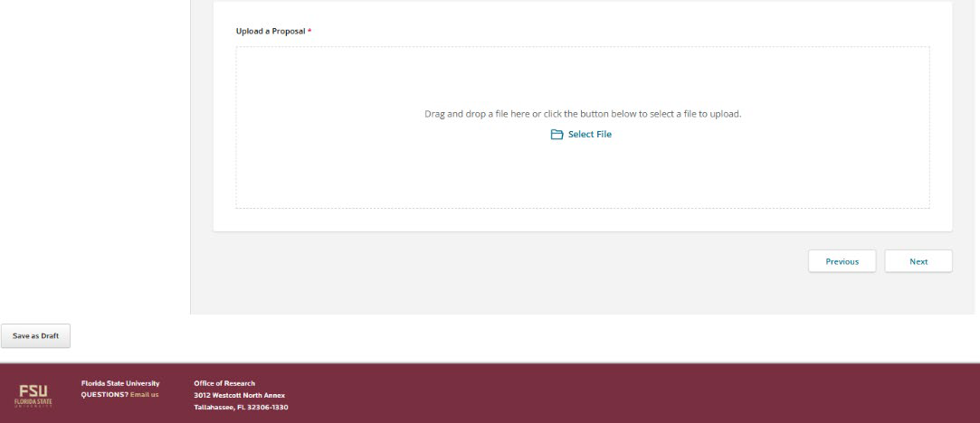
Proposal
  Download the FYAP Grant Proposal Template from the CRC website.
  Read the formatting instructions, and limit the proposal to 5 pages.
  After that is a quick Acknowledgement statement, then “Preview” and “Submit” your application.

Slide 12
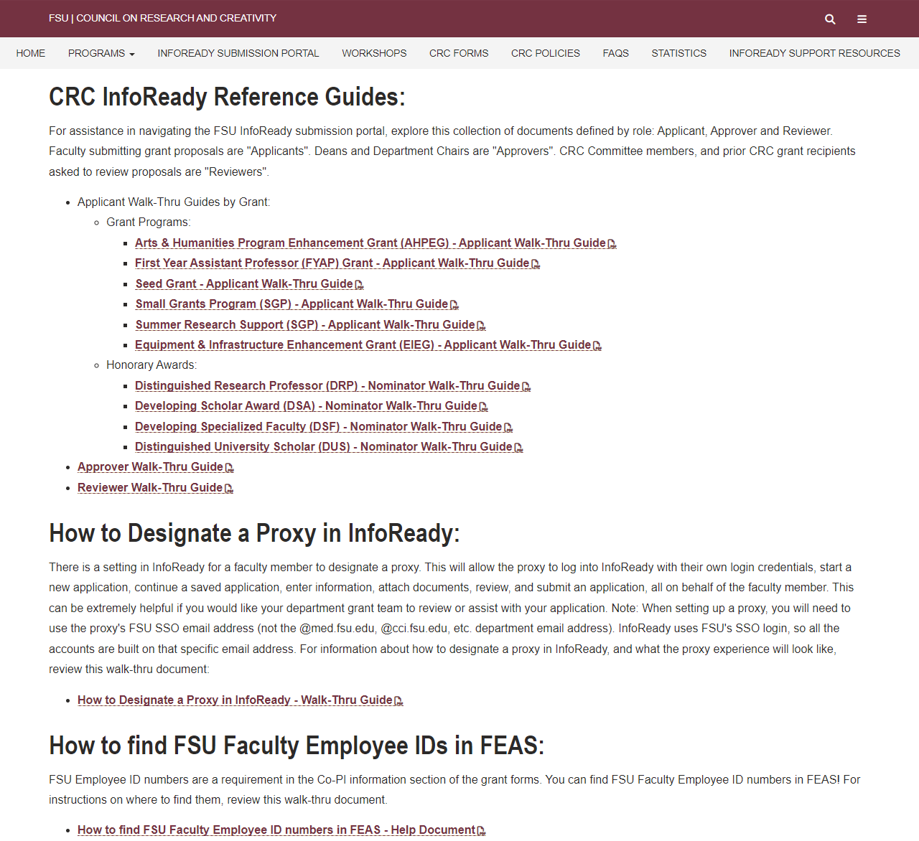
Resources
  There are lots of resources available to you on the CRC website!
  For any assistance with the application process, review the “InfoReady Support Resources” tab.
  There you will find:
    Budget Forms
    A Prior CRC Award History Search Tool
    CRC InfoReady Reference Guides (a walk-through guide for every grant and honorary award form).
    A walk-thru on how to designate a proxy.
    A walk-thru on how to find FSU employee ID numbers in FEAS (if you’re including Co-PIs).
    CV and Proposal Help Documents.
    Reviewer Guidelines for every grant and honorary award.
Email: RSCH-CRC@fsu.edu

Slide 13
CRC Internal Funding Programs
Competitive Grants
  Arts & Humanities Program Enhancement Grant (AHPEG)
  Committee on Faculty Research Support (COFRS)
  Equipment & Infrastructure Enhancement Grant (EIEG)
  First Year Assistant Professor (FYAP) Grant
  Seed Grant (Seed)
  Small Grants Program (SGP)

Slide 14
CRC Internal Funding Programs
Honorary Grants
  Developing Scholars Award (DSA)
  Distinguished Research Professor (DRP)
  Distinguished Specialized Faculty (DSF)
  Distinguished University Scholar (DUS)

Slide 15

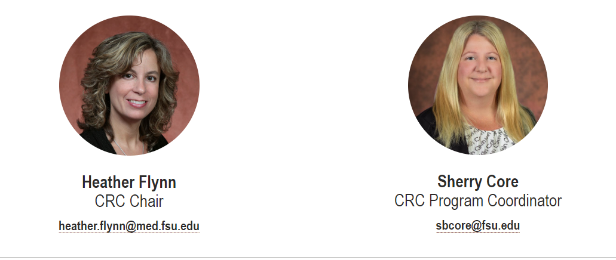
Contact Us!

