Slide 1
Welcome!
Council on Research & Creativity
First Year Assistant Professor Workshop

Slide 2
CRC Programs
Competitive Grant Programs
Arts & Humanities Program Enhancement Grant (AHPEG)
Committee on Faculty Research Support (COFRS) Grant
Equipment & Infrastructure Enhancement Grant (EIEG)
First Year Assistant Professor (FYAP) Grant
Funding Agency Travel (FAT) Grant
Multidisciplinary Support (MDS) Grant
Planning Grant (PG)
Small Grants Program (SGP)
Honorary Grant Programs
Developing Scholar Award (DSA)
Distinguished Research Professor (DRP)
Distinguished University Scholar (DUS)
Developing Specialized Faculty (DSF)
Notes:
Information can be found in the CRC brochure included in your packets.
FYAP overview –
intended to enable faculty to devote significant time and effort during their first summer at FSU to the research and creative activity responsibilities of their academic careers.
summer award that can be used toward salary, or research-related expenses, for the three months between the spring and fall semesters.
Like all other CRC grants it is COMPETITIVE, though it is typically funded at or above 80%.
Information found on website

Slide 3
CRC Website and Portal
Research.fsu.edu/crc

Slide 4
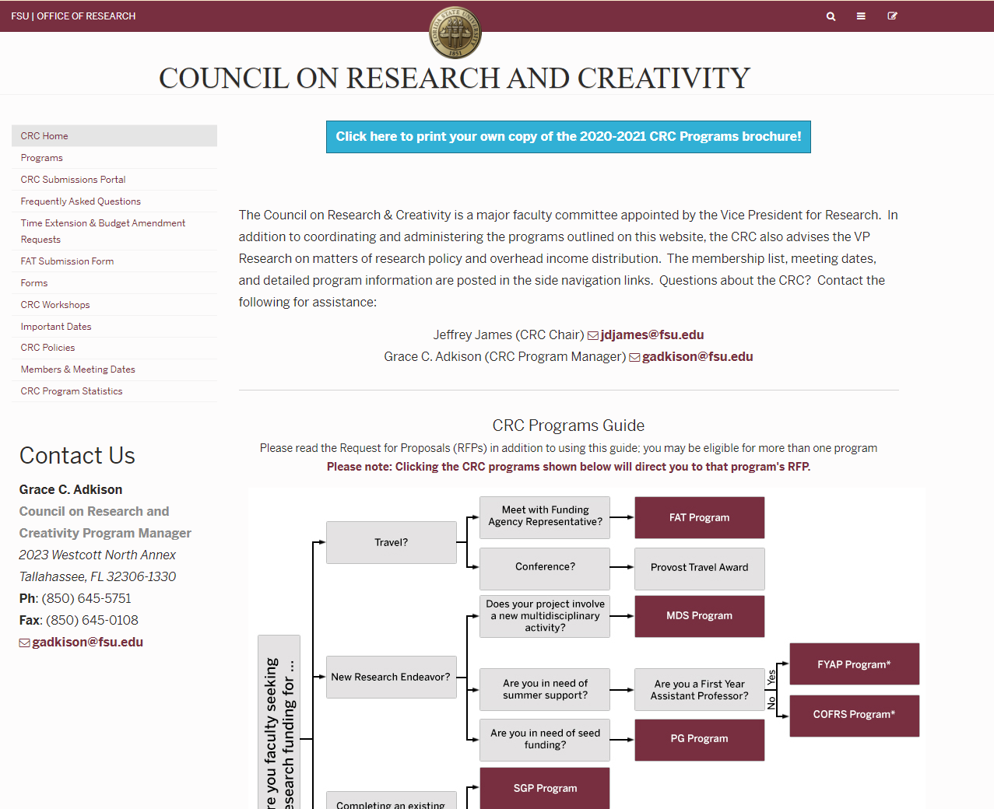
Notes:
KEY POINTS:
Programs – list of CRC programs – next slide
CRC Submissions Portal
FAQ’s - check for quick answers

Slide 5
Notes:
KEY POINTS:
Page provides a quick summary of programs
Programs – links to RFP
CRC Submissions Portal – next slide

Slide 6
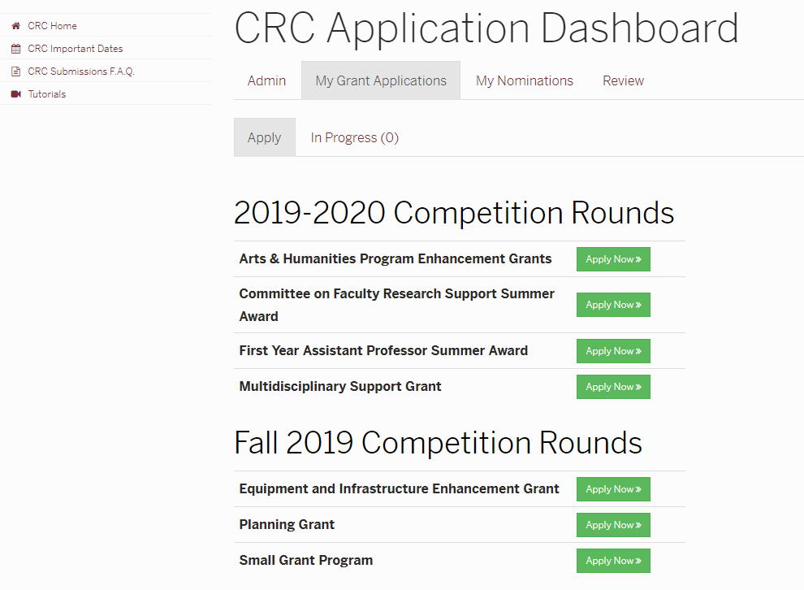
Notes:
My Grant Applications – See programs open for submission, see proposals in progress

Slide 7
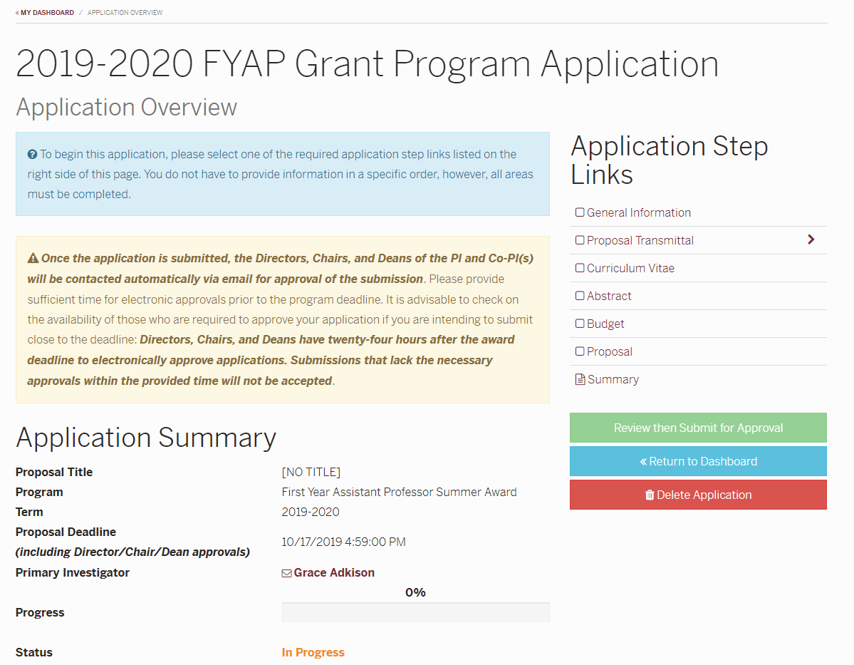
Notes:
Everything – including pre-review and approvals – is done through the portal.
The portal will automatically send your proposal to your Chair and Dean once is has been successfully submitted.
Application Summary – shows the status and progress bar
Step Links – step-by-step entry of information to submit proposal
Your information is tied to your login info. The person who initiates the proposal is automatically considered the PI.

Slide 8
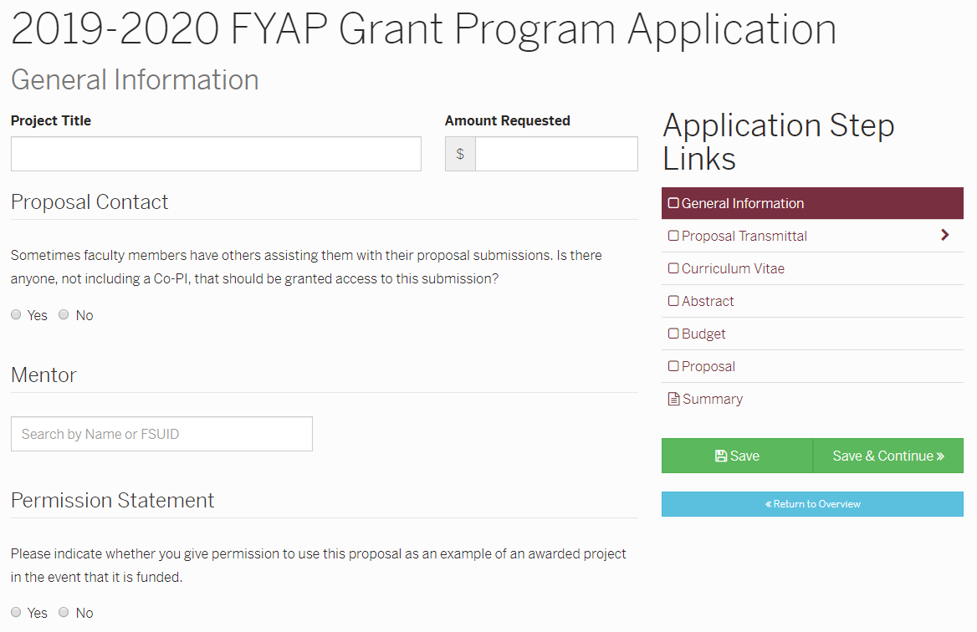
Notes:
PLEASE INCLUDE YOUR DEPARTMENT REP AS A PROPOSAL CONTACT!!!!
You are required to choose a mentor. They will receive notification that they are being named as mentor, and they will need to acknowledge that in the system.
Permission Statement – we ask for permission to use your proposal in our successful proposal database.

Slide 9
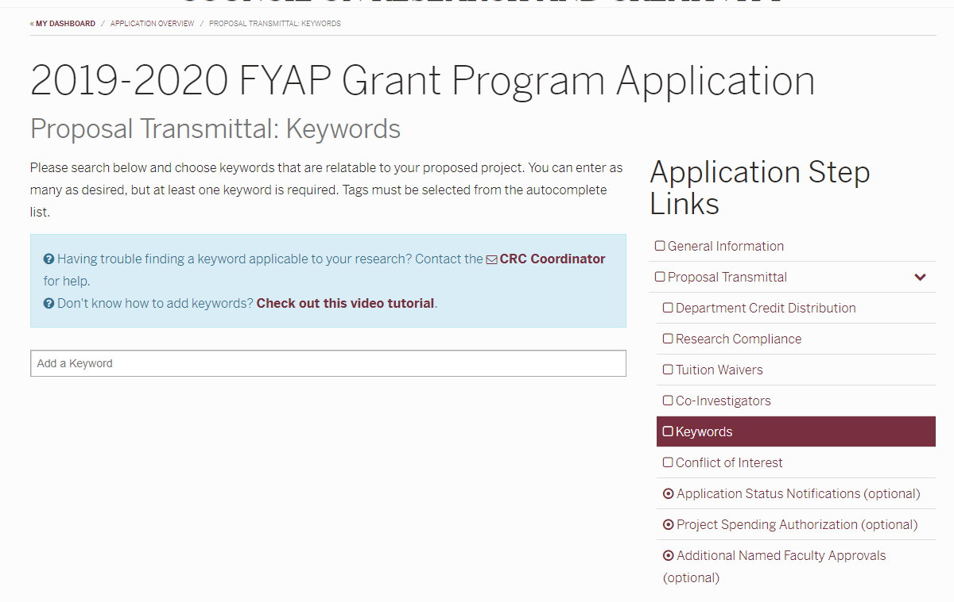
Notes:
KEYWORDS – In order to locate specific keywords related to your research, you need to begin typing on the “Add a Keyword” line

Slide 10
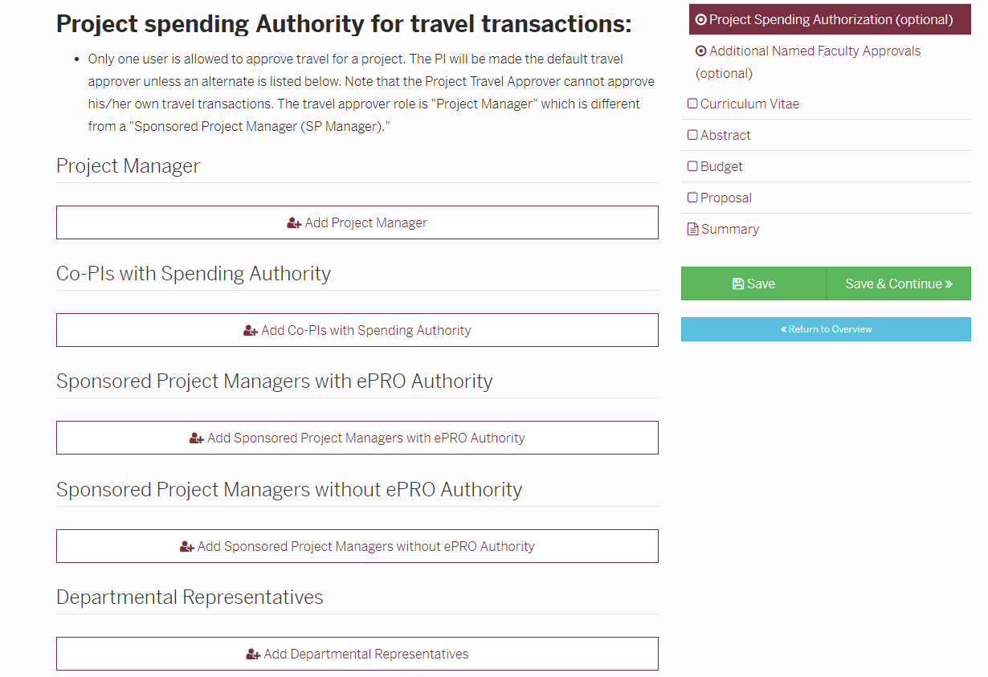
Notes:
PLEASE INCLUDE YOUR DEPARTMENT REP AS A PROPOSAL CONTACT!!!! You will need to talk with your Department Rep or Department Budget person in order to set up this portion . Having the right people as part of the Project Team will ensure that the award and financial transactions will be processed expediently. Descriptions for all options located on this page (above screenshot)

Slide 11
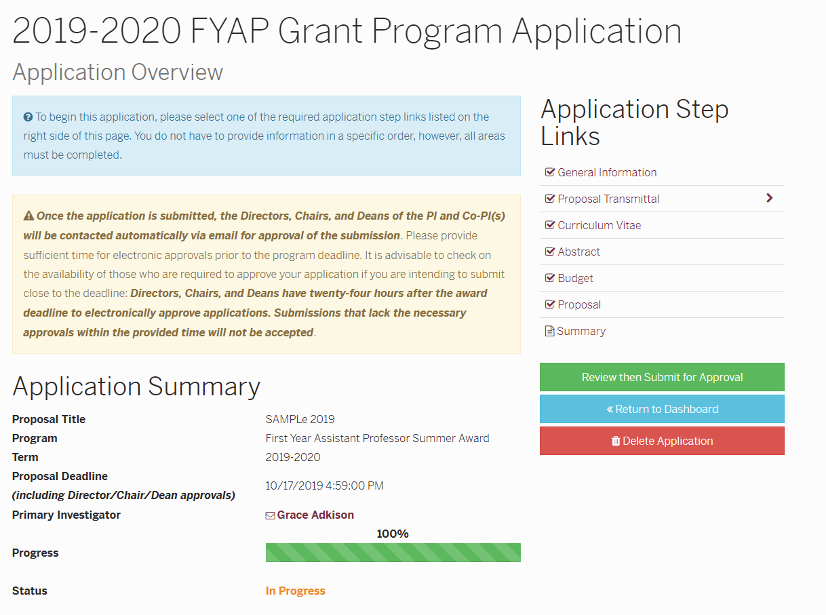
Notes:
Once you’re ready to submit, you will be sent to the Application overview
See the PROGRESS BAR and STATUS on this page. This is the same page you will see if you leave the proposal and come back to it.
Click Review then Submit button

Slide 12
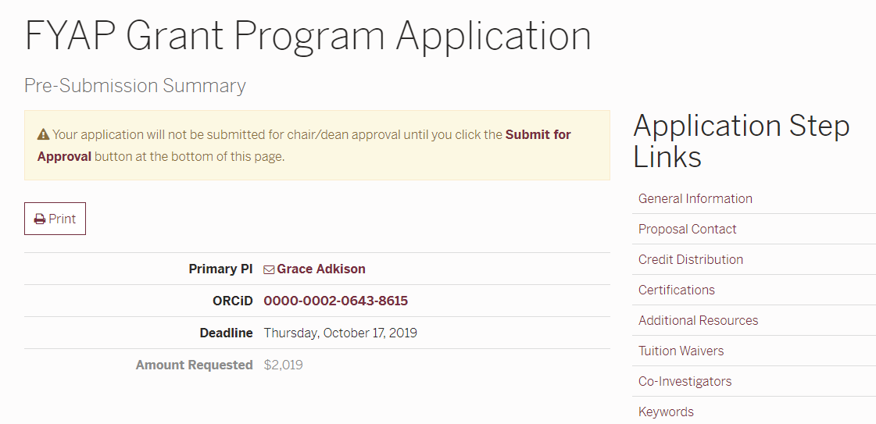
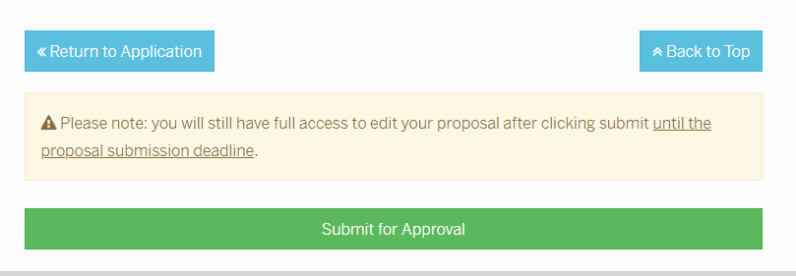
Notes:
Pre-Submission Summary – scroll ALL THE WAY to the bottom of the page to click the submit for approval button. Status changes to “Pending Approval”
This automatically triggers an email to be sent to your Chair for approval. Once the Chair approves, the portal triggers another email to the Dean for their approval. At this time, the status changes to “Pending Technical Review” At THIS stage, the proposal is ready for pre-review.
The proposal must reach this stage 10 days prior to the Proposal deadline in order to qualify for technical pre-review.

Slide 13
Grace Adkison
Jeffrey James
CRC Chair jdjames@fsu.edu
CRC Program Manager gadkison@fsu.edu

