Slide 1
COUNCIL ON RESEARCH & CREATIVITY
FYAP WORKSHOP
September 9, 2022

Slide 2
CRC Internal Funding Programs
Competitive Grants
Arts & Humanities Program Enhancement Grant (AHPEG)
Committee on Faculty Research Support (COFRS)
Equipment & Infrastructure Enhancement Grant (EIEG)
First Year Assistant Professor (FYAP) Grant
Seed Grant (Seed)
Small Grants Program (SGP)

Slide 3
CRC Internal Funding Programs
honorary Grants
Developing Scholars Award (DSA)
Distinguished Research Professor (DRP)
Distinguished Specialized Faculty (DSF)
Distinguished University Scholar (DUS)

Slide 4
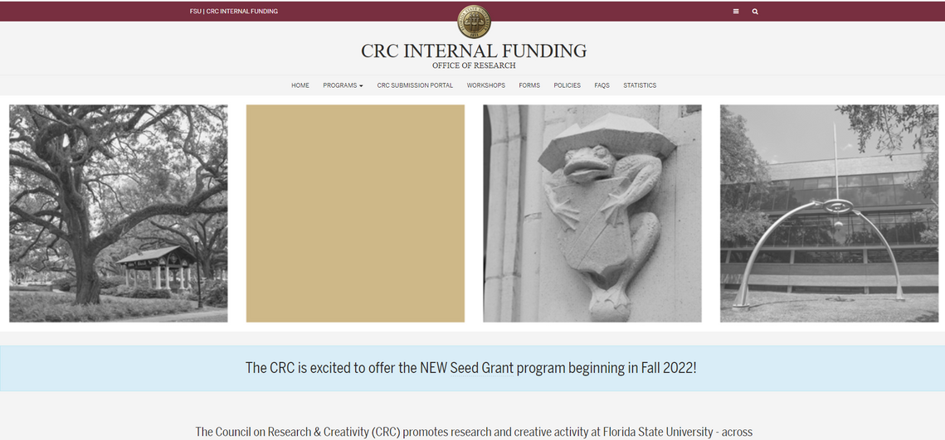
Website and Portal

Slide 5
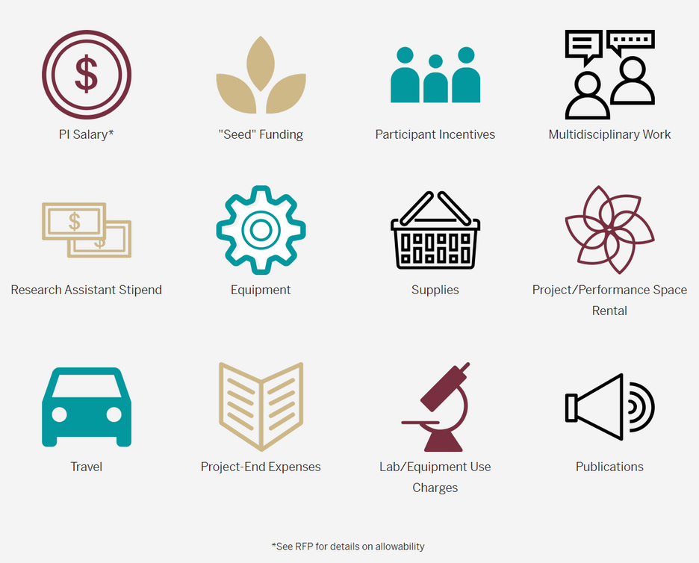
locating programs
Top menu drop-down
Funding Guide icons
Notes:
Two ways to find programs – top drop-down menu and scroll down to the icons. Icons link to the programs that support that type of funding. Be sure to thoroughly read RFP when applying!
Point out other items on top menu bar
-CRC Submissions Portal link (also on next page)
-Workshops (this year’s posters, archive of past posters)
-Forms
-Policies
-Frequently Asked Questions
-Award statistics

Slide 6
additional navigation
Amendment Requests
Application Portal
Application and Award FAQs
Notes:
Keep scrolling – Time extensions and budget amendments
- another link to CRC submission portal
- another link to Frequently Asked Questions –check here for quick answers
CRC PORTAL NEXT SLIDE

Slide 7
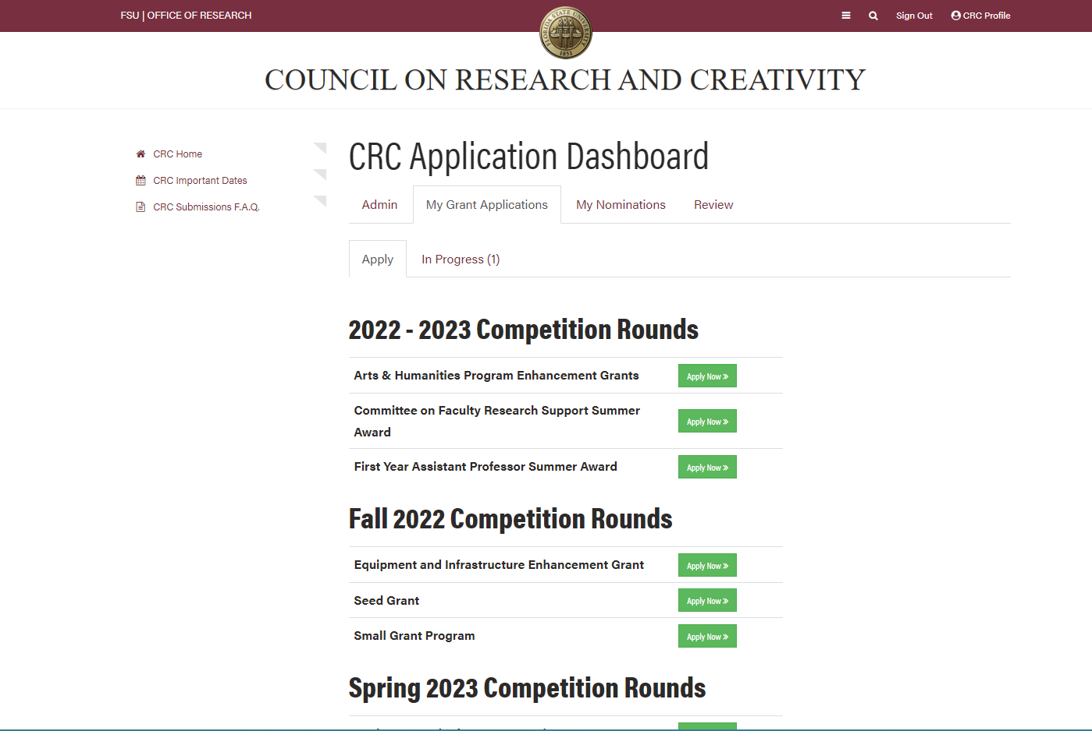
CRC Portal
Open competition rounds
Applications in progress
Open nomination rounds
Reviewer portal
Notes:
Landing page for CRC portal after login – Application Dashboard
Can view
-open competition rounds and nomination rounds
- applications in progress
- reviewer portal (COFRS)
APPLY NOW

Slide 8
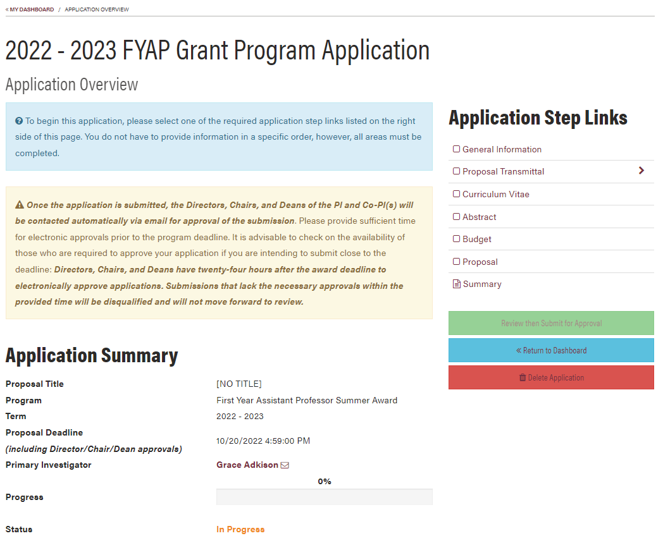
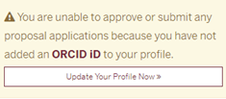
getting started
Step Links
Progress bar
Proposal Status
ORCID info
Notes:
Application Overview and Summary
-See at a glance your application progress
Step links – step by step
Progress bar
Proposal Status
ORCID info – enter it once and you won’t need to enter it again.
Portal User profile – information is tied to your login. PI role is automatically assigned to whoever starts the application

Slide 9
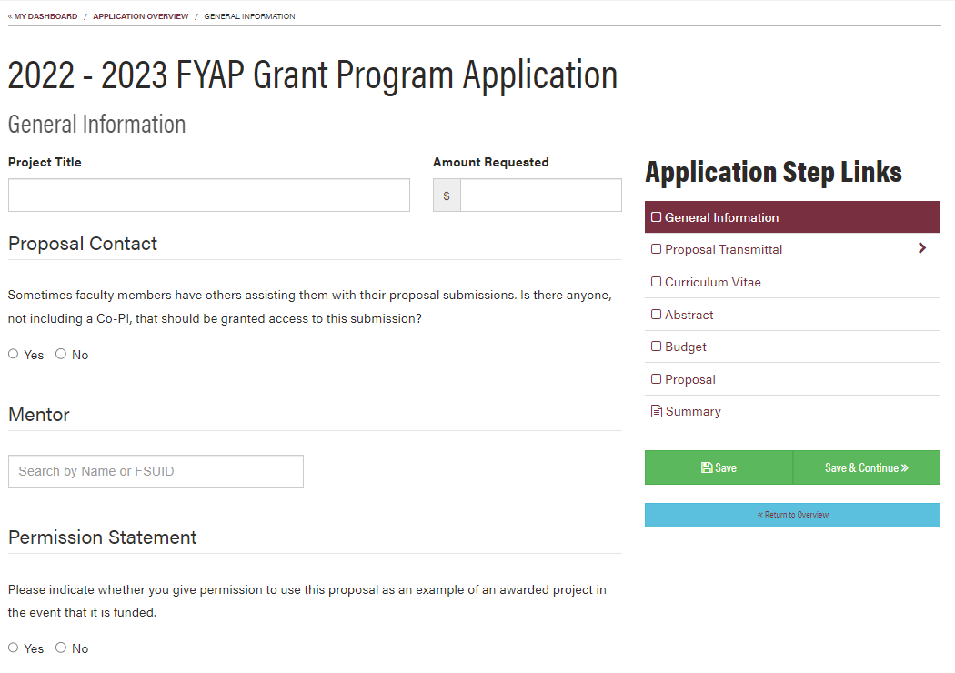
general info
Proposal Contact
Mentor
Notes:
PLEASE INCLUDE YOUR DEPARTMENT REP AS A PROPOSAL CONTACT!!!!
You are required to choose a mentor. They will receive notification that they are being named as mentor, and they will need to acknowledge that in the system.
Permission Statement – we ask for permission to use your proposal in our successful proposal database.

Slide 10
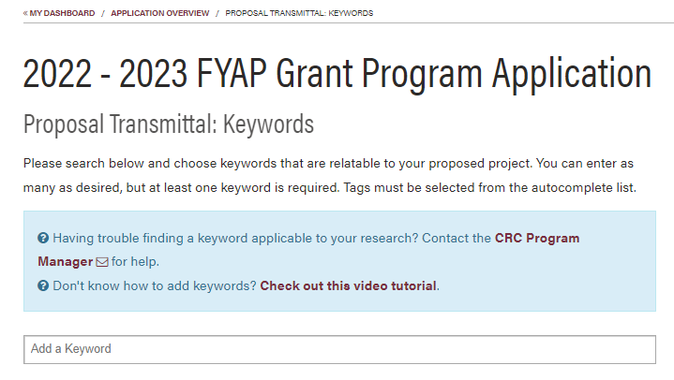
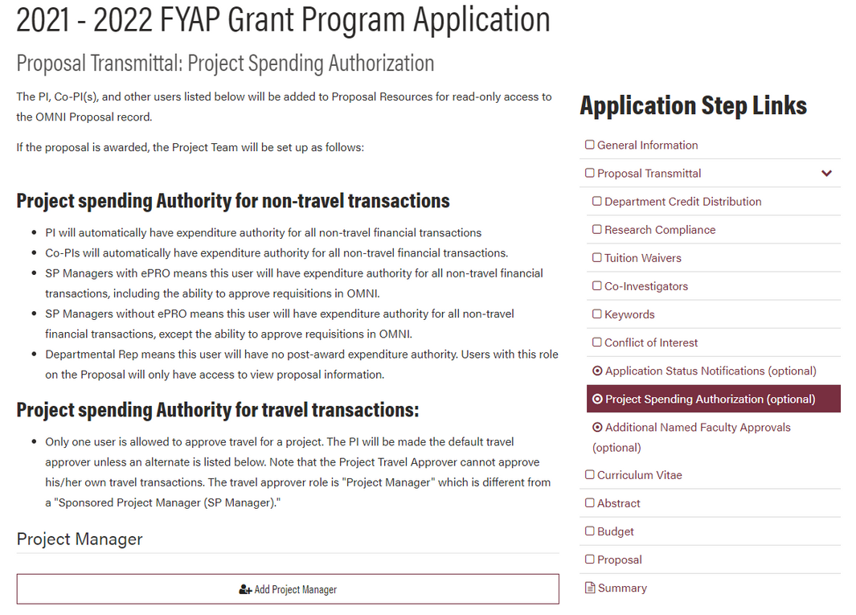
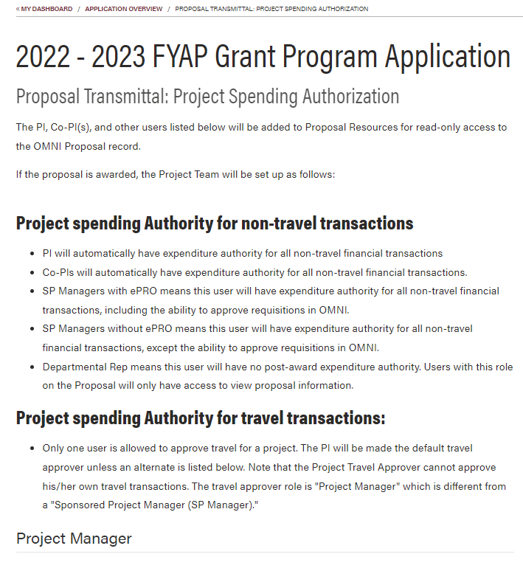
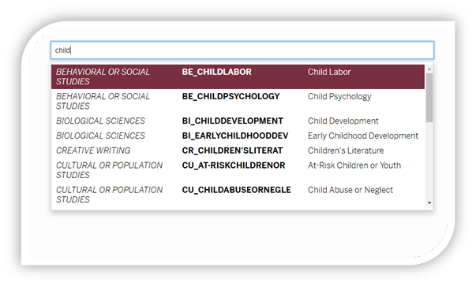
PRoposal Transmittal
Keywords
Optional project personnel
Notes:
KEYWORDS – In order to locate specific keywords related to your research, you need to begin typing on the “Add a Keyword” line
PLEASE INCLUDE YOUR DEPARTMENT REP AS A PROPOSAL CONTACT!!!!
You will need to talk with your Department Rep or Department Budget person in order to set up this portion .
Having the right people as part of the Project Team will ensure that the award and financial transactions will be processed expediently.
Descriptions for all options located on this page

Slide 11
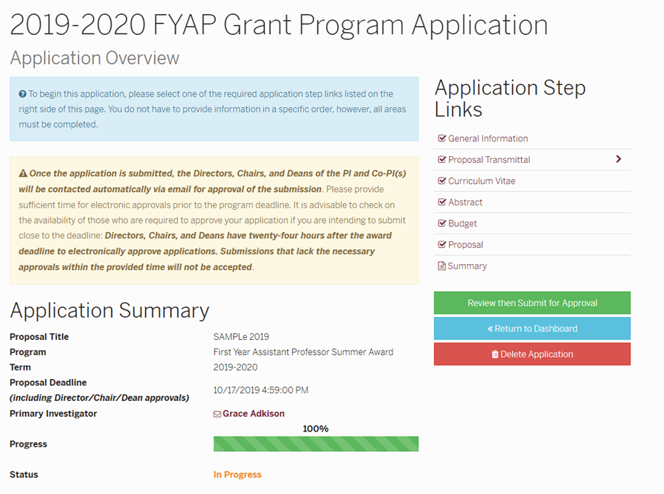
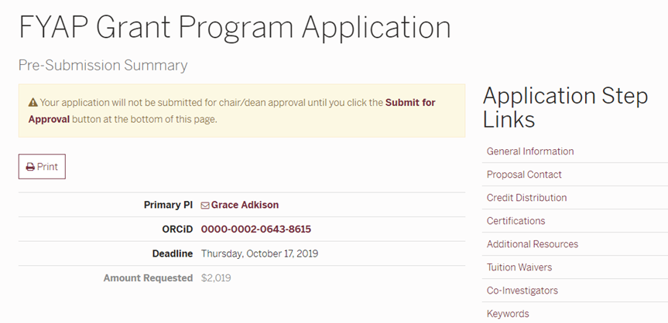
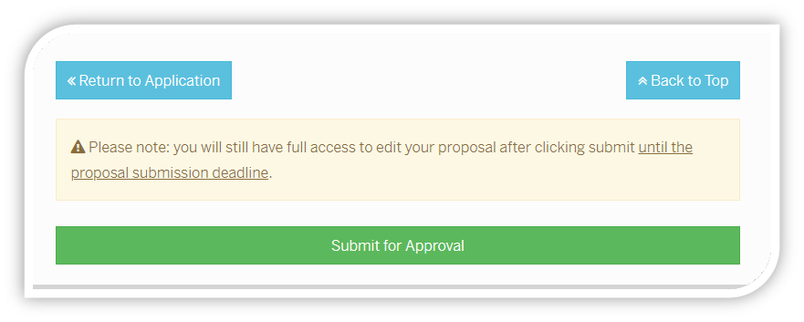
proposal submission
Notes:
Once you’re ready to submit, you will be sent BACK to the Application overview
See the PROGRESS BAR and STATUS on this page. This is the same page you will see if you leave the proposal and come back to it.
Click Review then Submit button
Pre-Submission Summary – scroll ALL THE WAY to the bottom of the page to click the submit for approval button. Status changes to “Pending Approval”
This automatically triggers an email to be sent to your Chair for approval. Once the Chair approves, the portal triggers another email to the Dean for their approval.
Status changes to “Pending Technical Review” At THIS stage, the proposal is ready for pre-review.
The proposal must reach this stage 10 days prior to the Proposal deadline to qualify for technical pre-review.

Slide 12
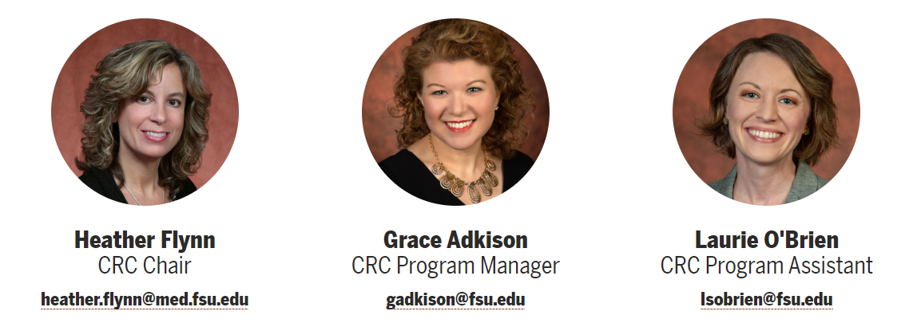
Contact Us!

